Slide 1
Web Technologies Accessing Data
Notes:
The theme here is accessing data from the Web. We start with scraping HTML and the high-level function readHTMLTable(). We then go into looking at the structure of HTML and accessing different parts of the document using Xpath. This introduces the structure of XML and the ways of accessing sub-nodes in the tree (xpath or manually via traversal.) Then we go on to looking at more complex queries which are dynamic, i.e. forms. We look at GET and POST. We show that there are functions for these, but they are built upon lower-level primitives and so required design from which we can learn. Then we move to XML-RPC and SOAP.

Slide 2
Topics
HTML pages
XPath
HTML forms
REST
SOAP
XML-RPC
(You don’t have to teach them all, but there are interesting aspects to all.)

Slide 3
Consumer Price Index
Suppose we have a financial time series and need to adjust for inflation. We need the CPI values for the relevant period.
We can look this up on the Web, e.g.
http://www.rateinflation.com/consumer-price-index/usa-historical-cpi.php

Slide 4
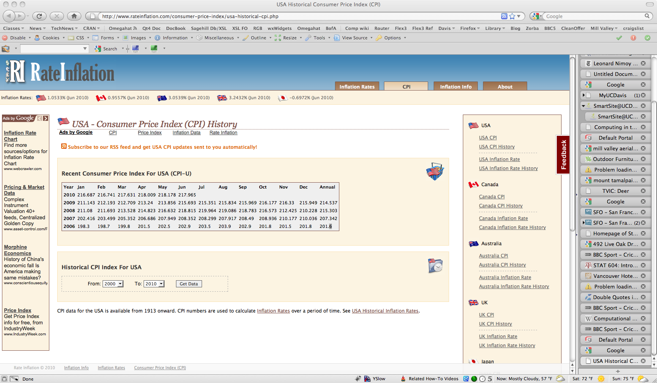

Slide 5
The data for the most recent 5 years is in the main table.
There is also an HTML form that allows the reader to specify the interval of interest. We’ll return to this.

Slide 6
How to read the data for the 5 years for each month?
Simple answer: readHTMLTable() in the XML package.
tbls = readHTMLTable(“http://www.rateinflation.com/consumer-price-index/usa-historical-cpi.php”)
length(tbls)
sapply(tbls, nrow)
We want the last one – 6 rows, including the header.

Slide 7
cpi = readHTMLTable("http://www.rateinflation.com/consumer-price-index/usa-historical-cpi.php", which = 11, header = TRUE)
Fix up the types of each column, converting from a factor to a number.
cpi= as.data.frame( lapply(cpi, function(x) as.numeric(as.character(x)))

Slide 8
Details
Interesting answer is how that function is implemented
Examine the HTML
find all <table> elements
process each of these to convert to a data frame
find <tr> elements for each row
recognize <th> elements or <thead> for header
<td> for data value
Unravel into data.frame
Details in the XML package and readHTMLTable()
But general concepts in Xpath and finding <table> nodes.

Slide 9
XPath
Xpath is yet another DSL – domain specific language
XML documents are trees and Xpath is a mechanism for finding nodes anywhere within the tree based on a “pattern”
Pattern is a path that identifies sequence of nodes by
direction or “axis” (parent, child, ancestor, descendant, sideways (<- ->))
node test – i.e. the name (e.g. table, thead, tr, td)
predicate test (has an attribute href, has an attribute href = “foo”)

Slide 10
Parse the XML/HTML document
doc = htmParse (“http://www.rateinflation.com/consumer-price-index/usa-historical-cpi.php”)
Find the <table> elements tbls = getNodeSet(doc, “//table”)
getNodeSet() takes a document or a node and searches through the sub-tree using a language for describing how to find the nodes of interest.

Slide 11
// is srt-hand for “/descendant::table”, / is the top-level/root node descendant is an “axis” table is the node-test
If the <table> of interest had an id attribute, we could add a predicate, e.g.
getNodeSet(doc, “//table[@id=‘cpi’]”)

Slide 12
getNodeSet() returns a list of matching nodes.
We can then recursively extract the nodes of interest, e.g. the <tr> and the <td> elements
can walk the tree ourselves if shallow
or use getNodeSet() to query the subtree easily
Convert the values in these sub-nodes to R values and combine into data structure.

Slide 13
Walking the tree
A node has a name
xmlName(node)
Attributes
xmlAttrs(node), xmlGetAttr(node, “attrName”)
Children
xmlChildren(node) – list of child nodes
Parent node
xmlParent(node)

Slide 14
rows = getNodeSet(tbl, “.//tr”) do.call(“rbind”, lapply(rows, getRowValues))
getRowValues gets all the <td> within a <tr> xpathSApply(row, “.//td”, xmlValue)

Slide 15
Xpath is similar to regular expressions
It is a way of expressing complex patters very tersely and having the Xpath engine implement the search.
Works for any XML document, so very general.
Can build up very precise or general queries
contextual knowledge important to catch all the nodes we want, but no more.
We use Xpath for processing XML from many different sources.

Slide 16
Back to the HTML form
What if we want more or different years?
Use the HTML form?
But how can we mimic selecting the Start and End years from within R, i.e. programmatically?
An HTML form is like an R function
takes inputs, returns an result – an HTML document
Need to mimic a Web browser to pass arguments to Web server.

Slide 17
RCurl
The RCurl package provides an R interface to a very general and powerful library that can perform Web queries programmatically and that are very customizable.
3 main functions:
getURLContent()
getForm()
postForm()

Slide 18
Similar functionality to download.url(), but much more customizable and general
Can handle
Secure HTTP – https
cookies, passwords
many additional important options
maintain state across requests
multiple concurrent requests

Slide 19
Examine HTML document and look for the <form>. Find the parameter names and use these as named parameters in getForm()
x = postForm("http://www.rateinflation.com/consumer-price-index/usa-historical-cpi.php", form = "usacpi", fromYear = "1945", toYear = "1965", `_submit_check` = "1" )
Then pass this to readHTMLTable(), which =

Slide 20
REST
Representational State Transfer
URL represents a state which can be queried or even updated via remote calls/queries.
Send parameterized Web query via getForm()
specify URL
name value pairs for parameters
Get back a “document”
may be
raw text
XML
JSONIO
binary data

Slide 21
Process result
Raw text – use text manipulation, regular expressions, connections to read into R object
JSON – JavaScript Object Notation
use RJSONIO or rjson
XML – parseXML() and Xpath (getNodeSet())
Binary data – treat as is, or if compressed, uncompress in-memory via Rcompression

Slide 22
Zillow
Zillow provides information and price estimates of homes
REST API info at http://www.zillow.com/howto/api/APIOverview.htm
Register to get a Zillow Web Service ID (ZWSID) that you pass in each call to a Zillow API method

Slide 23
Call GetZEstimate for a property giving street address
getForm("http://www.zillow.com/webservice/GetSearchResults.htm", `zws-id` = ZWSID, address = “1292 Monterey Ave”,
citystatezip = “Berkeley, CA”)
Result is a text string which contains an XML document

Slide 24
Getting the Result Info
XML contains <request>, <message>, <response>
Extract property id, price estimate, lat./long., comparables link, etc.
Use Xpath and xmlValue().
doc = xmlParse(txt, asText = TRUE)
est = doc[[“//result/zestimate”]]
as.numeric(xmlValue(est[[“amount”]]))

Slide 25
R package Zillow provides functions for several of the API methods and hides all the details.

Slide 26
Yahoo Search
Yahoo Web Search Service
http://developer.yahoo.com/search/web/V1/webSearch.html
out = getForm("http://search.yahooapis.com/WebSearchService/V1/webSearch", appid = yahooAppIdString,
query = "REST XML Yahoo",
results = 100,
output = "json")

Slide 27
library(RJSONIO)
ans = fromJSON(out)
ans is a list with 1 element named ResultSet
length(ans$ResultSet) # 6
names(ans$ResultSet)
[1] "type" "totalResultsAvailable"
[3] "totalResultsReturned" "firstResultPosition"
[5] "moreSearch" "Result"

Slide 28
Individual Search Result Item
names(ans$ResultSet$Result[[1]])
[1] "Title" "Summary" "Url"
[4] "ClickUrl” "DisplayUrl" "ModificationDate"
[7] "MimeType” "Cache"

Slide 29
REST
Pros:
simple and easy to get started
natural exploitation of URLs as resources
Cons:
cannot send or retrieved complex/hierarchical data structures
have to process result manually
have to find methods and inputs manually by reading documentation.
Do this once and build R functions to hide the details.

Slide 30
GoogleDocs
EBI
Flickr
Twitter
Zillow
NY Times
Google Trends
MusicBrainz
LastFM
…
R packages for several of these

Slide 31
SOAP
Simple Object Access Protocol
Richer and more complex than REST
can send highly structured data via XML
Send request in an Envelope containing a request to invoke a method in the server’s object
Send arguments as self-describing objects
SOAP allows us to define new data types and structures
application specific data types

Slide 32
SOAP
Would have to construct the SOAP request
the envelop and the message
Too many details to do manually.
Instead, SOAP service publishes a description of its methods and data types
WSDL document – Web Service Description Language
Code reads this and generates R functions to invoke each of the methods, coercing the R arguments to their XML representation and converting the XML result to an R object.
Transparent to user

Slide 33
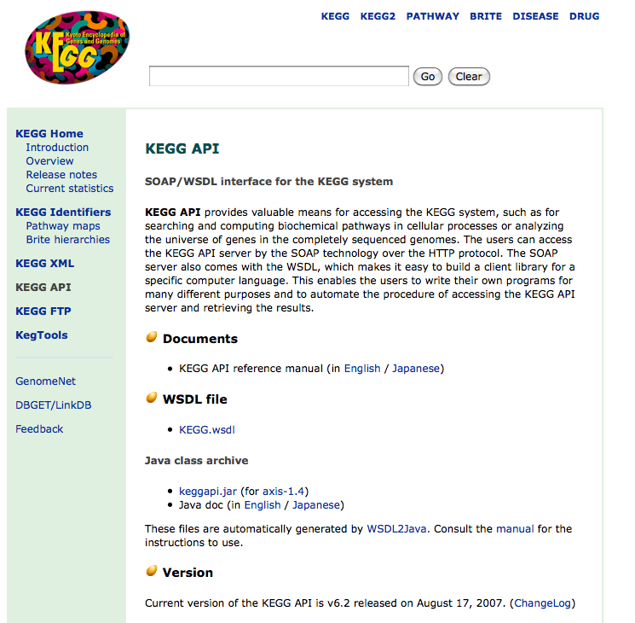
KEGG
Kyoto Encyclopedia of Genes and
Genomes provides a SOAP
Web Service (among other
services) to access its system
functionality (API)
http://www.genome.jp/kegg/soap/

Slide 34
From R
library(SSOAP)
u = “http://soap.genome.jp/KEGG.wsdl”
kegg.wsdl = processWSDL(u)
kegg.iface = genSOAPClientInterface(, kegg.wsdl)
Now we have an S4 object containing class definitions and a list of functions
names(kegg.iface@functions)

Slide 35
Invoke the list_databases method
kegg.iface@functions$list_databases()
returns a list of S4 Definition objects
e.g. An object of class "Definition” Slot "entry_id”: [1] "nt”
Slot "definition”: [1] "Non-redundant nucleic acid sequence database"

Slide 36
Get enzymes for a specific gene id
iface@functions$get_enzymes_by_gene('eco:b0002')
[1] "ec:1.1.1.3" "ec:2.7.2.4"

