Slide 1
Programming Fundamentals

Slide 2

Programming concepts and understanding of the essentials of programming languages form the basis of computing.

Slide 3
Goals
To outline what aspects of a language (specifically R) you might want to teach your students
Discuss how to teach this effectively
concepts, examples, motivation, context
Discuss aspects of the language that not all users are familiar with
and to show the logic/simplicity of the language

Slide 4
Three aspects to statistical programming
  interactive use for exploratory data analysis
  programming numerically intensive tasks
  writing functions/software for reuse
Obviously related, and there is a natural progression.

Slide 5
Some students won’t have seen a “programming language” before
Some may have seen HTML - a declarative language that has no control flow.
Many will be unfamiliar with the command-line
REPL - Read-Eval-Print-Loop
Explain the difference between a spreadsheet and a programming environment.

Slide 6
For some students, we have to get them past the “why isn’t this like X? It’s so lame!”
So need to show them how it is useful, and how the language constructs help them to do things.
So we have to get them to want to do something which involves, e.g. a lot of repetition.
e.g. give them a corpus of e-mail messages, 1 per file, or person per file and ask how many messages do we have?
Get them to consider the language as a servant.

Slide 7
What is a computation?
Transformation from on or more inputs to an output
Transition from old state to new state
Algorithm set of directions for carrying out a computation in terms of other simpler computations
Examples
  Find the average annual rainfall at a weather station
  Crop a digital photo
  Sort the mail by sender in your mail program

Slide 8
Language Model
Critical to teach the concepts, structure, logic and design of the language
Students will often gravitate to “how to” and mimicking rather than abstracting the specific to gain this “higher understanding” of the language.
Syntax versus Semantics and computational model.
Getting past details allows them to
  reason about problems
  apply their knowledge of one language to another.

Slide 9
Most of the languages we will use are
  interpreted
  high-level
  garbage collected
  “interactive”
  & have large libraries
R, MATLAB, ... - triple of
  language
  interpreter
  environment (packages)

Slide 10
Getting Started
Get students familiar with the basics of the environment. Do this with an interactive demo. Place online after class a transcript of session (with comments).
How to start (command line or GUI) and quit q()
How to use R as a calculator
Show them the continuation prompt
> 2 *
+ 3

Slide 11
Terminology
Invoke a computation with an expression
Pass the expression off to the computer to evaluate
Return a value or output of the expression

Slide 12
Syntax
Do arithmetic - 1 + pi
Order of operations – log(100) + sin(pi/2) * 15 (log(100) + sin(pi/2)) * 15
Simple plots - curve(sin, -pi, pi)
Assign results to variables
x = 1 + pi
print(x)
x result of evaluating a non-assignment => print

Slide 13
Transcript
> 1 + pi
[1] 4.141593
> log(100) + sin(pi/2) * 15 #multiplication first, log base e
[1] 19.60517
> (log(100) + sin(pi/2)) * 15 #parentheses modify order
[1] 84.07755
> (log(100, base = 10) + sin(pi/2)) * 15 #change parameter called base
[1] 45

Slide 14
Transcript
> curve(sin, -pi, pi) #curve function called, 3 arguments
> x = 1 + pi
> print(x)
[1] 4.141593
> x
[1] 4.141593
> x = rnorm(100)
> mean(x)
[1] 0.02533064

Slide 15
Parsing: break down expression –
  white space,
  digits 2x vs 2*x,
  naming conventions
No declarations of variables needed
or type information

Slide 16
Explore assignments
  stored in session area - global environment
  see names of existing variables - objects()
  where does curve() come from?
    find(“curve”)
    search() and the concept of the search path
      how does R use this
      > pi= 3
      > find("pi")
      [1] ".GlobalEnv" "package:base"

Slide 17
Remove one or more objects – rm(x, pi)
Save variables for future use – save(x, z, file =“myvars.rda”)
Restore – load(“myfile.rda”) (Where are these?)
Keep track of code – history()

Slide 18
What about ‘+’ in 1 + 2?
Does R just know about that?
find(“+”)
“package:base”
1 + 2 is actually a function call
`+`(1, 2)
In fact, everything in R is a function call
simple, single concept that makes lots of things easy to reason about, and several computational tasks feasible. (infix vs function style)
Notion of function call is similar to other languages
e.g. shell - find . -name '*.R'

Slide 19
Everything's an Object
If we can see 'x', can we see '+'?
Print the value of + - poor choice!
`+`
sin
We can pass a function as an argument to a function
curve(sin)
So functions are first class values.
In fact, every value is a first class object.

Slide 20
Function Calls
What's a function?
  for now, a black box that takes zero or more inputs, and returns a value, an object.
  leads to 2 issues:
    how do we specify the inputs
    parameter matching
    what sort of values can we pass in and get out?
    data structures

Slide 21
Getting Help
How to get help (help.start)
It is useful to show them the elements of a help page and how to read them,
interpret some of the "ambiguous" content,
explain some of the terms
follow the See Also
connect to the manuals which give some more details

Slide 22
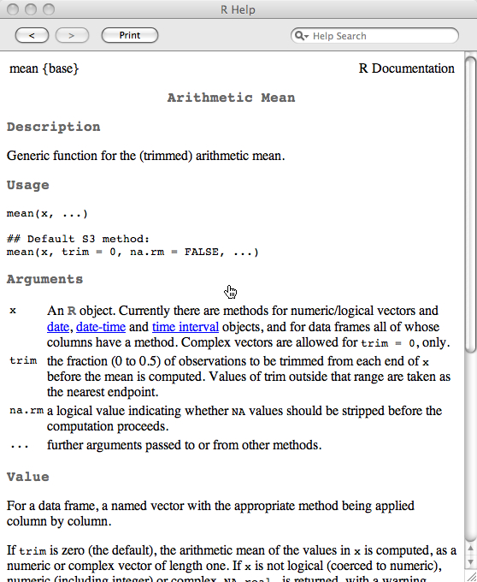
Help Page
help(mean)
Description - what the function does
Usage – definition/how to call the function
Arguments - purpose of each argument
Value – return value from function
References -
See Also – related functions
Examples -

Slide 23
Work environment
Where do you write your code? Not in a Word document
  Text editors – the GUI’s editor, eMacs & ESS
How do you find your data, code?
  File system – trees
  Simple shell commands – cd, ls, pwd, cp, mv, rm, mkdir, rmdir
Can you use a faster computer? – ssh, scp

