Slide 1
Computing in the Statistics Curricula

Slide 2
Background
NSF (DUE) funded grant on “Integrating Computing into the Statistics Curricula”
Goals:
  map syllabi and sequences of courses for modern stat. programs
  Facilitate instructors to introduce and teach such classes, providing resources (lecture notes, syllabi, assignments, data sets) and support network.
4th of 4 workshops
  Second one for teaching instructors to teach stat. computing.
  1st discussed model syllabi for different types of students
  3rd develop case studies in stat. computing for use by the stat. community. (In preparation.)

Slide 3
State of affairs
Computing is a very large part of a data analysts daily task, yet remarkably small part of our educational programs
We teach only enough computing to enable doing assignments, leaving students to learn on their own by mimicking and adjusting existing templates.
Results are not good.

Slide 4
Importance of Computing
Computing is as fundamental to statistics education as mathematics.
We need to make the students facile with computing so they can transparently use it to express ideas.
  Compute correctly and efficiently
As long as computing is a difficulty, it is a distraction from one’s primary focus.
  We must reduce it from being an obstacle or focus when performing analyses.
  Need to enable them to reason about computations.

Slide 5
Critical point in statistics.
Statistical computing is much broader than traditional material we have taught
  Need different topics for different types of students.
Computing is becoming increasingly vital part of statistical education in this era of
  the Web
  Ubiquitous data availability & sources.
  Increased volume and complexity of data.
  New and ever-evolving Web technologies.
  Increased relevance of data analysis in all fields, done by non-statisticians
  Communicating results in new ways (e.g. Web graphics)
If we can’t compute the right answer, others will be involved to compute another answer.
And computing the answer means dealing with increasingly complex computations and technologies.
Notes:
We are at a very important point in statistics and stat. education because of the Web and its technologies.
These are sources of data, and ways to communicate results of statistical analyses, and technologies
that we have to use to collaborate with other scientists.
So we have to embrace these and master them so that we can play an important role in data-centered
sciences. Otherwise, as we have seen in the past, other fields will fill the void we leave in not being able
to actually carry statistical analysis through the data pipeline, from start to finish. It is not enough to say
we know the best answer, but we don’t know anything about implementing it, delivering it, scaling it, …

Slide 6
Computing is typically just one missing dimension of our programs
  Exposure to modern statistical methods.
  Actual solving of scientific/data problems with statistical approaches.
We tend to use a computing class to address both of these, as well as computing/programming topics.

Slide 7
We need to teach it early in the students program.
Integrate it properly into a program
  Teach it an intellectually rich level so students learn to reason about computation, not just “trial and error”.
  Leverage it as an alternative medium for learning statistical concepts.

Slide 8
Focus
Our focus here is on
  our upper-division and graduate classes.
  Teaching computational skills for data analysis and statistical research.
  Equipping our students with knowledge for their careers to be able to use computers easily and to learn and evaluate new technologies as they continue to emerge.
We are less focused on “using computing to teach statistics”
  But are interested in how to integrate computing into such classes.

Slide 9
Challenges
Students today are very familiar with computers, phones, etc.
But not with scientific computing
  Vocabulary, computational reasoning, programming
We have to get them past “this is too hard to use”, “why can’t I click on a button”, …
  Need to learn grammar and computational model to express themselves, both to the computer and to humans.
  Compare with how we teach stat. concepts, or to write essays
GUIs are convenient, but imply that the ability to compute is of secondary importance and that the computations are generic/templates.

Slide 10
Organizational Challenges
We also have to get our colleagues on board
  Difficult since few of us have been trained in computing.
Fit more into already crammed curricula, and room for few additional classes.
Computing requires regular, repeated exposure to internalize concepts, vocabulary and “grammar”.

Slide 11
Format
Hopefully, very interactive with questions, comments, etc. from everybody.
Please let us know if you want us to schedule discussion on a topic not in the “schedule”.
Notes will be available on the Web site after the conference and will be updated as comments/questions are received.
Goal is to make these materials available to you and others to facilitate teaching stat. computing classes.

Slide 12
“Rules of engagement”
When speaking, please identify yourself to everyone and let us know your institution.
We hope in the coffee/food breaks you’ll interact and build connections.

Slide 13
Schedule
During the day, we’ll have a mix of discussions and tutorials
We have asked some people to give short presentations on what they are doing.
Everyone else, please participate throughout.
Each topic will be a mix of
  Big picture reason about why the topic is important
  Technical details about the material – tutorial
  Ways we teach this material
Introduce some material about R that is less familiar to most people, with the hope of it helping you to teach computing.

Slide 14
Emphasis on R
We will be talking a great deal about R and numerous “modern” technologies.
We hope to be discussing computing & programming at a level that is general and abstracts to other programming languages, e.g. MATLAB, Python.
Some will expect material on SAS
perfectly reasonable.

Slide 15
SAS, etc.
Firstly, we are much more familiar with R and other technologies.
Focus is on general, complete programming languages and modern technologies students are likely to encounter over the years.
Fundamentals of programming are transferable to other languages.
R is free, easy to deploy and widely used in stat. departments
  For both teaching and research.
Increasingly widely used in industry.

Slide 16
In our courses, we teach 5 languages
  R and 4 DSLs – Domain Specific Languages
    Regular expressions for patterns in text
    XML/HTML/KML/SVG & XPath
    SQL – database query language
    (Unix) shell
Key is to learn how to learn new languages and technologies.

Slide 17
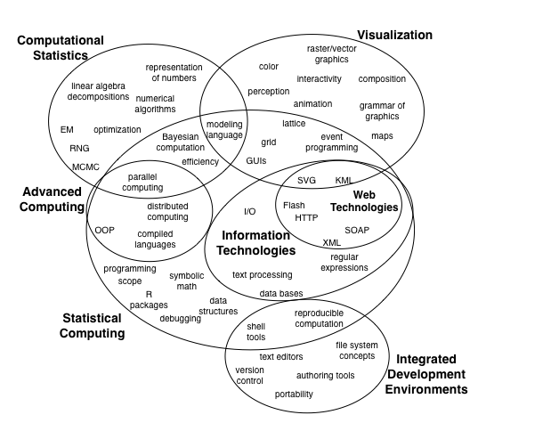
What to teach - Themes & Topics
Notes:
This is a reasonable overview of the different topics in “computing for statistics”. There are other topics and many more detailed sub-topics.
The point is to list not only the traditional topics (linear algebra computations, optimization, random number generation), but to add more
modern topics such as Web technologies; interactive, dynamic graphics; parallel computing; fundamental topics usually left to students
to learn by themselves such as editors, shells, version control; and also to introduce some modern statistical methods.
We also have tried to show some “loose” groupings of topics into the 5 different types of classes organized
along themes of Stat Computing & Programming; Computational Statistics; Advanced Stat. Computing;
Information Technologies; and Visualization
In practice, we include topics from different themes in a single course.

Slide 18
Leave it to Computer Science?
It may seem reasonable to have stat. students take computer science classes. Is this good?
Students would benefit from such classes, but only in addition to an solid statistical computing class.
The skills are different –
programming for data analysis versus
many data structures, programming languages, software design, efficiency in run-time
Vectorized computations on sample observations versus focus on individual elements.
Text manipulation & data input
Graphics & Information visualization versus low-level graphics.

Slide 19
If we want statistics to thrive and play an important role in the data-centric world, we need to
  Teach computing
  Do research in the next generation of computing technologies for statistics.
  And the only way to do the latter, is to do the former!
Notes:
This is a call to both teach computing so that students learn the skills so that they can do data analysis and research more effectively,
and also to teach computing so that people are better able to do research in new computing, and that computing literacy improves within
our field so that all researchers can talk about computation and understand the difference between good and bad computing research, papers, etc.
At present, we have a real problem in that academic statisticians really don’t have a good knowledge of computing, software design, etc.
As a result, the fledgling field of statistical computing is made up of a lot of papers that describe programming activities, and not really research.
Stat. computing researchers can understand and discuss statistical research, but stat. researchers have only a superficial understanding of stat. computing
research and require a lot of background information in talks. As a result, most talks are “dumbed down”. We need to change this if we are to go on
and not only use computers but develop new ways for statisticians to use and do computing.

Slide 20
Summary
We have to stop thinking of computing as an optional add-on within the study of statistics that students pick up in an ad hoc manner by themselves.
Computing is an essential, foundational skill for modern data analysis and without such skills, our students are missing at least half of the essential knowledge.
It is at least time for stat. instructors to learn modern stat. computing & to enhance their programs with computing & data analysis classes.

