Slide 1
Developing Assignments

Slide 2
Challenges
Challenging and time consuming to create rich, realistic assignments with suitable pedagogical activities.
Multiple iterations to find a data set, carve out activities at the right level.
Ideally, we want to borrow from actual research projects as case studies.
Modern statistical methods are computationally intensive, the mathematical understanding comes later

Slide 3
Goals
Ideally, we want to borrow from actual research projects as case studies.
Include modern statistical methods that are computationally intensive yet intuitive
Have students think statistically in approaching all aspects of data analysis, not just the modeling
Build on multiple topics to model the complexity of real applications and to promote a sense of accomplishment

Slide 4
Goals, ctd.
Expect the students to learn some things on their own, i.e. that they will have to find resources outside of those provided in the classroom.
Participate in the entire data analysis cycle

Slide 5
Data Analysis Process
decompose the problem
identify key components
abstract and formulate different strategies
connect the original problem to the statistical framework
choose and apply methods
reconcile the limitations of the solution
communicate ﬁndings

Slide 6
Data Sources for Projects
Supplementary materials to TAS article lists a dozen datasets and simulation studies
One excellent source – Explorations in Statistics Research Workshop
Last year’s workshop – contribution from participants - create case studies with a focus on computing
Data Expo

Slide 7
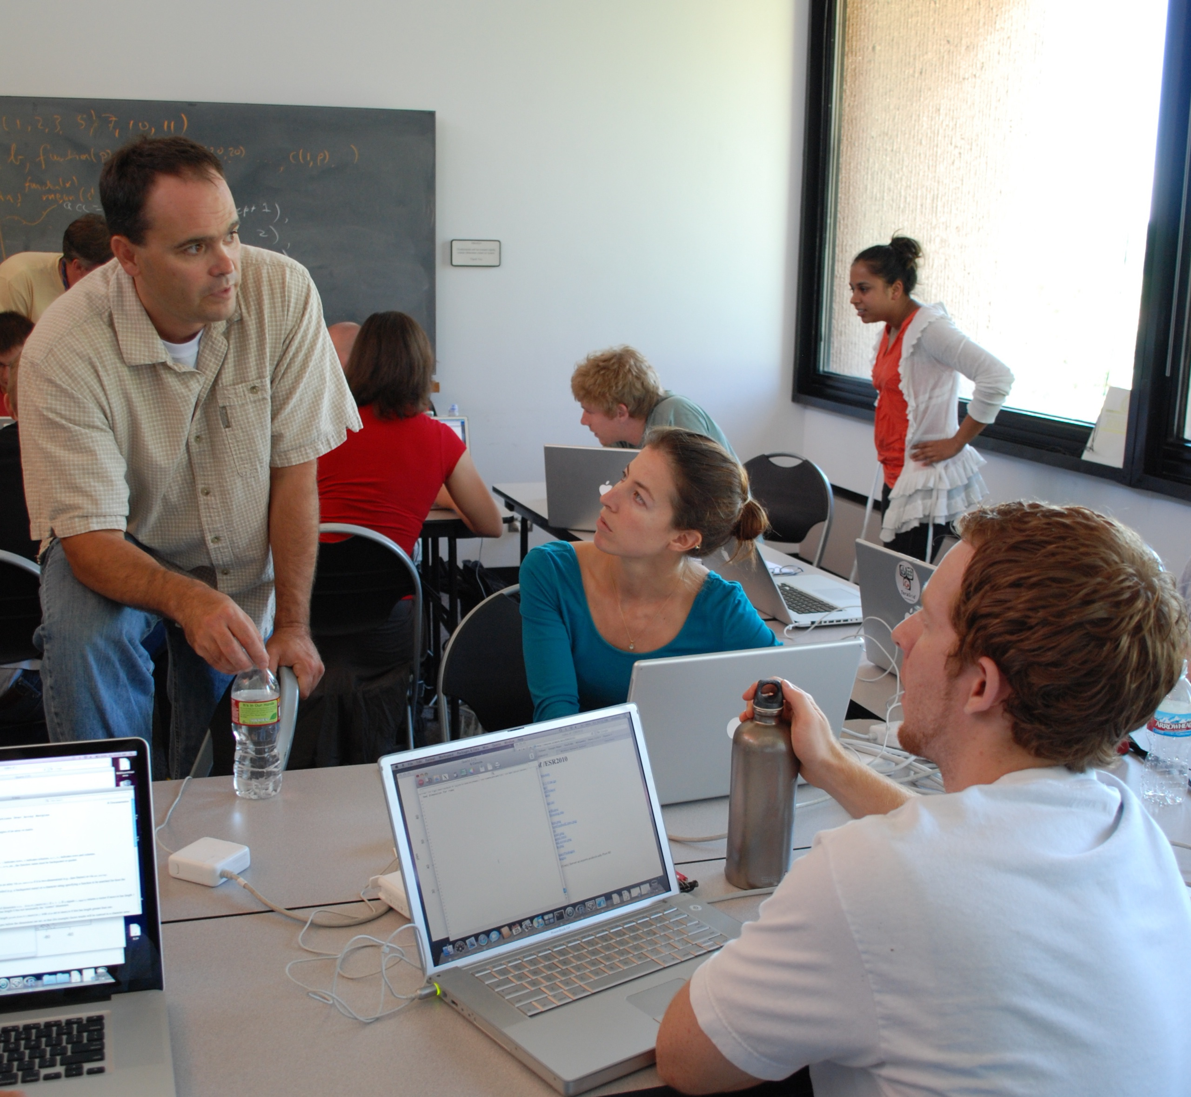
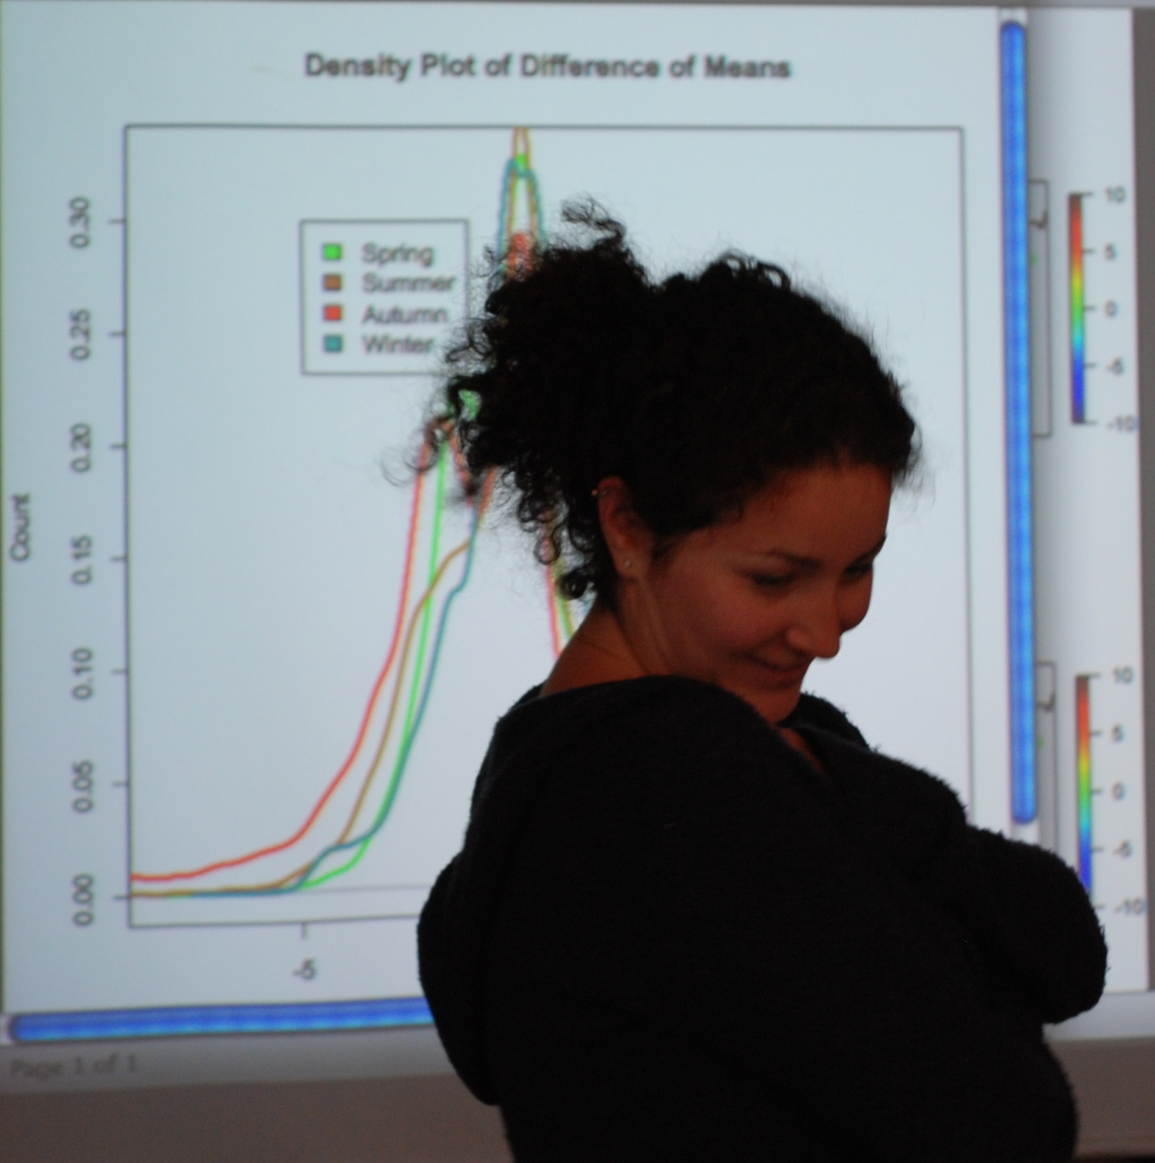
Explorations in Statistics Research
The seven day workshop is designed so that students get a sense of how statisticians approach large, complex problems.

Slide 8
Examples of Data
Baseball database
Wireless geo-location
Elephant seal foraging
CA traffic
Census/Geographic/Election results
State of the union addresses
Spam/Ham Spam Assassin

Slide 9
Birth and Assassination Process

Slide 10
Example Project
Questions
Are there differences between the counties that go for Clinton and those that go for Obama?
Where are the Clinton-counties located?
How well can you predict the primary results for the upcoming primaries?

Slide 13
Data
2000 Census data at the county level: Excel files
cc07_tabB1.xls: population, land area, and density
cc07_tabB3.xls: race, age, gender
cc07_tabB4.xls: HS degree, Bachelor's degree, foreign born population, persons in poverty, HH income >$75,000
2004 Presidential election: countyVotes2004.txt scraped from CNN website
2008 Democratic Primary: DemPrimary2008.txt scraped from CNN Website
Geographic data: counties.gml latitude and longitude
Auxiliary data:
top 30 cities in country
mapping of states to regions
mapping of townships to counties for New England States

Slide 14
Background
The CNN site presentation of the data changed from 2004 to 2008.
In 2004, it was available in HTML tables, and could be acquired through programmatic calls to the Web and post-processing the HTML.
In 2008, the tables were generated on the fly in javascript and json. We used a packet sniffer to figure out the correct URL to call. Then we programmatically called the URL, received json in return, and processed it with RJson package to get plain text.

Slide 15
Logistics
Final Project
Intermediate deadlines over 3 week period
Students worked in groups of 3-5
Turned in: 8-10 page write up; 6 plots; all code (documented).

Slide 17
Step II: Model Fitting and Map making
Provide plots for comment.
This group of students followed the color schemes of the NYT, and they added markers that make it clear that Obama tends to get support in the big cities.
Step III: Final Write-up
Students turn in, report with graphics embedded, appendix of how the data frame was created, and code. Samples will be posted on the web.

Slide 18
This group of students followed the color schemes of the NYT, and they added markers that make it clear that Obama tends to get support in the big cities.

Slide 19
This group of students examined how the state primaries unfolded in time. The size of the circle denotes the vote margin, the color denotes the winner, and there are many markers to indicate political events.

Slide 20
These students display the percentage victory through color, in addition to showing the size of the victory through area of the circle.

Slide 21
These students used their recursive partitioning results to predict the Obama/Clinton wins and place the predictions on the map. It shows the Obama advantage in the deep south, the Clinton advantage in the Appalachians, and the close race in the Midwest.

Slide 22
Goal of HWs
Practice with writing code, designing functions, and improving code
Reinforce use of statistical thinking in all aspects of statistical computing
Vary format of work to be handed in
Drills vs. Practice
Opportunity to bring in data analysis
Variants of an assignment
Part of a project

Slide 23
Brief Descriptions of HW
What are skills needed?
What are the expectations?

Slide 24
Traffic flow on highways in CA
Read documentation to figure out which function to use to read data
Explore relationship between 2 variables
Hand in pdf file – paragraph, code, plots

Slide 25
Wireless Geo-location
Practice investigating characteristics of data
Convert from one data structure to another
Use different structures for different types of analyses

Slide 26
Deconstruct - Reconstruct
Use common terminology for describing a plot and its components
Evaluate effectiveness of a plot
Identify the message in the plot
Find additional data/markers to improve plot
Familiarity with basic plotting software
Turn in HTML

Slide 27
Birth and Assassination Process
Build simulation from standard RNG functions
Experience with function writing
Understand randomness
Use EDA to test functions
Use DOE to explore the characteristics of the process

Slide 28
State of Union Address
Modern methods:
Text mining: K-L distance and S-J metric
Term frequency; document frequency
MDS, Hierarchical clustering
Experience with function writing
Understand randomness
Use EDA to test functions
Use DOE to explore the characteristics of the process

Slide 29
Cross-validation
Modern methods:
Text mining: K-L distance and S-J metric
Term frequency; document frequency
MDS, Hierarchical clustering
Experience with function writing
Understand randomness
Use EDA to test functions
Use DOE to explore the characteristics of the process

Slide 30
Cross-validation
Experience with function writing
Profiling code to speed it up
Well written code -

Slide 31
Student plots from HW & projects

Slide 32
Spam Assassin
Return-Path: whisper@oz.net
Delivery-Date: Fri Sep 6 20:53:36 2002
From: whisper@oz.net (David LeBlanc)
Date: Fri, 6 Sep 2002 12:53:36 -0700
Subject: [Spambayes] Deployment
In-ReplyTo:<LNBBLJKPBEHFEDALKOLCIEJABCAB.tim.one@comcast.net>
Message-ID: <GCEDKONBLEFPPADDJCOECEHJENAA.whisper@oz.net>
You missed the part that said that spam is kept in the "eThunk" and
was viewable by a simple viewer for final disposition?
Of course, with Outbloat, you could fire up PythonWin and stuff the
Spam into the Junk Email folder... but then you loose the ability to
retrain on the user classified ham/spam.
David LeBlanc
Seattle, WA USA
> -----Original Message-----
> From: spambayes-bounces+whisper=oz.net@python.org
> [mailto:spambayes-bounces+whisper=oz.net@python.org]On Behalf

Slide 33
LA traffic at all hours

Slide 34
County Map 2004 US Presidential Election

Slide 35
Elephant seal migration

Slide 36
Wireless geolocation

