Slide 1
248 Thursday February 7 1011 Evans Victor Panaretos Lausanne
Spectral Analysis of Functional Data
Functional data analysis deals with statistical problems where each observation in a sample is an entire realization of a random function, the aim being to infer characteristics of the law of the random function on the basis of the data. Especially the second-order structure of functional data, as encoded by the covariance operator and its spectrum, is fundamental in the development of corresponding statistical methodology.
In this talk we explore the problem of conducting statistical inferences on this second-order structure of functional data and quantifying the associated uncertainty.
We consider both the context of independent functional observations, as well as that of dependent functional observations (time series in function space).

Slide 2
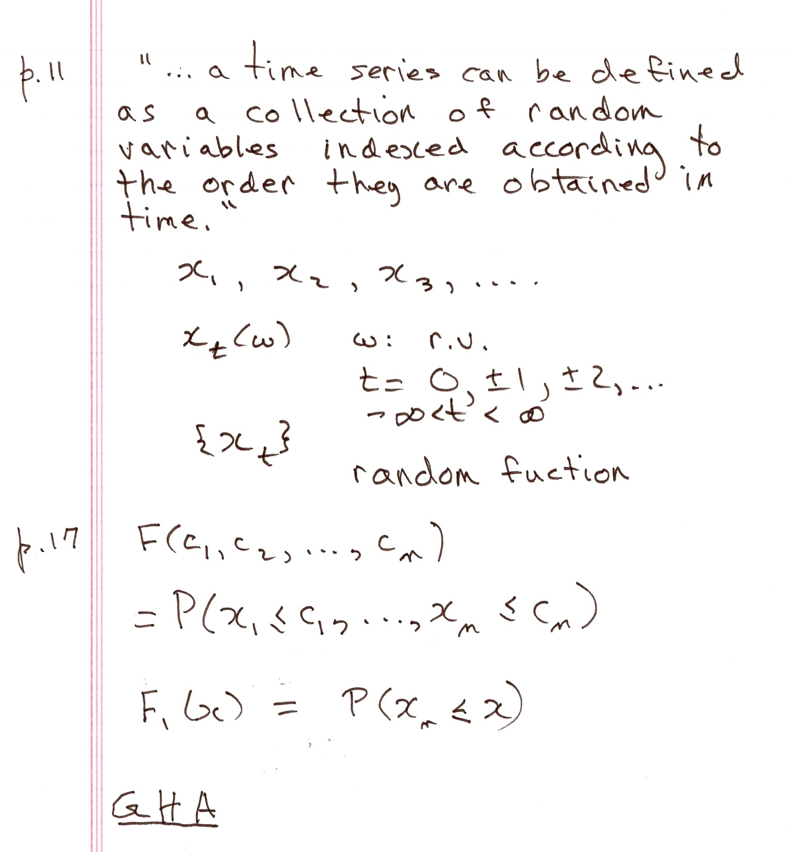

Slide 3
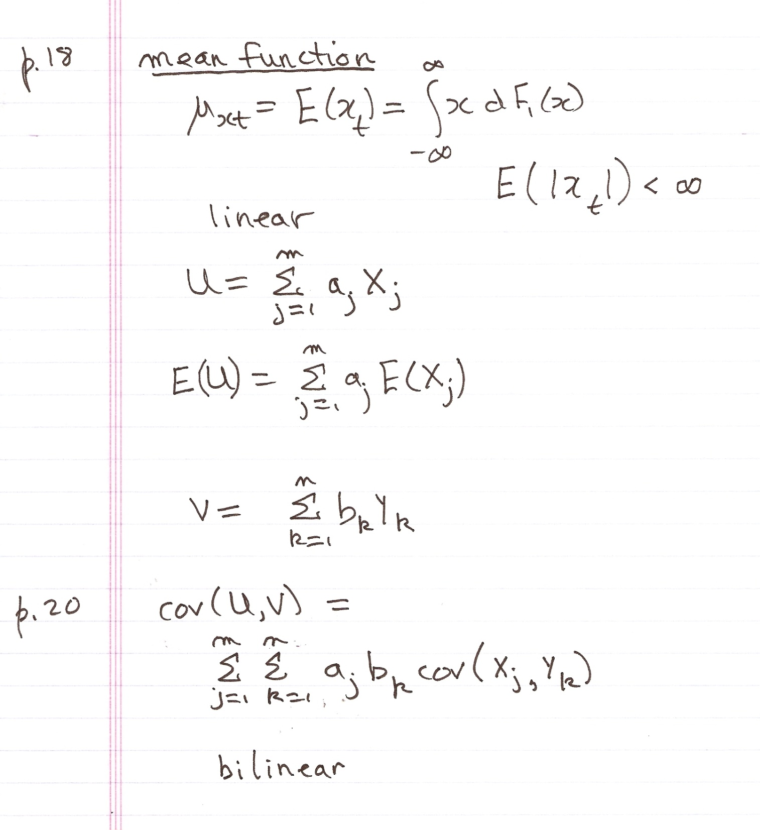

Slide 5
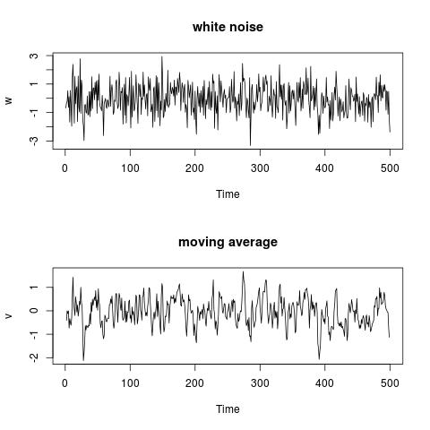

Slide 6
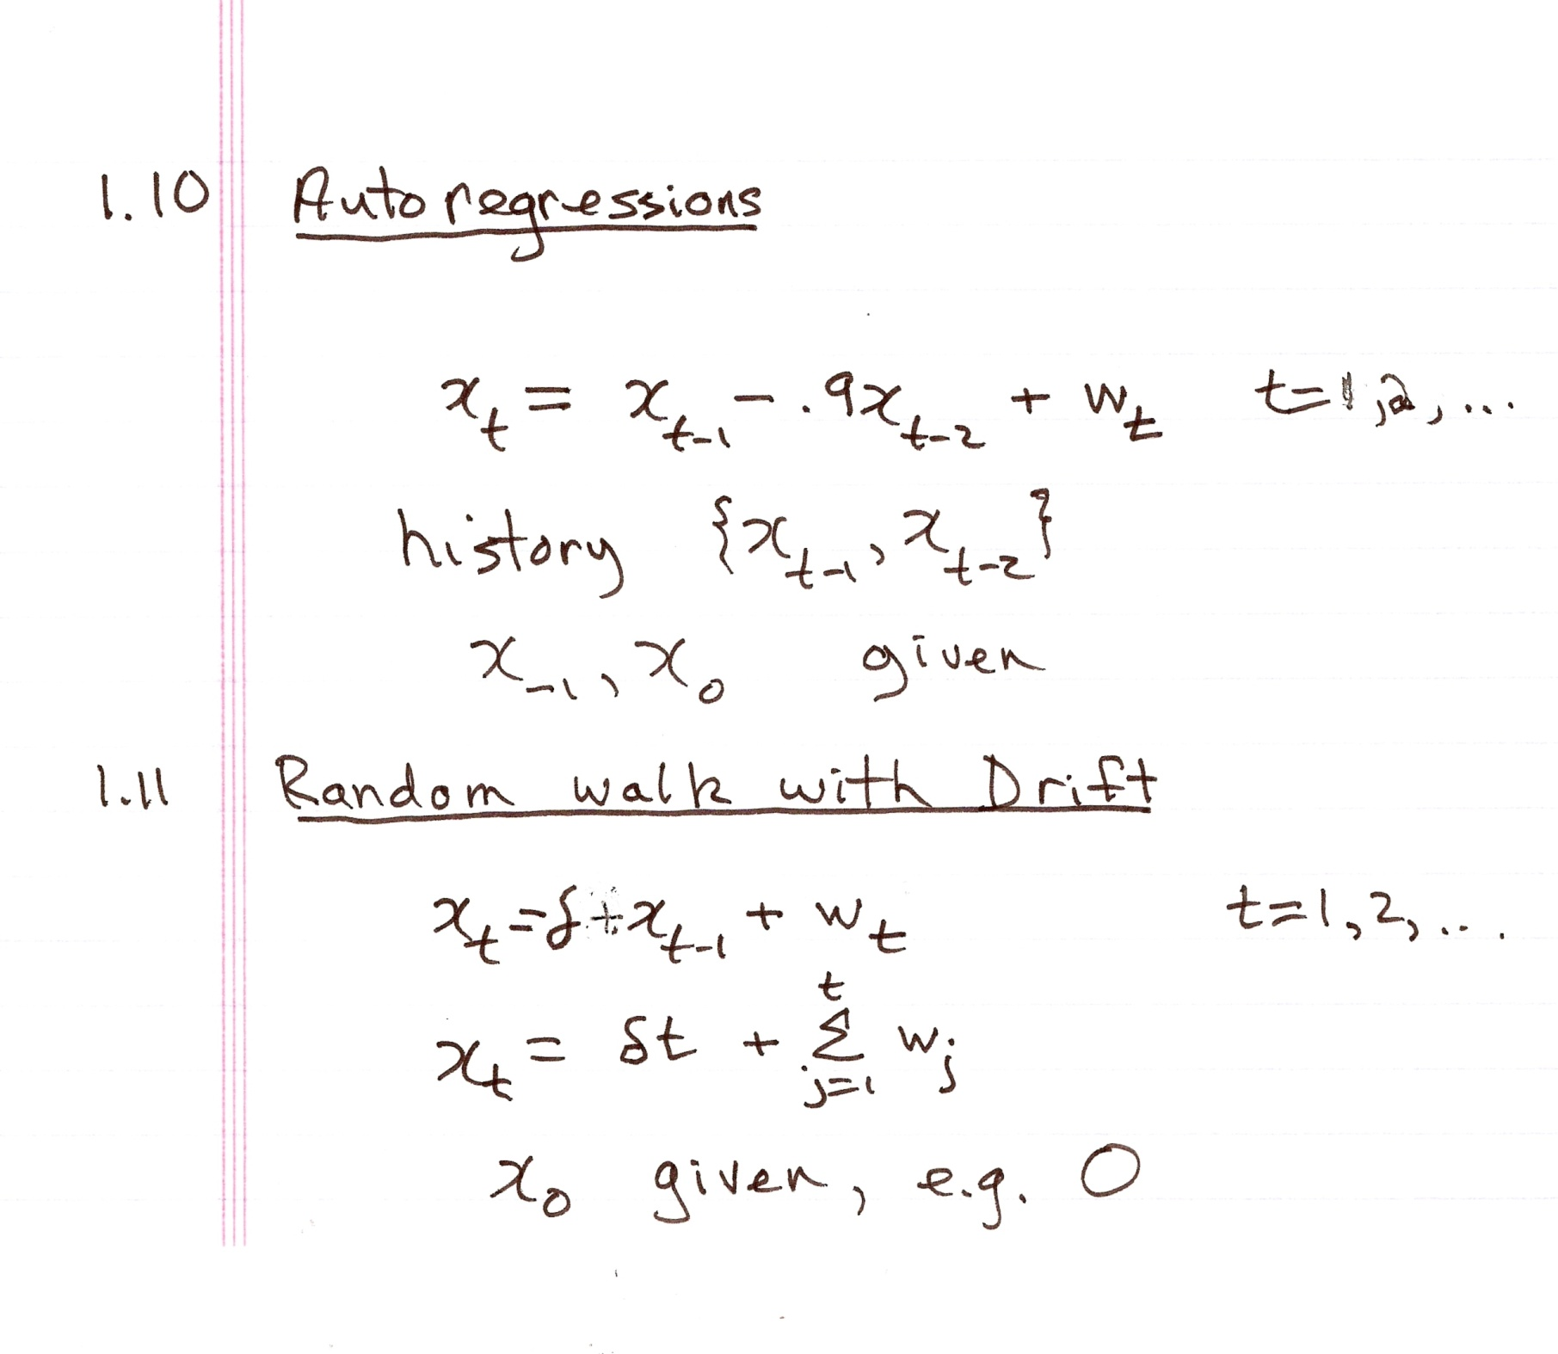

Slide 7
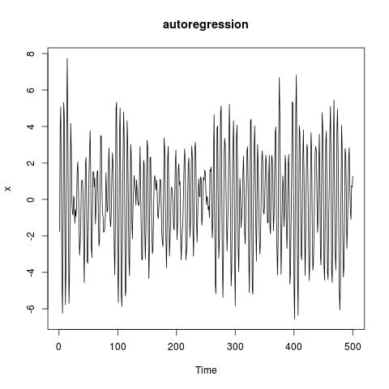

Slide 8
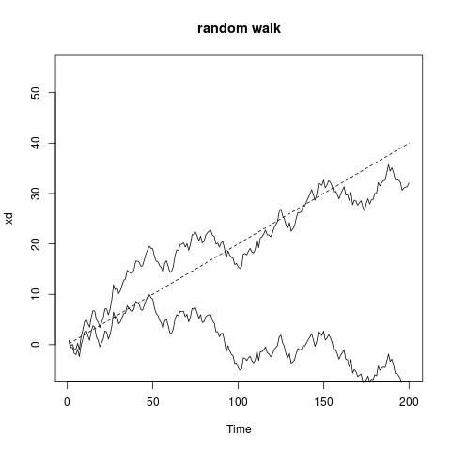

Slide 9
Elephant seal journey.
Were endangered
Formulas for: great circle, SDE

Slide 10
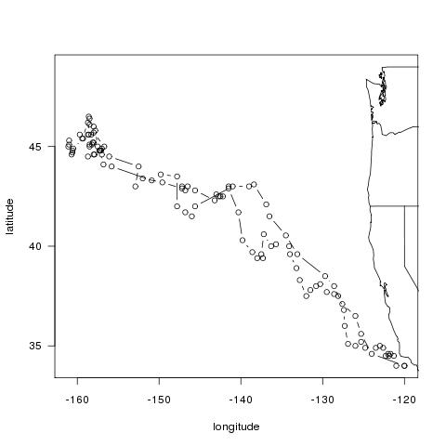
An elephant seal's journey

Slide 11
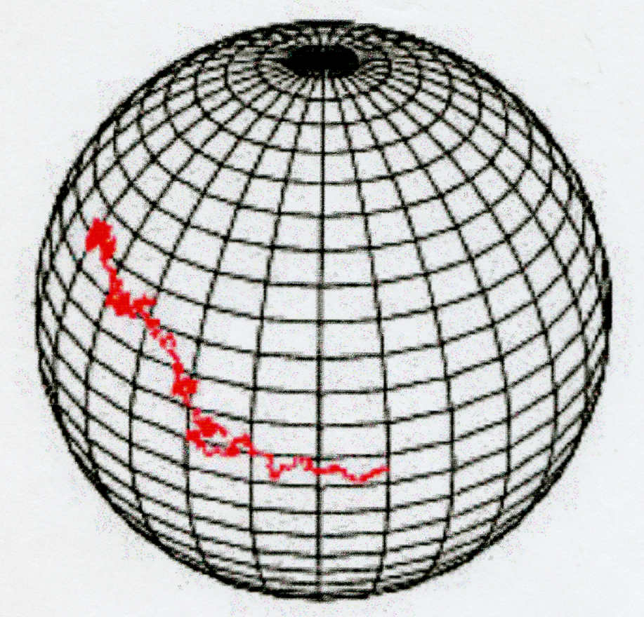
Elephant seal

Slide 12
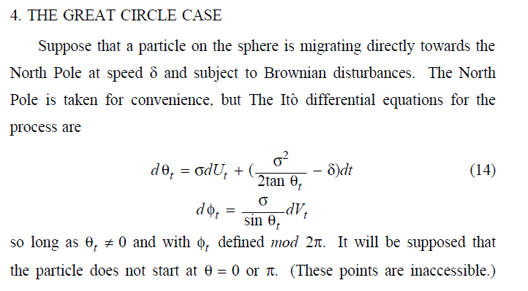

Slide 13
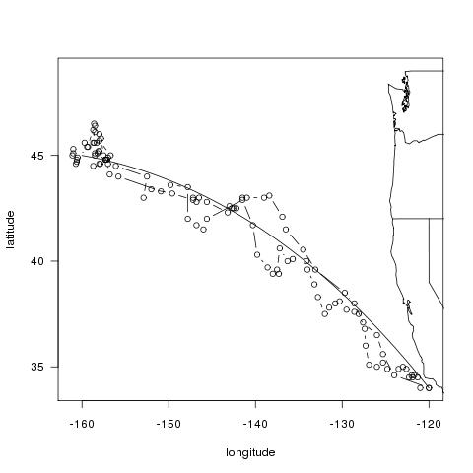
D. R. Brillinger and B. S. Stewart (1998)

Slide 15
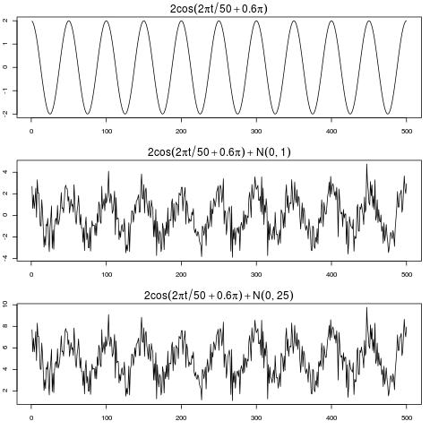

Slide 17
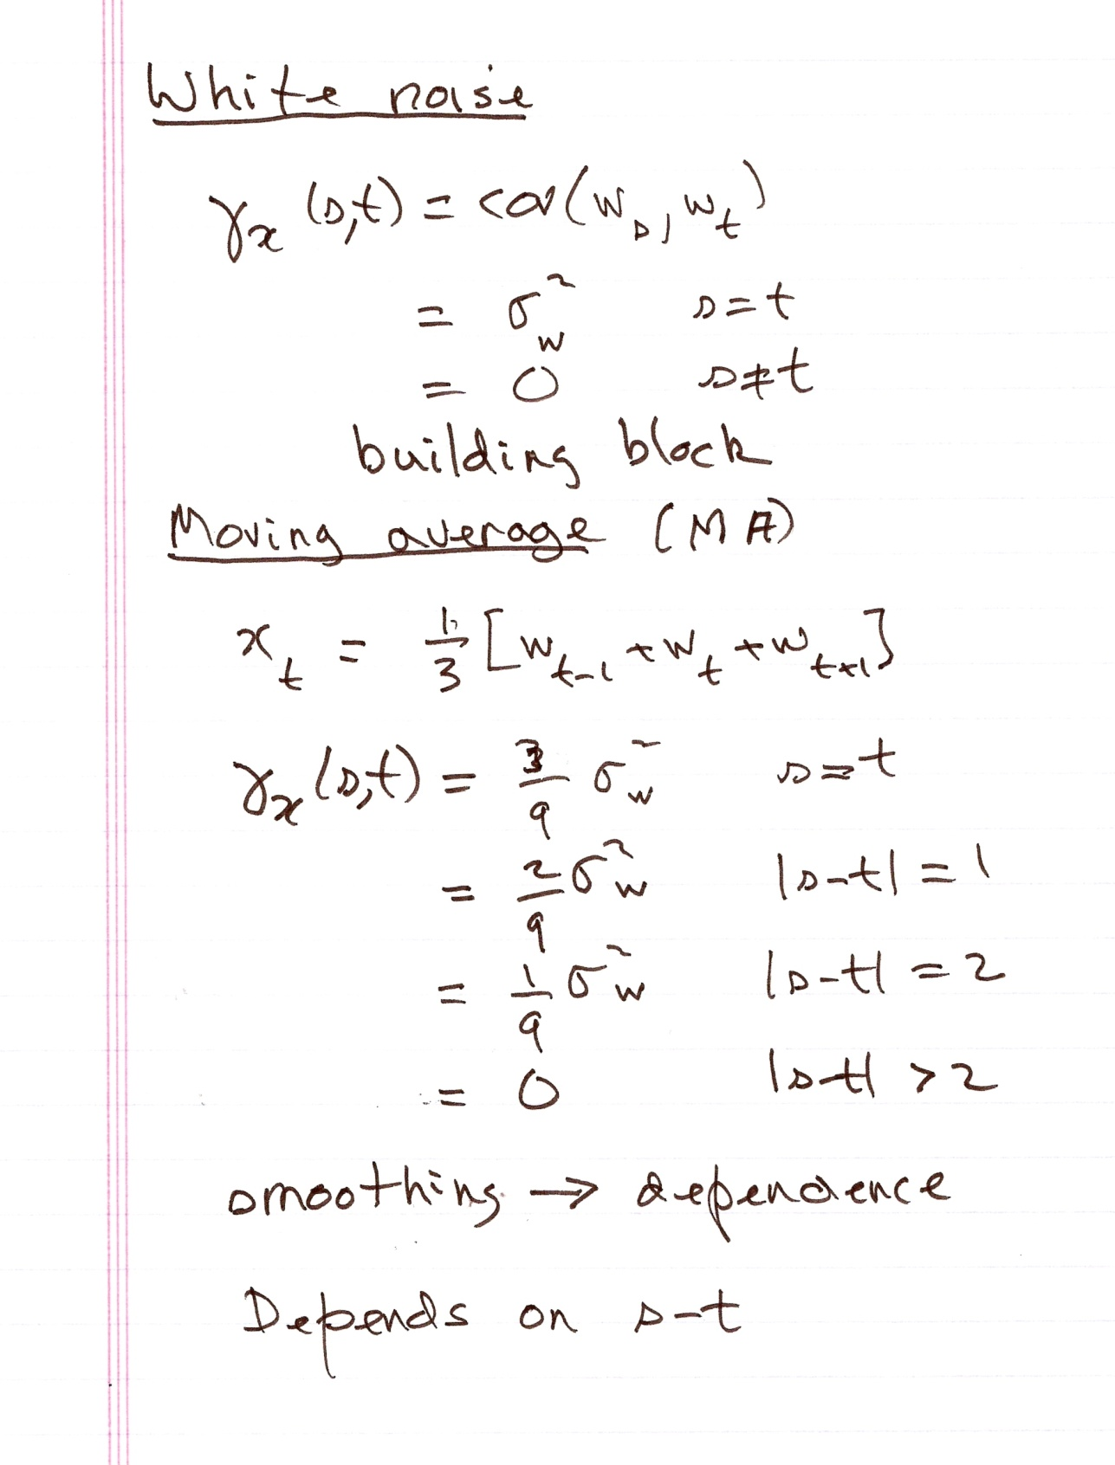

Slide 18
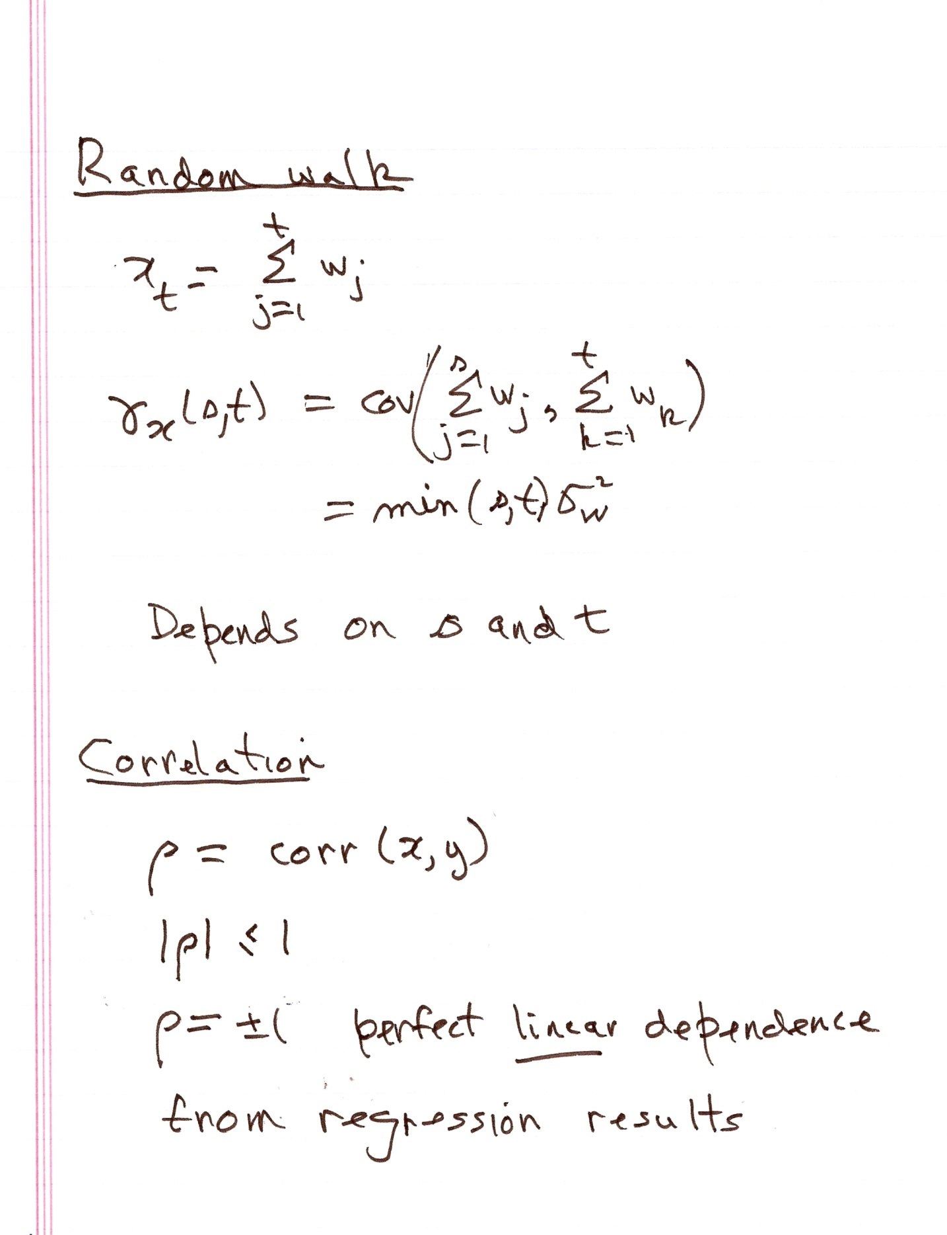

Slide 19
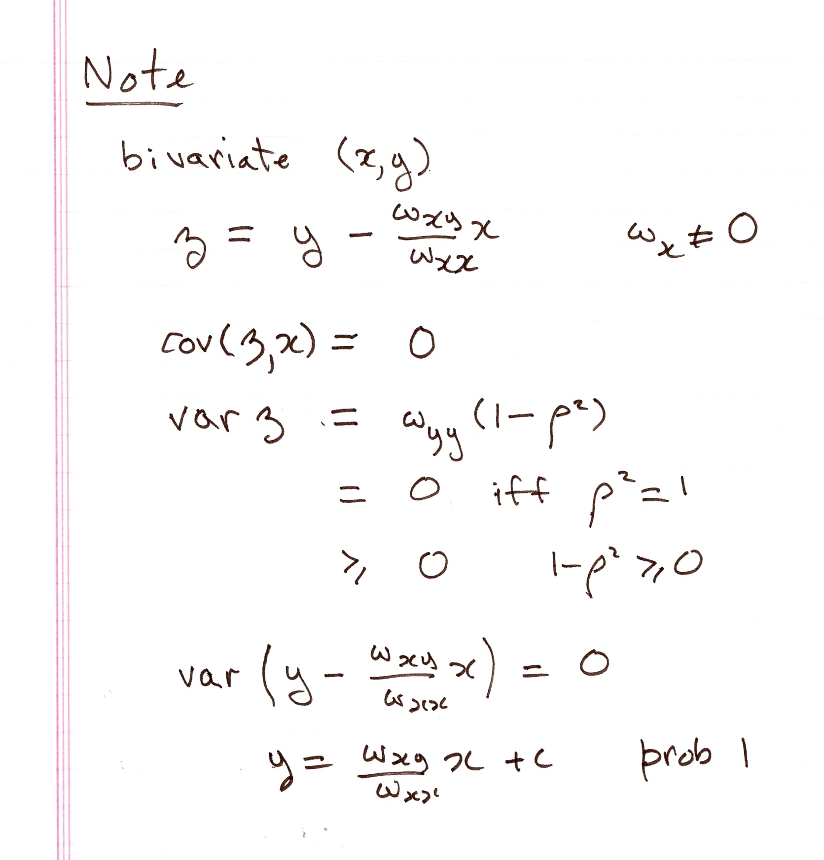

Slide 20
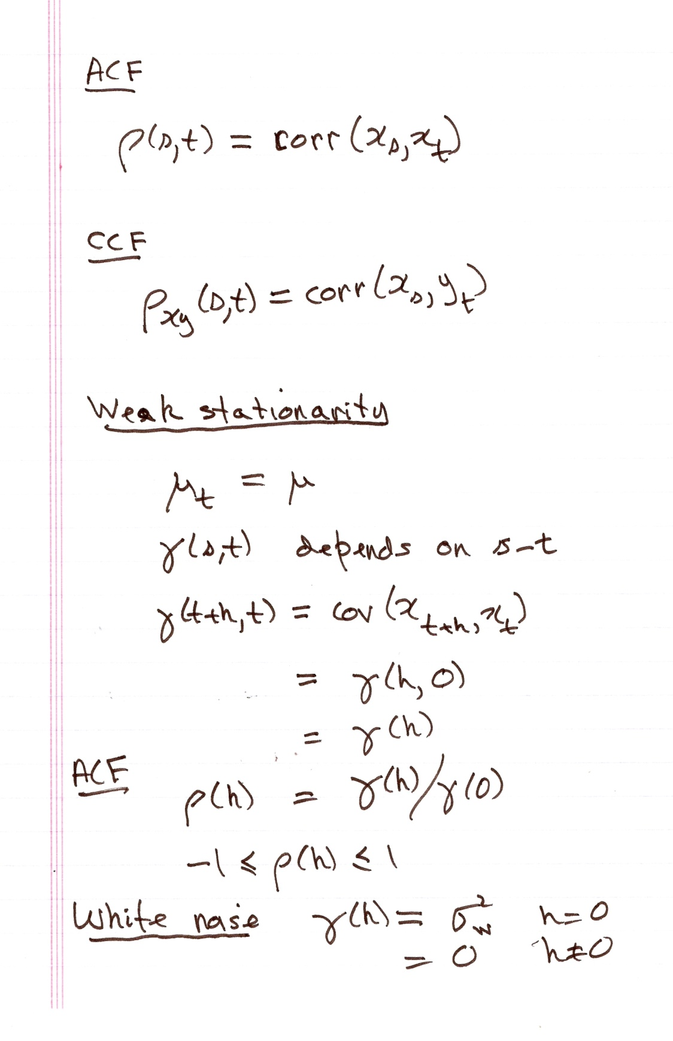

Slide 21
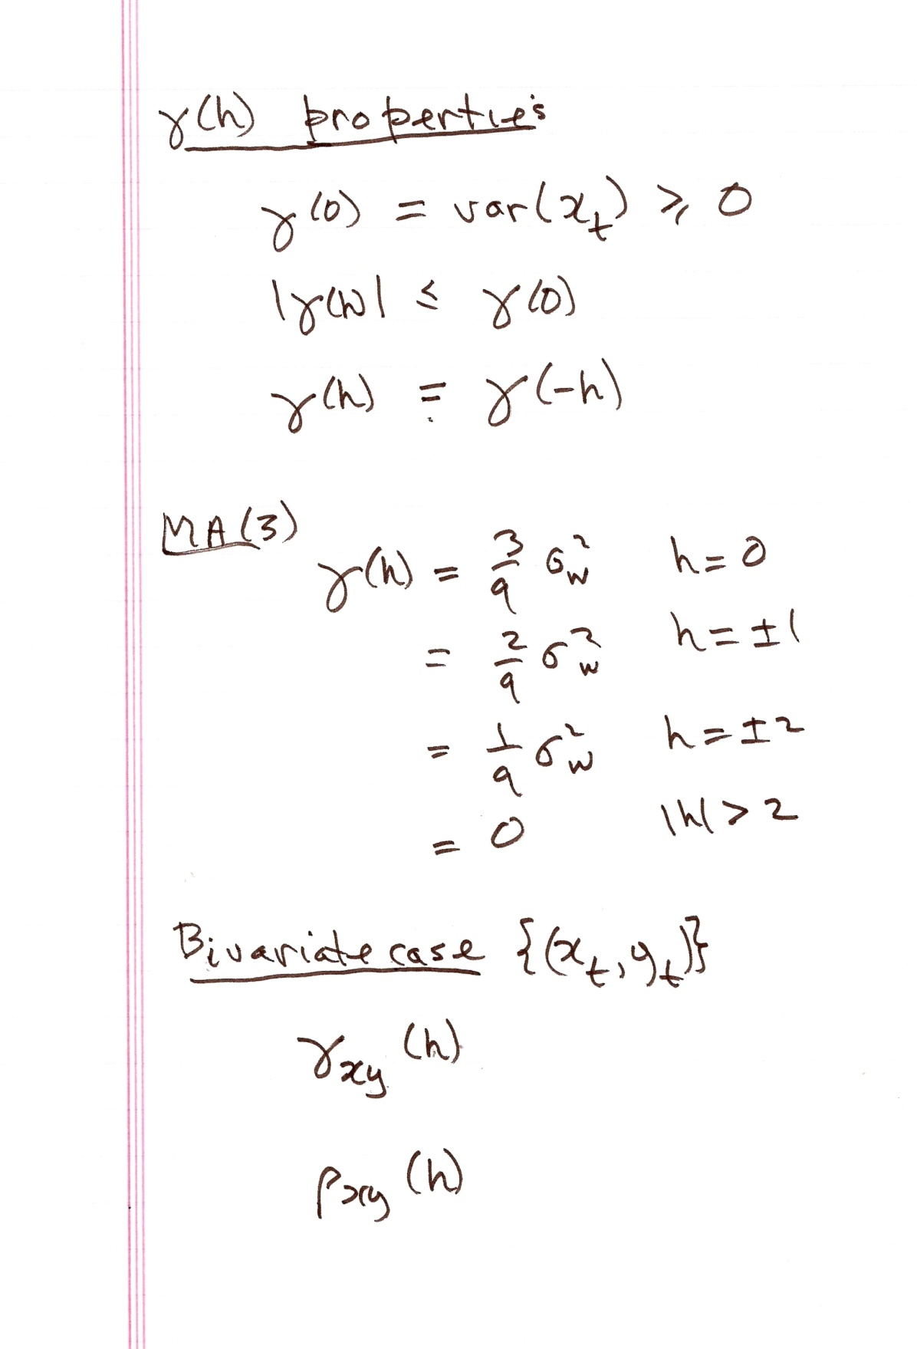

Slide 22
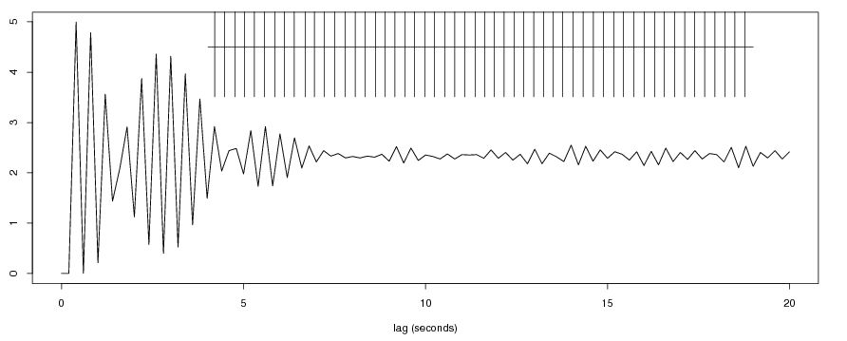
Aplysia californica
L10 as pacemaler

Slide 23
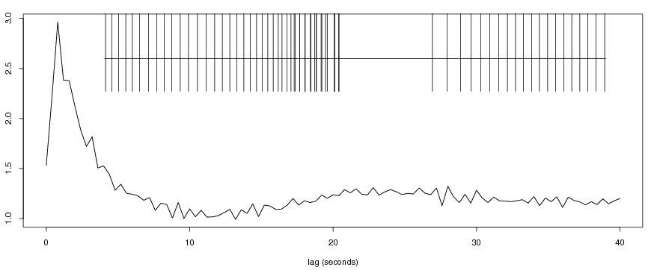
L10 bursting

Slide 24
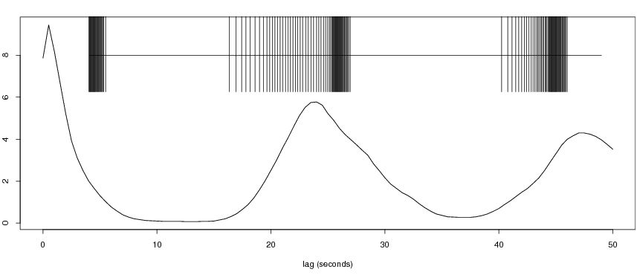
L10 bursting with accelerando

Slide 26
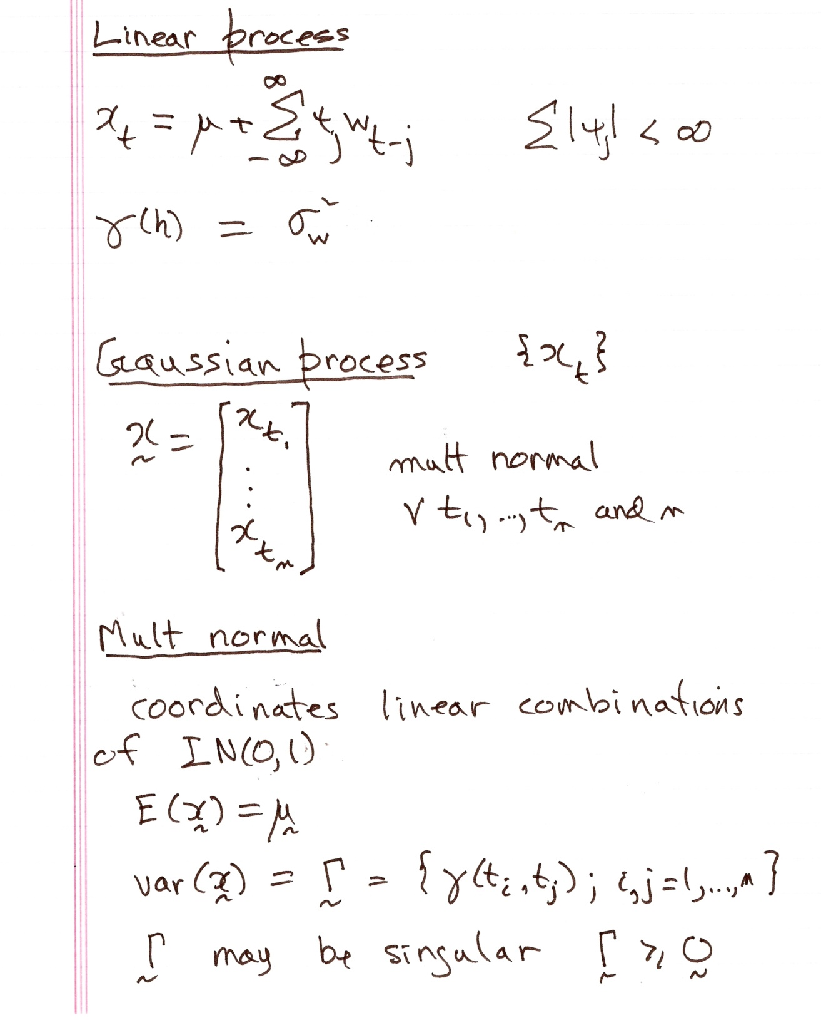

Slide 28
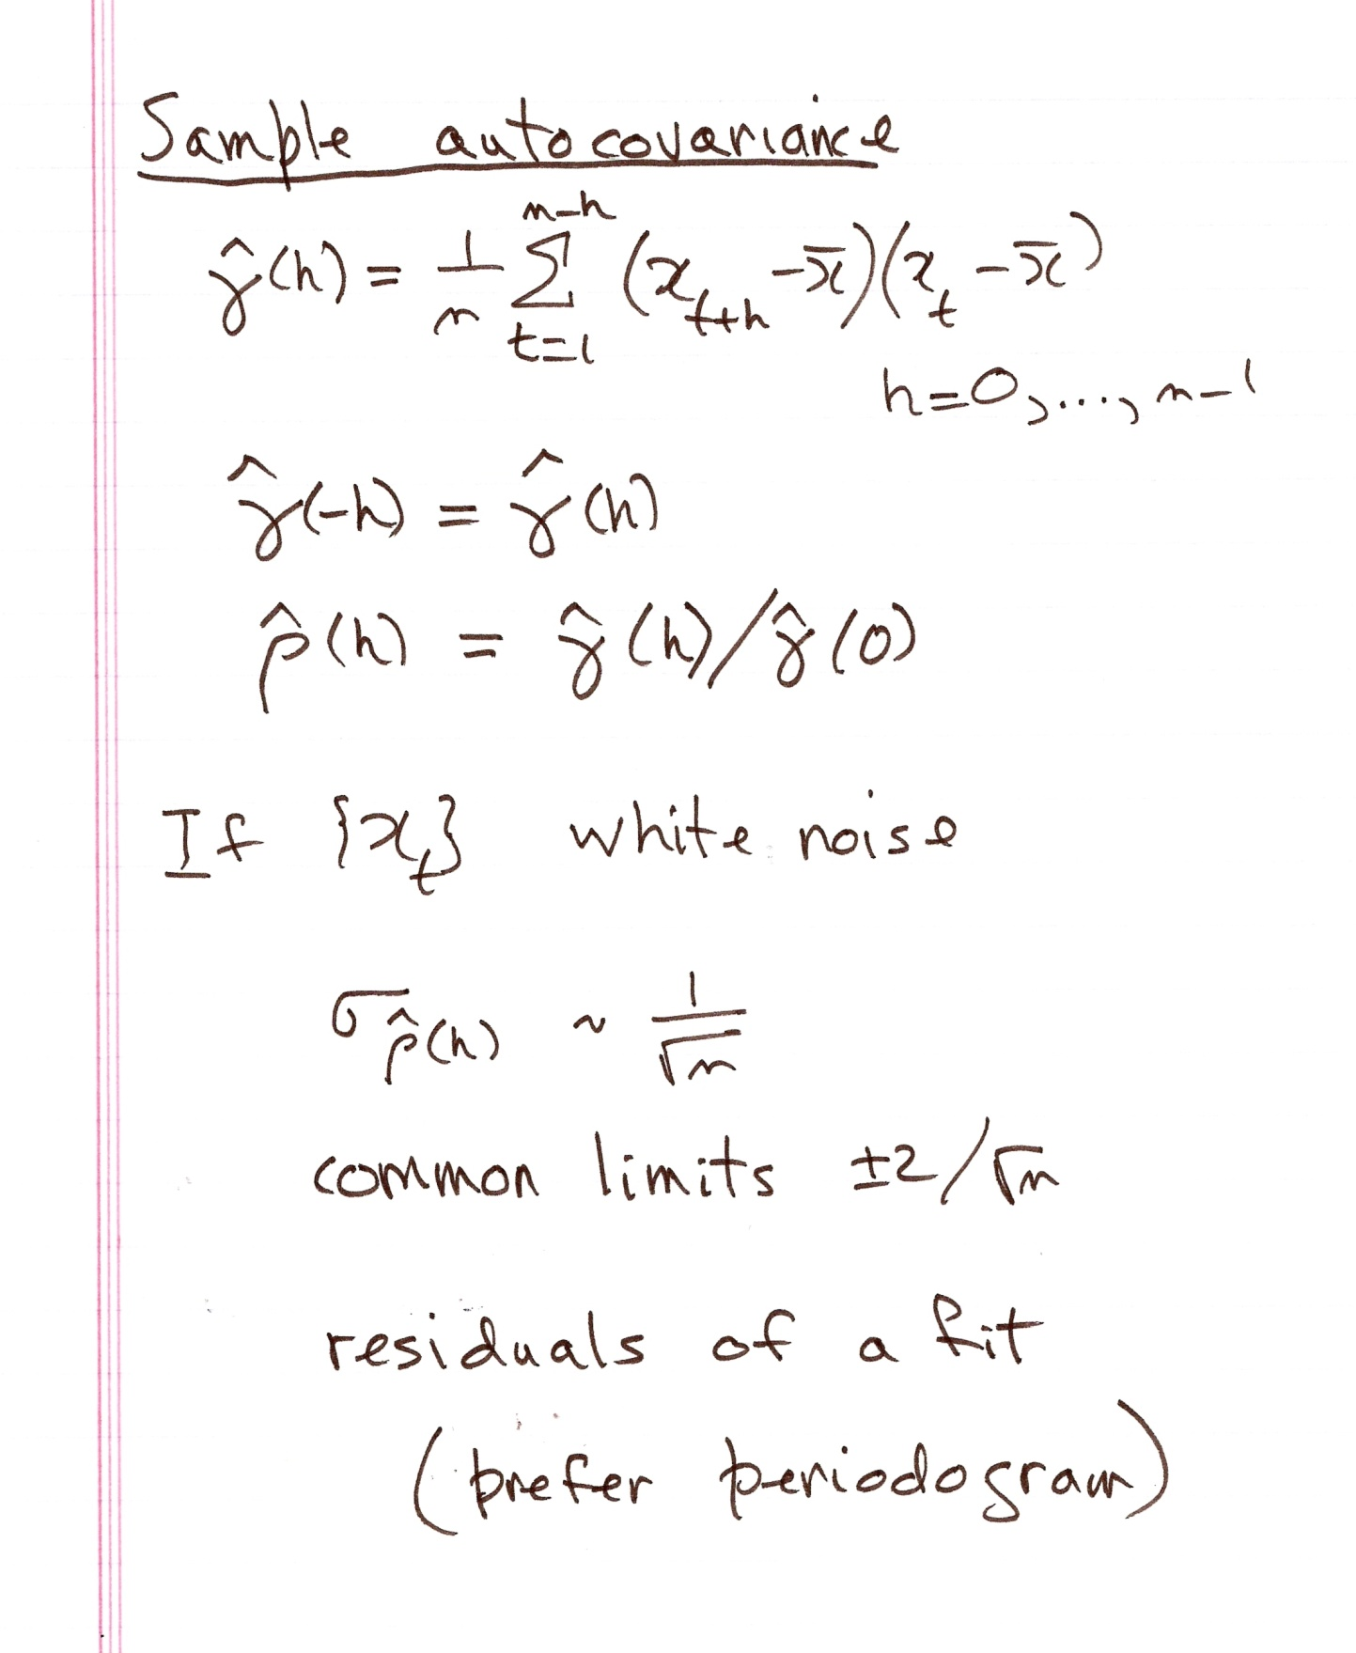

Slide 29
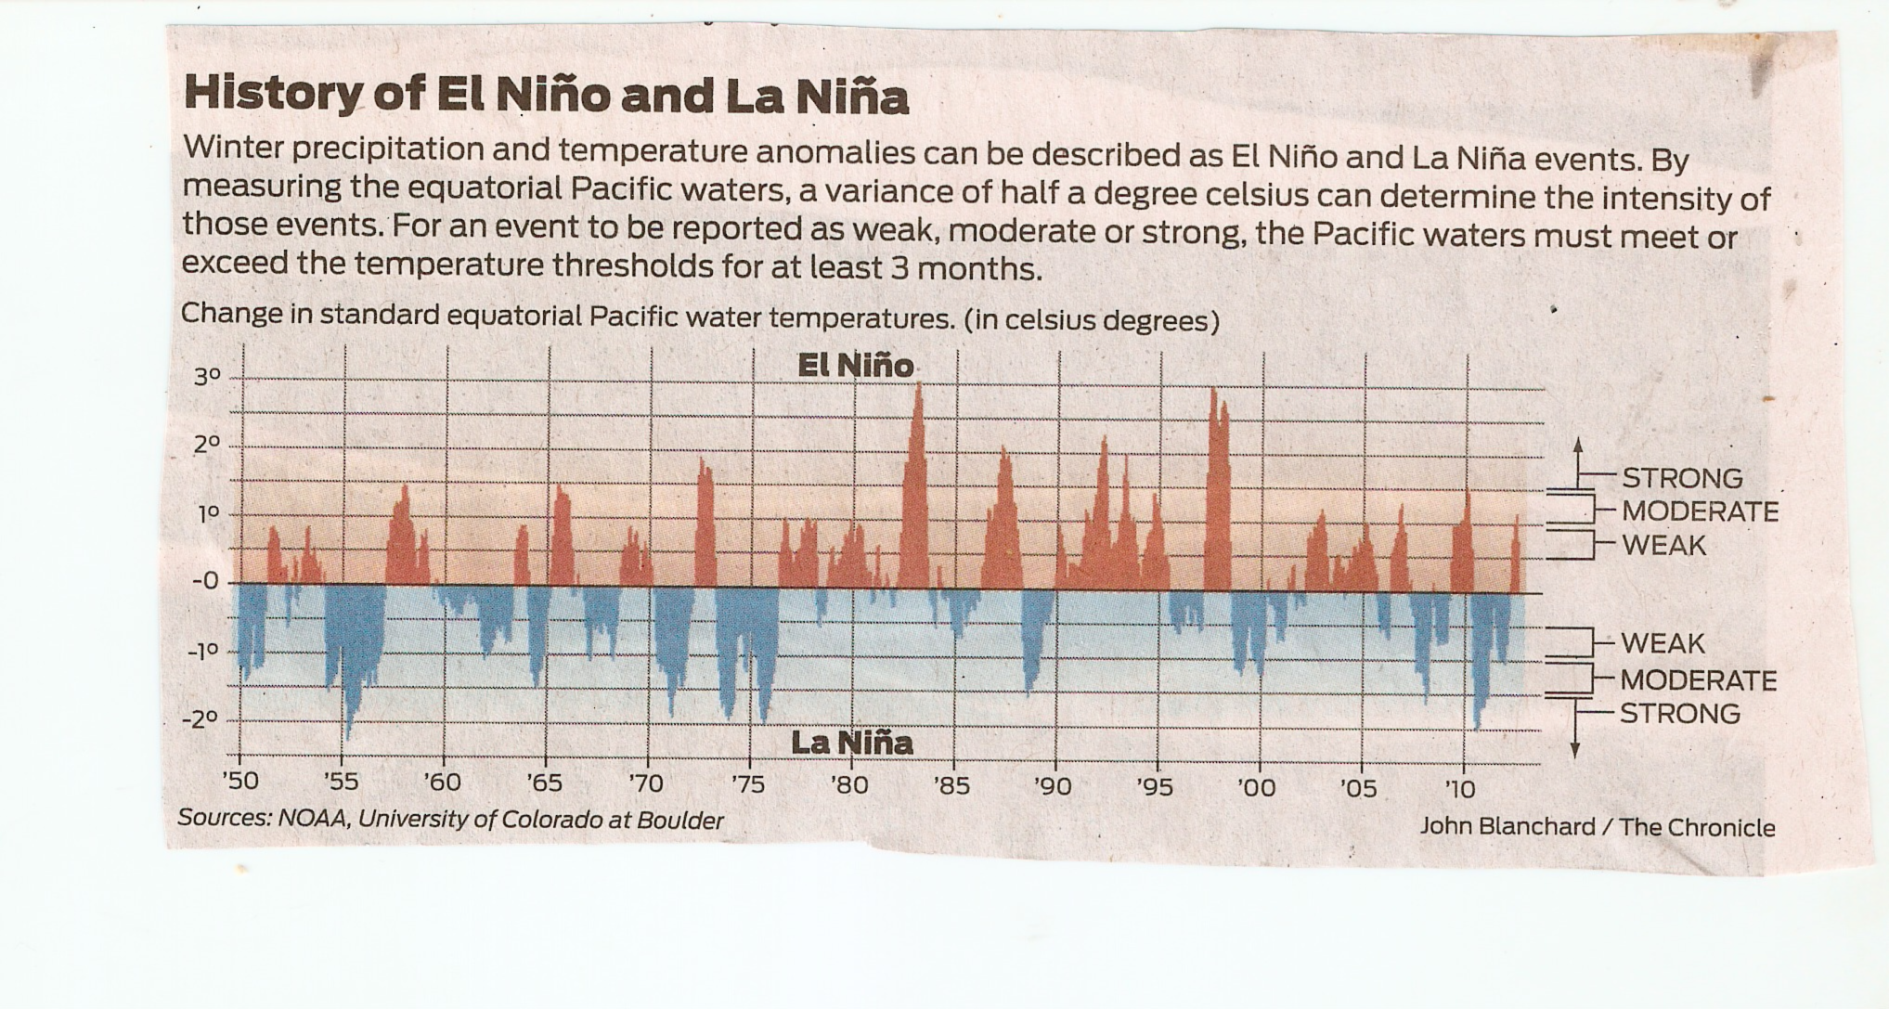

Slide 30
El Nino returns; will rain follow?
SF Chronicle 9/7/2012
"El Nino/Southern Oscillation (ENSO) is the most important coupled ocean-atmospher phenomenon to cause global climate variability on interannual time scales."

Slide 31
http://www.esrl.noaa.gov/psd/enso/mei/table.html
MEI Index (last update: 5 September 2012)
Bimonthly MEI values (in 1/1000 of standard deviations), starting with Dec1949/Jan1950, thru last month. More information on the MEI can be found on the MEI homepage. Missing values are left blank. Note that values can still change with each monthly update, even though such changes are typically smaller than +/-0.1. All values are normalized for each bimonthly season so that the 44 values from 1950 to 1993 have an average of zero and a standard deviation of "1".
Responses to 'FAQs' can be found below this table: YEAR DECJAN JANFEB FEBMAR MARAPR APRMAY MAYJUN JUNJUL JULAUG AUGSEP SEPOCT OCTNOV NOVDEC
1950 -1.022 -1.146 -1.289 -1.058 -1.42 -1.366 -1.33 -1.065 -.576 -.394 -1.154 -1.247
1951 -1.068 -1.196 -1.209 -.437 -.275 .464 .739 .853 .779 .752 .728 .467
1952 .406 .133 .088 .262 -.267 -.638 -.245 -.16 .362 .311 -.338 -.125
1953 .024 .38 .267 .712 .84 .246 .416 .253 .522 .092 .049 .313
1954 -.051 -.019 .175 -.506 -1.425 -1.589 -1.397 -1.468 -1.154 -1.372 -1.146 -1.106
1955 -.771 -.695 -1.133 -1.557 -1.631 -2.287 -1.932 -2.043 -1.826 -1.745 -1.826 -1.862
1956 -1.436 -1.3 -1.396 -1.156 -1.302 -1.508 -1.207 -1.143 -1.363 -1.463 -1.036 -1.014
1957 -.948 -.352 .152 .352 .908 .773 .937 1.122 1.183 1.098 1.133 1.231

Slide 32
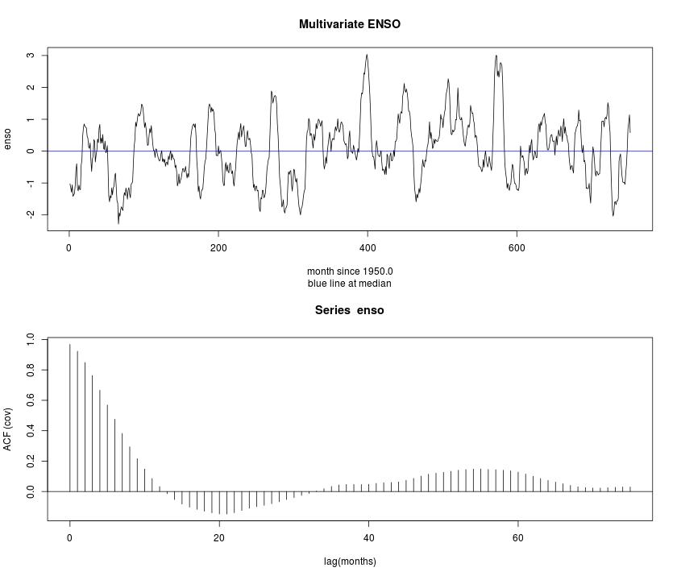

Slide 33
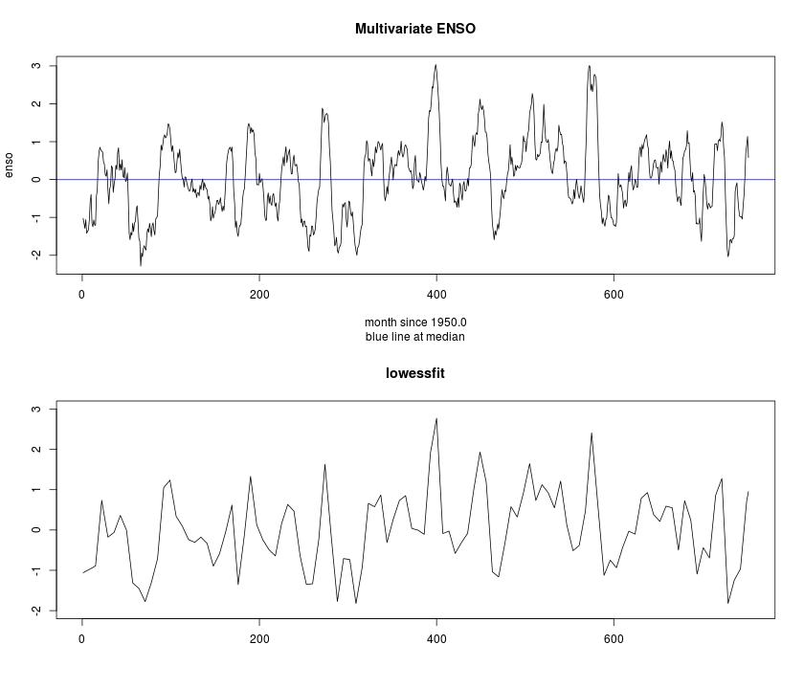

Slide 34
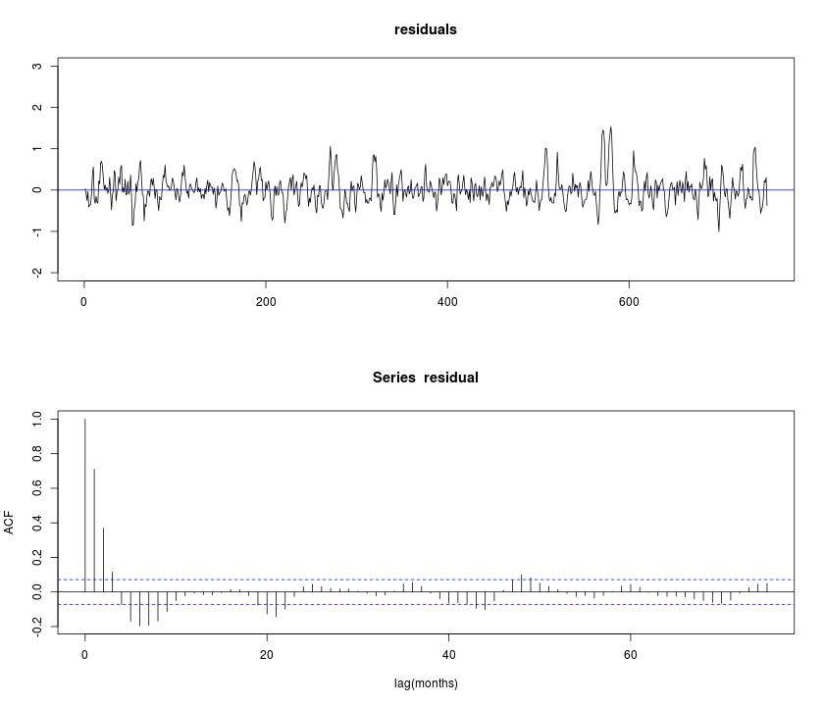

Slide 35
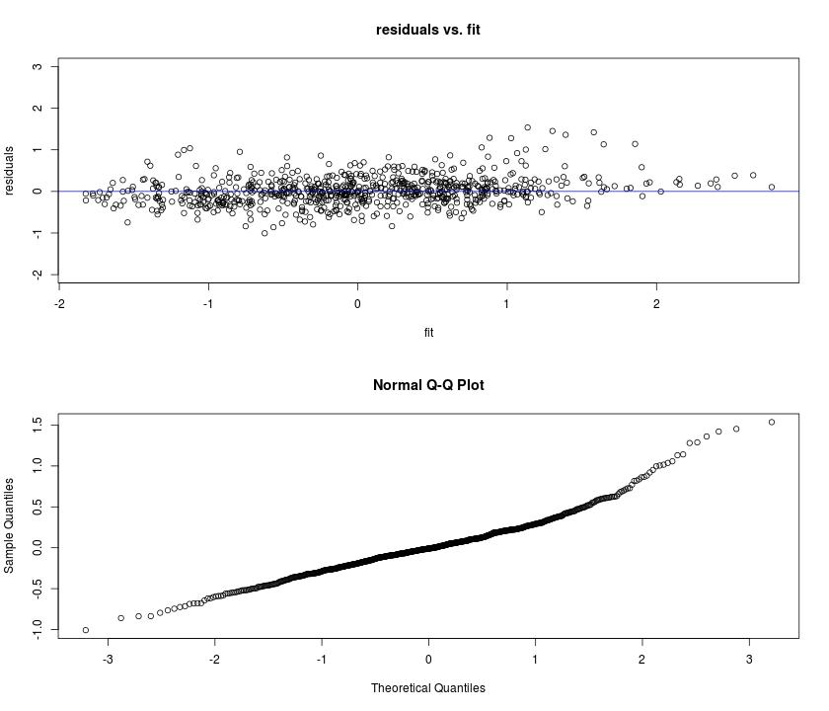

Slide 37
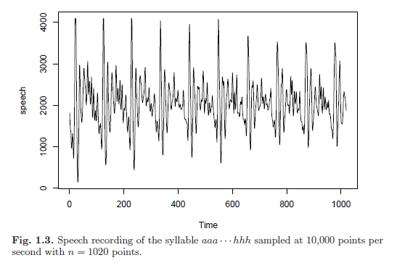
10000 Hz
Phrase: aaa…hhh
Computer recognition of speech
compare “signature” with members of library
Pitch period

Slide 38
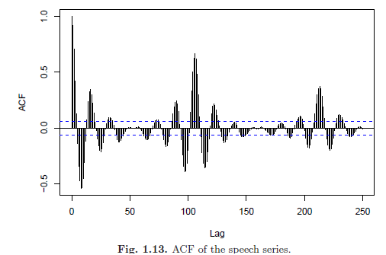
Pitch period 106-109 points
Encode/decipher speech

Slide 39
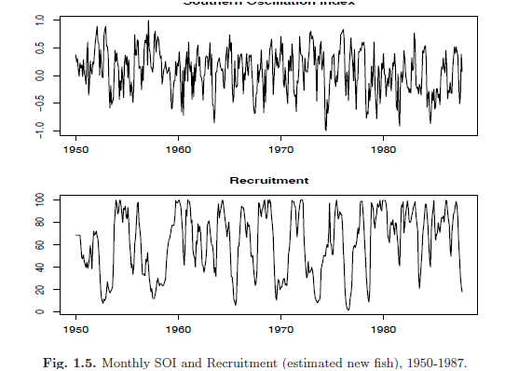
Southern Oscillation Index ~ temperature
El Nino - Central Pacific warms – every 3-7 years
Recruitment – new fish
period 12, 50 m
driven by El Nino?

Slide 40
About 5% of points outside +- 2/sqrt(n) if white noise

Slide 41
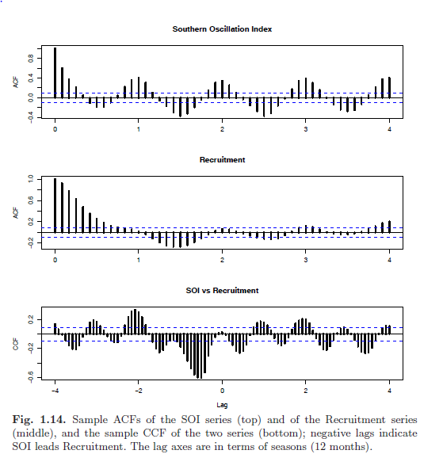
SOI period 1 year
Recruit lags by 6 m
negatively

Slide 42
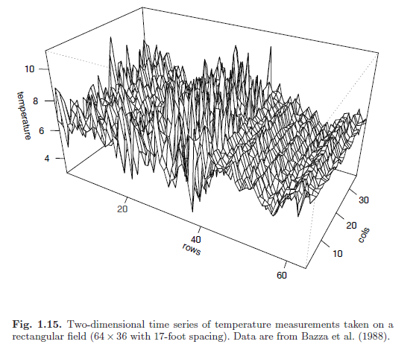
Spatial data
Periodicity along rows
average across columns

Slide 43
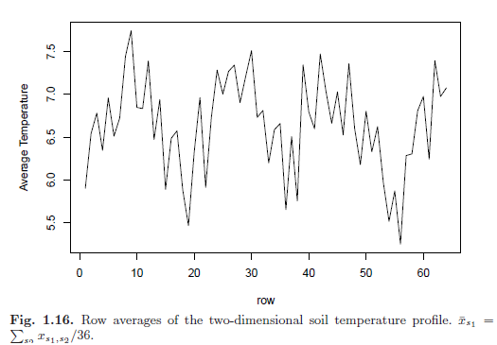
Plowing, seeding, watering?

Slide 44
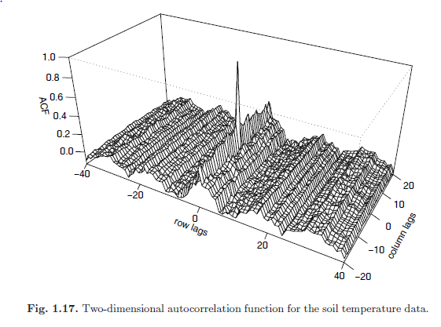

Slide 45
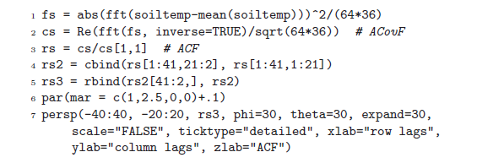

Slide 46
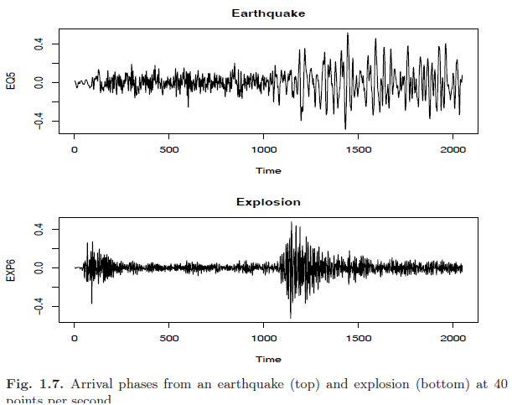
Nonstationarity

Slide 47
Some problems

Slide 48
Topics.
t. s.
{xj }, t=0,±1,±2,…}
Probability model
wn, ma, ar
Time series = signal + noise
acf, ccf (cov , corr) (γ, ρ)
Strict/weak stationarity
Gaussian
X-bar
Acf-hat, ccf-hat
±2/√ (n)

Slide 49
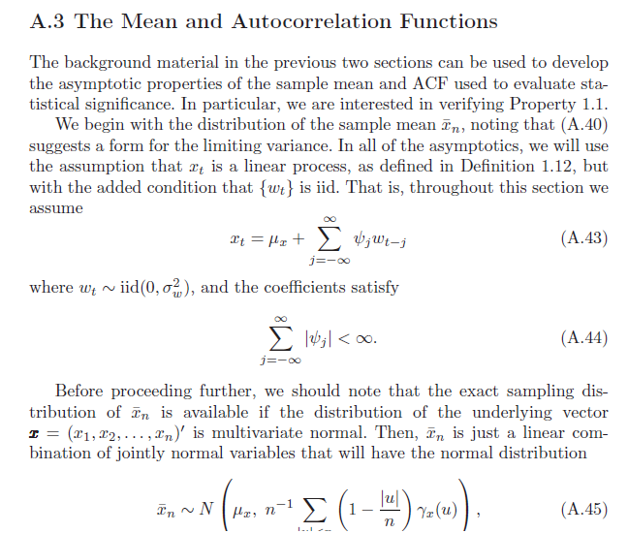

Slide 50
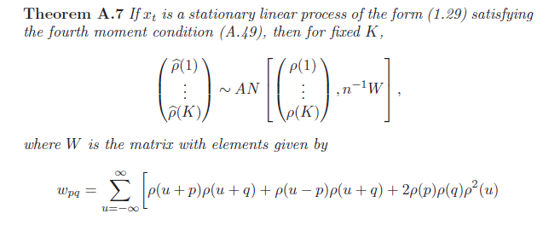
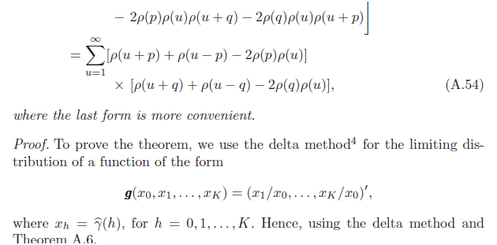

Slide 51
Example 1.9
w = rnorm(500,0,1) # 500 N(0,1) variates
v = filter(w, sides=2, rep(1,3)/3) # moving average
par(mfrow=c(2,1)) plot.ts(w, main="white noise")
plot.ts(v, ylim=c(-3,3), main="moving average") # now try this:
ts.plot(w, v, lty=2:1, col=1:2, lwd=1:2)
Example 1.10
w = rnorm(550,0,1) # 50 extra to avoid startup problems - the [-(1:50)] on the next line...
x = filter(w, filter=c(1,-.9), method="recursive")[-(1:50)] #... removes the first 50 values p
plot.ts(x)
Example 1.11.
set.seed(154)
w = rnorm(200,0,1)
x = cumsum(w)
wd = w +.2 xd = cumsum(wd)
plot.ts(xd, ylim=c(-5,55))
lines(x)
lines(.2*(1:200), lty="dashed")
Example 1.12
c = 2*cos(2*pi*(1:500)/50 + .6*pi)
w = rnorm(500,0,1)
par(mfrow=c(3,1), mar=c(3,2,2,1), cex.main=1.5)
plot.ts(c, main=expression(x[t]==2*cos(2*pi*t/50+.6*pi)))
plot.ts(c+w, main=expression(x[t]==2*cos(2*pi*t/50+.6*pi)+N(0,1))))
plot.ts(c+5*w, main=expression(x[t]==2*cos(2*pi*t/50+.6*pi)+N(0,25)))

