Slide 1

Randomized Numerical Linear Algebra (RandNLA): Past, Present, and Future
Petros Drineas¹ & Michael W. Mahoney²
¹ Department of Computer Science, Rensselaer Polytechnic Institute
² Department of Mathematics, Stanford University
To access our web pages:
Drineas
Michael Mahoney

Slide 2
Why RandNLA?
Randomization and sampling allow us to design provably accurate algorithms for problems that are:
Massive
(matrices so large that can not be stored at all, or can only be stored in slow memory devices)
Computationally expensive or NP-hard
(combinatorial optimization problems such as the Column Subset Selection Problem)

Slide 3
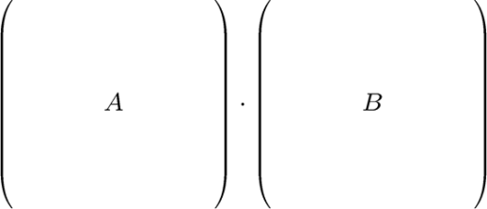
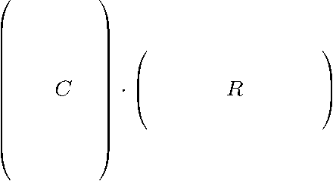

RandNLA: sampling rows/columns
Randomized algorithms
  By (carefully) sampling rows/columns of a matrix, we can construct new, smaller matrices that are close to the original matrix (w.r.t. matrix norms) with high probability.
  By preprocessing the matrix using random projections, we can sample rows/columns much less carefully (uniformly at random) and still get nice bounds with high probability.

Slide 4
RandNLA: sampling rows/columns
Randomized algorithms
  By (carefully) sampling rows/columns of a matrix, we can construct new, smaller matrices that are close to the original matrix (w.r.t. matrix norms) with high probability.
  By preprocessing the matrix using random projections, we can sample rows/columns much less carefully (uniformly at random) and still get nice bounds with high probability.
  Matrix perturbation theory
  The resulting smaller matrices behave similarly (in terms of singular values and singular vectors) to the original matrices thanks to the norm bounds.
  Structural results that “decouple” the “randomized” part from the “matrix perturbation” part are important in the analyses of such algorithms.

Slide 5
Interplay
Applications in BIG DATA
(Data Mining, Information Retrieval, Machine Learning, Bioinformatics, etc.)
Theoretical Computer Science
Randomized and approximation algorithms
Numerical Linear Algebra
Matrix computations and linear algebra (ie., perturbation theory)

Slide 6
Roadmap of the tutorial
Focus: sketching matrices (i) by sampling rows/columns and (ii) via “random projections.”
Machinery: (i) Approximating matrix multiplication, and (ii) decoupling “randomization” from “matrix perturbation.”
Overview of the tutorial:
(i) Motivation: computational efficiency, interpretability
(ii) Approximating matrix multiplication
(iii) From matrix multiplication to CX/CUR factorizations and approximate SVD
(iv) Improvements and recent progress
(v) Algorithmic approaches to least-squares problems
(vi) Statistical perspectives on least-squares algorithms
(vii) Theory and practice of: extending these ideas to kernels and SPSD matrices
(viii) Theory and practice of: implementing these ideas in large-scale settings

Slide 7
Areas of RandNLA that will not be covered in this tutorial
Element-wise sampling
  Introduced by Achlioptas and McSherry in STOC 2001.
  Current state-of-the-art: additive error bounds for arbitrary matrices and exact reconstruction under (very) restrictive assumptions
  (important breakthroughs by Candes, Recht, Tao, Wainright, and others)
  To do: Efficient, optimal, relative-error accuracy algorithms for arbitrary matrices.
Solving systems of linear equations
  Almost optimal relative-error approximation algorithms for Laplacian and Symmetric Diagonally Dominant (SDD) matrices (Spielman, Teng, Miller, Koutis, and others).
  To do: progress beyond Laplacians.

Slide 8
Areas of RandNLA that will not be covered in this tutorial
Element-wise sampling
  Introduced by Achlioptas and McSherry in STOC 2001.
  Current state-of-the-art: additive error bounds for arbitrary matrices and exact reconstruction under (very) restrictive assumptions
  (important breakthroughs by Candes, Recht, Tao, Wainright, and others)
  To do: Efficient, optimal, relative-error accuracy algorithms for arbitrary matrices.
Solving systems of linear equations
  Almost optimal relative-error approximation algorithms for Laplacian and Symmetric Diagonally Dominant (SDD) matrices (Spielman, Teng, Miller, Koutis, and others).
  To do: progress beyond Laplacians.
There are surprising (?) connections between all three areas (row/column sampling, element-wise sampling, and solving systems of linear equations).

Slide 9
Roadmap of the tutorial
Focus: sketching matrices (i) by sampling rows/columns and (ii) via “random projections.”
Machinery: (i) Approximating matrix multiplication, and (ii) decoupling “randomization” from “matrix perturbation.”
Overview of the tutorial:
(i) Motivation: computational efficiency, interpretability
(ii) Approximating matrix multiplication
(iii) From matrix multiplication to CX/CUR factorizations and approximate SVD
(iv) Improvements and recent progress
(v) Algorithmic approaches to least-squares problems
(vi) Statistical perspectives on least-squares algorithms
(vii) Theory and practice of: extending these ideas to kernels and SPSD matrices
(viii) Theory and practice of: implementing these ideas in large-scale settings

Slide 10
Human genetics
Single Nucleotide Polymorphisms: the most common type of genetic variation in the genome across different individuals.
They are known locations at the human genome where two alternate nucleotide bases (alleles) are observed (out of A, C, G, T).
SNPs
… AG CT GT GG CT CC CC CC CC AG AG AG AG AG AA CT AA GG GG CC GG AG CG AC CC AA CC AA GG TT AG CT CG CG CG AT CT CT AG CT AG GG GT GA AG …
… GG TT TT GG TT CC CC CC CC GG AA AG AG AG AA CT AA GG GG CC GG AA GG AA CC AA CC AA GG TT AA TT GG GG GG TT TT CC GG TT GG GG TT GG AA …
… GG TT TT GG TT CC CC CC CC GG AA AG AG AA AG CT AA GG GG CC AG AG CG AC CC AA CC AA GG TT AG CT CG CG CG AT CT CT AG CT AG GG GT GA AG …
… GG TT TT GG TT CC CC CC CC GG AA AG AG AG AA CC GG AA CC CC AG GG CC AC CC AA CG AA GG TT AG CT CG CG CG AT CT CT AG CT AG GT GT GA AG …
… GG TT TT GG TT CC CC CC CC GG AA GG GG GG AA CT AA GG GG CT GG AA CC AC CG AA CC AA GG TT GG CC CG CG CG AT CT CT AG CT AG GG TT GG AA …
… GG TT TT GG TT CC CC CG CC AG AG AG AG AG AA CT AA GG GG CT GG AG CC CC CG AA CC AA GT TT AG CT CG CG CG AT CT CT AG CT AG GG TT GG AA …
… GG TT TT GG TT CC CC CC CC GG AA AG AG AG AA TT AA GG GG CC AG AG CG AA CC AA CG AA GG TT AA TT GG GG GG TT TT CC GG TT GG GT TT GG AA …
individuals
Matrices including thousands of individuals and hundreds of thousands if SNPs are available.

Slide 11
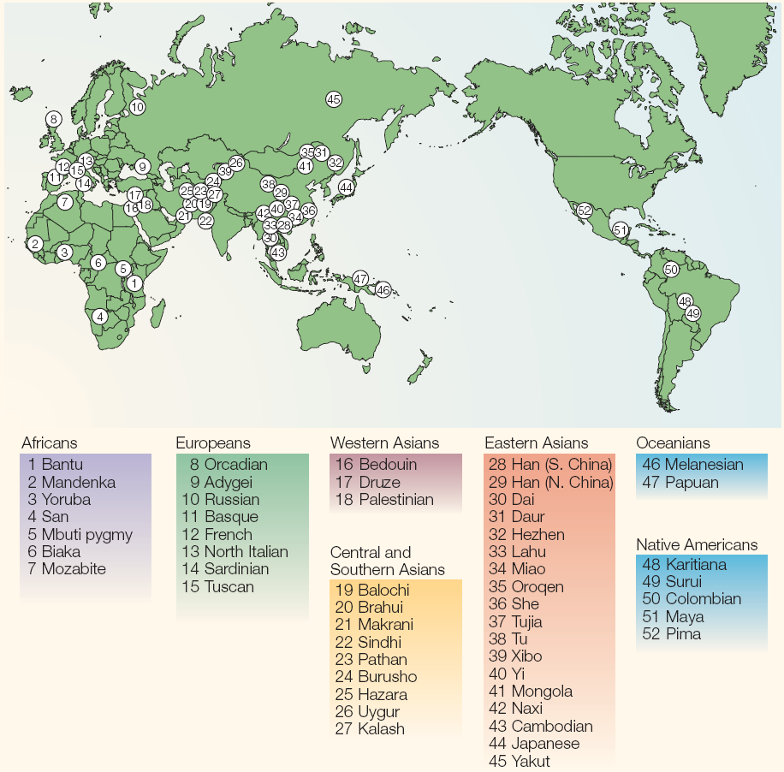
HGDP data
1,033 samples
7 geographic regions
52 populations
The Human Genome Diversity Panel (HGDP)
Cavalli-Sforza (2005) Nat Genet Rev
Rosenberg et al. (2002) Science
Li et al. (2008) Science

Slide 12
CEU
HGDP data
1,033 samples
7 geographic regions
52 populations
TSI
JPT, CHB, & CHD
HapMap Phase 3 data
1,207 samples
11 populations
MEX
GIH
ASW, MKK, LWK, & YRI
HapMap Phase 3
The Human Genome Diversity Panel (HGDP)
Cavalli-Sforza (2005) Nat Genet Rev
Rosenberg et al. (2002) Science
Li et al. (2008) Science
The International HapMap Consortium (2003, 2005, 2007) Nature

Slide 13
CEU
HGDP data
1,033 samples
7 geographic regions
52 populations
TSI
JPT, CHB, & CHD
HapMap Phase 3 data
1,207 samples
11 populations
MEX
GIH
ASW, MKK, LWK, & YRI
HapMap Phase 3
We will apply SVD/PCA on the (joint) HGDP and HapMap Phase 3 data.
Matrix dimensions:
2,240 subjects (rows)
447,143 SNPs (columns)
Dense matrix:
over one billion entries
The Human Genome Diversity Panel (HGDP)
Cavalli-Sforza (2005) Nat Genet Rev
Rosenberg et al. (2002) Science
Li et al. (2008) Science
The International HapMap Consortium (2003, 2005, 2007) Nature

Slide 14
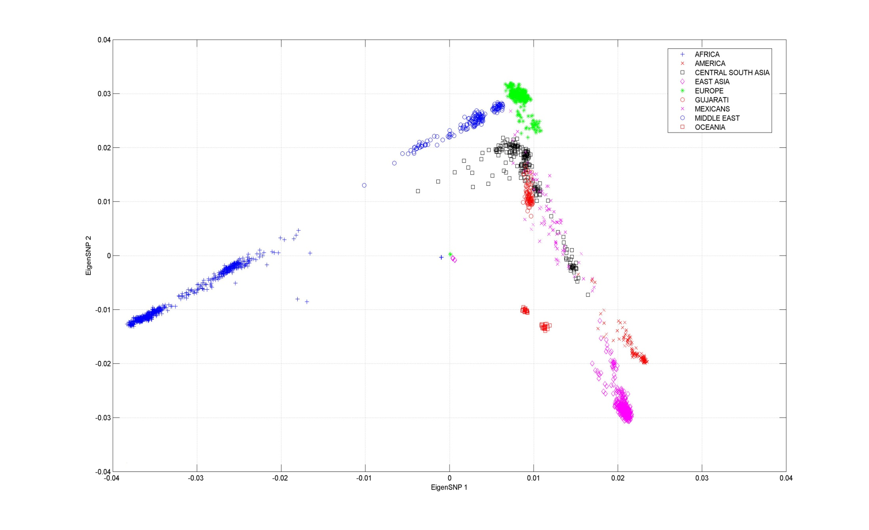
Paschou, Lewis, Javed, & Drineas (2010) J Med Genet
Europe
Middle East
Gujarati Indians
South Central Asia
Mexicans
Africa
Oceania
America
East Asia
Top two Principal Components (PCs or eigenSNPs)
(Lin and Altman (2005) Am J Hum Genet)
The figure renders visual support to the “out-of-Africa” hypothesis.
Mexican population seems out of place: we move to the top three PCs.

Slide 15
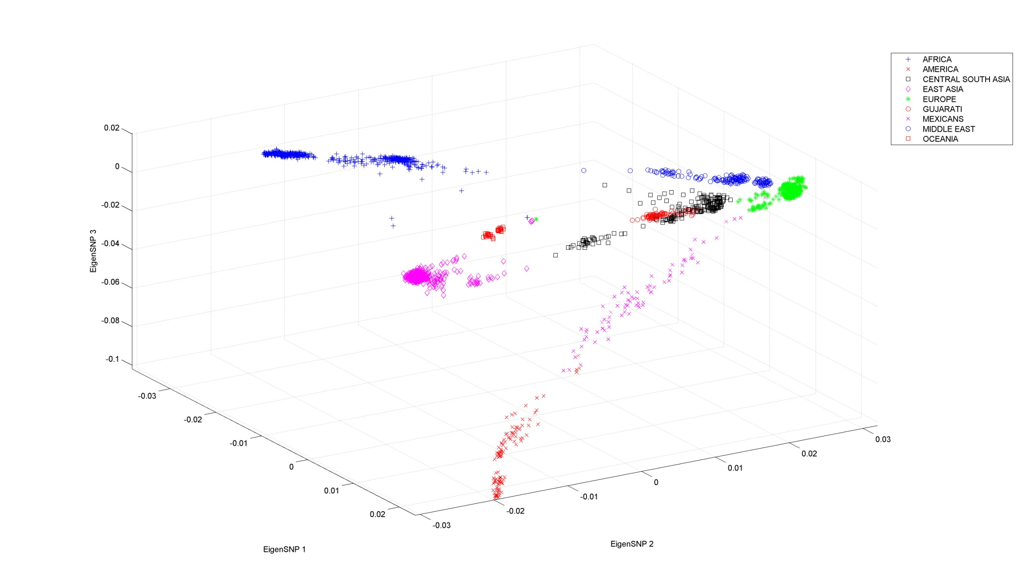
Paschou, Lewis, Javed, & Drineas (2010) J Med Genet
Africa
Middle East
S C Asia & Gujarati
Oceania
Europe
East Asia
Mexicans
America
Not altogether satisfactory: the principal components are linear combinations of all SNPs, and – of course – can not be assayed!
Can we find actual SNPs that capture the information in the singular vectors?
Formally: spanning the same subspace.

Slide 16
Issues
Computing large SVDs: computational time
  In commodity hardware (e.g., a 4GB RAM, dual-core laptop), using MatLab 7.0 (R14), the computation of the SVD of the dense 2,240-by-447,143 matrix A takes about 12 minutes.
  Computing this SVD is not a one-liner, since we can not load the whole matrix in RAM (runs out-of-memory in MatLab).
  We compute the eigendecomposition of AA^{T}.
  In a similar experiment, we had to compute the SVD of a 14,267-by-14,267 matrix to analyze mitochondrial DNA from 14,267 samples from approx. 120 populations in order to infer the relatedness of the Ancient Minoans to Modern European, Northern African, and Middle Eastern populations.
  (Hughey, Paschou, Drineas, et. al. (2013) Nature Communications)
Obviously, running time is a concern.
Machine-precision accuracy is NOT necessary!
  Data are noisy.
  Approximate singular vectors work well in our settings.

Slide 17
Issues (cont’d)
Selecting good columns that “capture the structure” of the top PCs
  Combinatorial optimization problem; hard even for small matrices.
  Often called the Column Subset Selection Problem (CSSP).
  Not clear that such columns even exist.
  The two issues:
  Fast approximation to the top k singular vectors of a matrix, and
  Selecting columns that capture the structure of the top k singular vectors
  are connected and can be tackled using the same framework.

Slide 18
SVD decomposes a matrix as…
The SVD has strong optimality properties.
Top k left singular vectors
It is easy to see that X = U_{k}^{T}A.
SVD has strong optimality properties.
The columns of U_{k} are linear combinations of up to all columns of A.

Slide 19

The CX decomposition
Mahoney & Drineas (2009) PNAS
Carefully chosen X
Goal: make (some norm) of A-CX small.
c columns of A, with c being as close to k as possible
Why?
If A is an subject-SNP matrix, then selecting representative columns is equivalent to selecting representative SNPs to capture the same structure as the top eigenSNPs.
We want c as small as possible!

Slide 20
CX decomposition
c columns of A, with c being as close to k as possible
Easy to prove that optimal X = C⁺A.
(with respect to unitarily invariant norms; C⁺ is the Moore-Penrose pseudoinverse of C).
Thus, the challenging part is to find good columns (SNPs) of A to include in C.
From a mathematical perspective, this is a combinatorial optimization problem, closely related to the so-called Column Subset Selection Problem (CSSP); the CSSP has been heavily studied in Numerical Linear Algebra.

Slide 21

Our objective for the CX decomposition
We would like to get theorems of the following form:
Given an m-by-n matrix A, there exists an efficient algorithm that picks a small number of columns of A such that with reasonable probability:

Slide 22
Our objective for the CX decomposition
We would like to get theorems of the following form:
Given an m-by-n matrix A, there exists an efficient algorithm that picks a small number of columns of A such that with reasonable probability:
Best rank-k approximation to A:
A_{k} = U_{k}U_{k}^{T}A

Slide 23
Our objective for the CX decomposition
We would like to get theorems of the following form:
Given an m-by-n matrix A, there exists an efficient algorithm that picks a small number of columns of A such that with reasonable probability:
low-degree polynomial in m, n, and k
Close to k/ε
constant, high, almost surely, etc.

Slide 24
Roadmap of the tutorial
Focus: sketching matrices (i) by sampling rows/columns and (ii) via “random projections.”
Machinery: (i) Approximating matrix multiplication, and (ii) decoupling “randomization” from “matrix perturbation.”
Overview of the tutorial:
(i) Motivation: computational efficiency, interpretability
(ii) Approximating matrix multiplication
(iii) From matrix multiplication to CX/CUR factorizations and approximate SVD
(iv) Improvements and recent progress
(v) Algorithmic approaches to least-squares problems
(vi) Statistical perspectives on least-squares algorithms
(vii) Theory and practice of: extending these ideas to kernels and SPSD matrices
(viii) Theory and practice of: implementing these ideas in large-scale settings

Slide 25
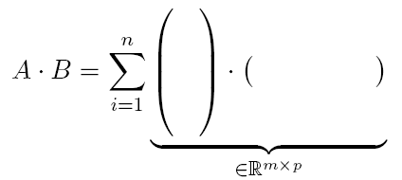
Approximating Matrix Multiplication
Problem Statement
Given an m-by-n matrix A and an n-by-p matrix B, approximate the product A·B,
OR, equivalently,
Approximate the sum of n rank-one matrices.
A^{(i)}
B_{(i)}
Each term in the summation is a rank-one matrix
i-th row of B
i-th column of A

Slide 26
A sampling approach
A^{(i)}
B_{(i)}
i-th row of B
i-th column of A
Algorithm
Fix a set of probabilities p_{i}, i =1…n, summing up to 1.
For t = 1…c,
  set j_{t} = i, where P(j_{t} = i ) = p_{i} .
(Pick c terms of the sum, with replacement, with respect to the p_{i}.)
Approximate the product AB by summing the c terms, after scaling.

Slide 27
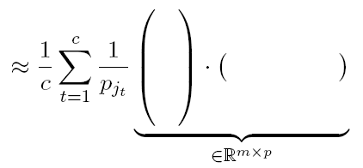
Sampling (cont’d)
A^{(i)}
B_{(i)}
i-th row of B
i-th column of A
A^{(j}t⁾
B^{(j}t⁾
Keeping the terms j₁, j₂, … j_{c}.

Slide 28
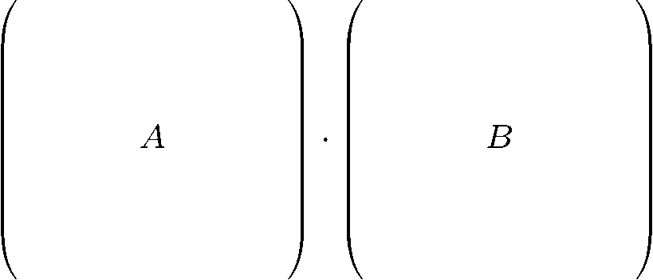
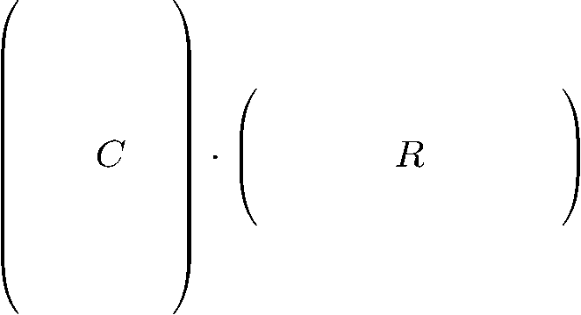


The algorithm (matrix notation)
Algorithm
Pick c columns of A to form an m-by-c matrix C and the corresponding c rows of B to form a c-by-p matrix R.
Approximate A · B by C · R.
Notes
We pick the columns and rows with non-uniform probabilities.
We scale the columns (rows) prior to including them in C (R).

Slide 29

The algorithm (matrix notation, cont’d)
Create C and R by performing c i.i.d. trials, with replacement.
For t = 1…c, pick a column A^{(j}t⁾ and a row B_{(jt)} with probability
Include A^{(j}t⁾/(cp_{jt})^{1/2} as a column of C, and B_{(jt)}/(sp_{jt})^{1/2} as a row of R.

Slide 30


The algorithm (matrix notation, cont’d)
We can also use the sampling matrix notation:
Let S be an n-by-c matrix whose t-th column (for t = 1…c) has a single non-zero entry, namely
Clearly:
Note: S is sparse (has exactly c non-zero elements, one per column).

Slide 31
Simple Lemmas
It is easy to implement this particular sampling in two passes.
The expectation of CR (element-wise) is AB (unbiased estimator), regardless of the sampling probabilities.
Our particular choice of sampling probabilities minimizes the variance of the estimator (w.r.t. the Frobenius norm of the error AB-CR).

Slide 32

A bound for the Frobenius norm
For the above algorithm,
This is easy to prove (elementary manipulations of expectation).
Measure concentration follows from a martingale argument.
The above bound also implies an upper bound for the spectral norm of the error AB-CR.

Slide 33
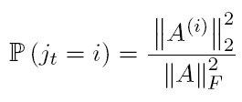

Special case: B = A^{T}
If B = A^{T}, then the sampling probabilities are
Also, R = C^{T}, and the error bounds are:

Slide 34


Special case: B = A^{T} (cont’d)
(Drineas et al. Num Math 2011, Theorem 4)
A better spectral norm bound via matrix Chernoff/Bernstein inequalities:
Assumptions:
Spectral norm of A is one (not important, just normalization)
Frobenius norm of A is at least 0.2 (not important, simplifies bounds).
Important: Set
Then: for any 0 < ε < 1, with probability at least 1 - δ,
A stronger result for the spectral norm is proven by M. Rudelson and R. Vershynin (JACM ’07).
Assume (for normalization) that ||A||₂ = 1. If

Slide 35
Special case: B = A^{T} (cont’d)
Notes:
The constants hidden in the big-Omega notation are small.
The proof is simple: an immediate application of an inequality derived by Oliveira (2010) for sums of random Hermitian matrices.
Similar results were first proven by Rudelson & Vershynin (2007) JACM, but the proofs were much more complicated.
We need a sufficiently large value of c, otherwise the theorem does not work.

Slide 36
Special case: B = A^{T} (cont’d)
Notes:
The constants hidden in the big-Omega notation are small.
The proof is simple: an immediate application of an inequality derived by Oliveira (2010) for sums of random Hermitian matrices.
Similar results were first proven by Rudelson & Vershynin (2007) JACM, but the proofs were much more complicated.
We need a sufficiently large value of c, otherwise the theorem does not work.
Open problems:
Non-trivial upper bounds for other unitarily invariant norms.
E.g., Schatten p-norms for other values of p. Especially for p = 1 (trace norm).
Upper bounds for non-unitarily invariant norms that might be useful in practice.

Slide 37

Using a dense S (instead of a sampling matrix…)
We approximated the product AB as follows:
Recall that S is an n-by-c sparse matrix (one non-zero entry per column).
Let’s replace S by a dense matrix, the random sign matrix:

Slide 38


Using a dense S (instead of a sampling matrix…)
We approximated the product AB as follows:
Recall that S is an n-by-c sparse matrix (one non-zero entry per column).
Let’s replace S by a dense matrix, the random sign matrix:
st(A): stable rank of A
If
then, with high probability (see Theorem 3.1 in Magen & Zouzias SODA 2012)

Slide 39

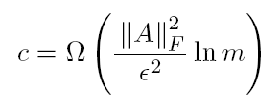
Using a dense S (instead of a sampling matrix…)
(and focusing on B = A^{T}, normalized)
Approximate the product AA^{T} (assuming that the spectral norm of A is one):
Let S by a dense matrix, the random sign matrix:
If
then, with high probability:

Slide 40
Using a dense S (instead of a sampling matrix…)
(and focusing on B = A^{T}, normalized)
Approximate the product AA^{T} (assuming that the spectral norm of A is one):
Let S by a dense matrix, the random sign matrix:
Similar structure with the sparse S case; some differences in the ln factor
If
then, with high probability:

Slide 41
Using a dense S (cont’d)
Comments:
This matrix multiplication approximation is oblivious to the input matrices A and B.
Reminiscent of random projections and the Johnson-Lindenstrauss (JL) transform.
Bounds for the Frobenius norm are easier to prove and are very similar to the case where S is just a sampling matrix.
We need a sufficiently large value for c, otherwise the (spectral norm) theorem does not hold.
It holds for arbitrary A and B (not just B = A^{T}); the sampling-based approach should also be generalizable to arbitrary A and B.

Slide 42
Using a dense S (cont’d)
Other choices for dense matrices S?
Why bother with a sign matrix?
(Computing the product AS and S^{T}B is somewhat slow, taking O(mnc) and O(pnc) time.)
Similar bounds are known for better, i.e., computationally more efficient, choices of “random projection” matrices S, most notably:
When S is the so-called subsampled Hadamard Transform Matrix.
(much faster; avoids full matrix-matrix multiplication; see Sarlos FOCS 2006 and Drineas et al. (2011) Num Math)
When S is the ultra-sparse projection matrix of Clarkson & Woodruff STOC 2013.
(the matrix multiplication result appears in Mahoney & Meng STOC 2013).

Slide 43
Recap: approximating matrix multiplication
We approximated the product AB as follows:
Let S be a sampling matrix (actual columns from A and rows from B are selected):
We need to carefully sample columns of A (rows of B) with probabilities that depend on their norms in order to get “good” bounds of the following form:
Holds with probability at least 1-δ by setting

Slide 44
Recap: approximating matrix multiplication
Alternatively, we approximated the product AB as follows:
Now S is a random projection matrix (linear combinations of columns of A and rows of B are formed).
Oblivious to the actual input matrices A and B !
Holds with high probability by setting
(for the random sign matrix)

Slide 45
Roadmap of the tutorial
Focus: sketching matrices (i) by sampling rows/columns and (ii) via “random projections.”
Machinery: (i) Approximating matrix multiplication, and (ii) decoupling “randomization” from “matrix perturbation.”
Overview of the tutorial:
(i) Motivation: computational efficiency, interpretability
(ii) Approximating matrix multiplication
(iii) From matrix multiplication to CX/CUR factorizations and approximate SVD
(iv) Improvements and recent progress
(v) Algorithmic approaches to least-squares problems
(vi) Statistical perspectives on least-squares algorithms
(vii) Theory and practice of: extending these ideas to kernels and SPSD matrices
(viii) Theory and practice of: implementing these ideas in large-scale settings

Slide 46
Back to the CX decomposition
Recall: we would like to get theorems of the following form:
Given an m-by-n matrix A, there exists an efficient algorithm that picks a small number of columns of A such that with reasonable probability:
Let’s start with a simpler, weaker result, connecting the spectral norm of A-CX to matrix multiplication.
(A similar result can be derived for the Frobenius norm, but takes more effort to prove; see Drineas, Kannan, & Mahoney (2006) SICOMP)
low-degree polynomial in m, n, and k
Close to k/ε
constant, high, almost surely, etc.

Slide 47
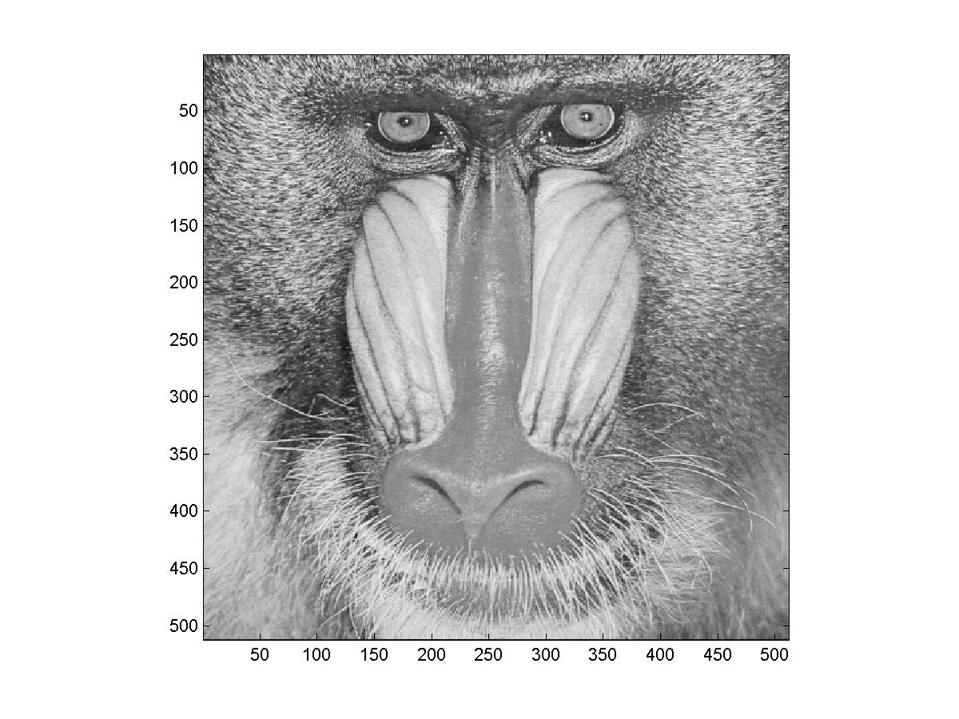
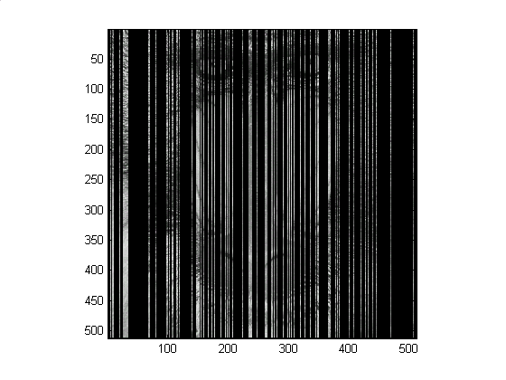
Approximating singular vectors
Title:
C:\Petros\Image Processing\baboondet.eps
Creator:
MATLAB, The Mathworks, Inc.
Preview:
This EPS picture was not saved
with a preview included in it.
Comment:
This EPS picture will print to a
PostScript printer, but not to
other types of printers.
Original matrix
Sampling (c = 140 columns)
Sample c (=140) columns of the original matrix A and rescale them appropriately to form a 512-by-c matrix C.
Show that A-CX is “small”.
(C⁺ is the pseudoinverse of C and X= C⁺A)

Slide 48
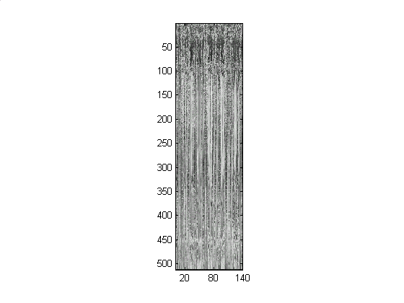
Approximating singular vectors
Title:
C:\Petros\Image Processing\baboondet.eps
Creator:
MATLAB, The Mathworks, Inc.
Preview:
This EPS picture was not saved
with a preview included in it.
Comment:
This EPS picture will print to a
PostScript printer, but not to
other types of printers.
Original matrix
Sampling (c = 140 columns)
Sample c (=140) columns of the original matrix A and rescale them appropriately to form a 512-by-c matrix C.
Show that A-CX is “small”.
(C⁺ is the pseudoinverse of C and X= C⁺A)

Slide 49

Approximating singular vectors (cont’d )
Title:
C:\Petros\Image Processing\baboondet.eps
Creator:
MATLAB, The Mathworks, Inc.
Preview:
This EPS picture was not saved
with a preview included in it.
Comment:
This EPS picture will print to a
PostScript printer, but not to
other types of printers.
A
CX
The fact that AA^{T} – CC^{T} is small will imply that A-CX is small as well.

Slide 50
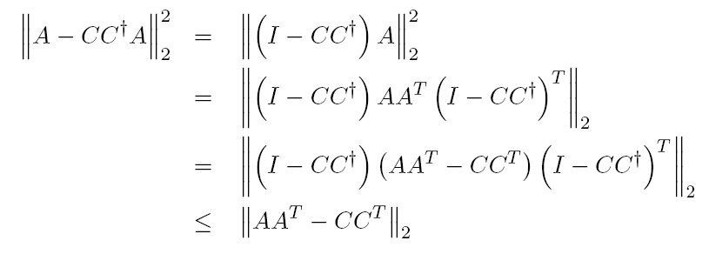
Proof (spectral norm)
Using the triangle inequality and properties of norms,
projector matrices
We used the fact that (I-CC⁺)CC^{T} is equal to zero.

Slide 51
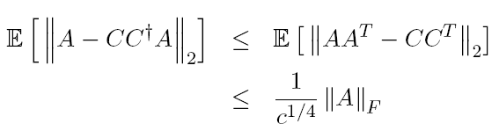
Proof (spectral norm), cont’d
Assume that our sampling is done in c i.i.d. trials and the sampling probabilities are:
We can use our matrix multiplication result:
(We will upper bound the spectral norm by the Frobenius norm to avoid concerns about c, namely whether c exceeds the threshold necessitated by the theory.)

Slide 52
Is this a good bound?
Problem 1: If c = n we do not get zero error.
That’s because of sampling with replacement.
(We know how to analyze uniform sampling without replacement, but we have no bounds on non-uniform sampling without replacement.)
Problem 2: If A had rank exactly k, we would like a column selection procedure that drives the error down to zero when c = k.
This can be done deterministically simply by selecting k linearly independent columns.
Problem 3: If A had numerical rank k, we would like a bound that depends on the norm of A-A_{k} and not on the norm of A.
Such deterministic bounds exist when c = k and depend on (k (n – k ))^{1/2} ||A-A_{k}||₂

Slide 53
Relative-error Frobenius norm bounds
Given an m-by-n matrix A, there exists an O(mn²) algorithm that picks
O((k /ε ²) ln (k /ε ²)) columns of A
such that with probability at least 0.9

Slide 54
The algorithm
Input: m-by-n matrix A,
0 < ε < .5, the desired accuracy
Output: C, the matrix consisting of the selected columns
Sampling algorithm
Compute probabilities p_{j} summing to 1
Let c = O((k /ε ²) ln (k /ε ²) ).
In c i.i.d. trials pick columns of A, where in each trial the j-th column of A is picked with probability p_{j}.
Let C be the matrix consisting of the chosen columns.

Slide 55
The algorithm
Input: m-by-n matrix A,
0 < ε < .5, the desired accuracy
Output: C, the matrix consisting of the selected columns
Sampling algorithm
Compute probabilities p_{j} summing to 1
Let c = O((k /ε ²) ln (k /ε ²) ).
In c i.i.d. trials pick columns of A, where in each trial the j-th column of A is picked with probability p_{j}.
Let C be the matrix consisting of the chosen columns.
Note: there is no rescaling of the columns of C in this algorithm; however, since our error matrix is A-CX = A-CC⁺A, rescaling the columns of C (as we did in our matrix multiplication algorithms), does not change A-CX = A-CC⁺A.

Slide 56
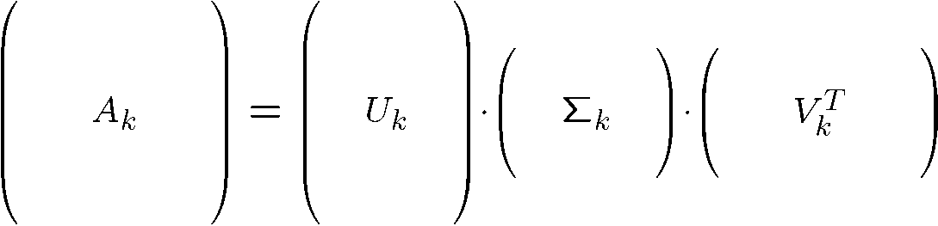



Subspace sampling (Frobenius norm)
V_{k}: orthogonal matrix containing the top k right singular vectors of A.
Σ _{k}: diagonal matrix containing the top k singular values of A.
Remark: The rows of V_{k}^{T} are orthonormal vectors, but its columns (V_{k}^{T})^{(i)} are not.

Slide 57
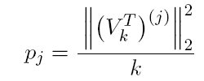
Subspace sampling (Frobenius norm)
V_{k}: orthogonal matrix containing the top k right singular vectors of A.
Σ _{k}: diagonal matrix containing the top k singular values of A.
Remark: The rows of V_{k}^{T} are orthonormal vectors, but its columns (V_{k}^{T})^{(i)} are not.
Subspace sampling in O(mn²) time
Normalization s.t. the p_{j} sum up to 1

Slide 58
Subspace sampling (Frobenius norm)
V_{k}: orthogonal matrix containing the top k right singular vectors of A.
Σ _{k}: diagonal matrix containing the top k singular values of A.
Remark: The rows of V_{k}^{T} are orthonormal vectors, but its columns (V_{k}^{T})^{(i)} are not.
Subspace sampling in O(mn²) time
Leverage scores
(many references in the statistics community)
Normalization s.t. the p_{j} sum up to 1

Slide 59
Towards a relative error bound…
Structural result (deterministic):
This holds for any n-by-c matrix S such that C = AS as long as the k-by-c matrix V_{k}^{T}S has full rank (equal to k ).

Slide 60
Towards a relative error bound…
Structural result (deterministic):
This holds for any n-by-c matrix S such that C = AS as long as the k-by-c matrix V_{k}^{T}S has full rank (equal to k ).
The proof of the structural result critically uses the fact that with X = C⁺A is the argmin for any unitarily invariant norm of the error A-CX.
Variants of this structural result have appeared in various papers.
( e.g., (i) Drineas, Mahoney, Muthukrishnan (2008) SIMAX, (ii) Boutsidis, Drineas, Mahoney SODA 2011, (iii) Halko, Martinsson, Tropp (2011) SIREV, (iv) Boutsidis, Drineas, Magdon-Ismail FOCS 2011, etc.)

Slide 61

The rank of V_{k}^{T}S
Structural result (deterministic):
This holds for any n-by-c matrix S such that C = AS as long as the k-by-c matrix V_{k}^{T}S has full rank (equal to k ).
Let S be a sampling and rescaling matrix, where the sampling probabilities are the leverage scores: our matrix multiplication results (and the fact that the square of the Frobenius norm of V_{k} if equal to k) guarantee that, for our choice of c (with constant probability):

Slide 62

The rank of V_{k}^{T}S (cont’d)
From matrix perturbation theory, if
it follows that all singular values (σ_{i} ) of V_{k}^{T}S satisfy:
By choosing ε small enough, we can guarantee that V_{k}^{T}S has full rank (with constant probability).

Slide 63
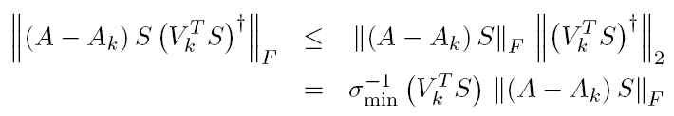
Bounding the second term
Structural result (deterministic):
This holds for any n-by-c matrix S such that C = AS as long as the k-by-c matrix V_{k}^{T}S has full rank (equal to k ).
Using strong submultiplicativity for the second term:

Slide 64

Bounding the second term (cont’d)
To conclude:
(i) We already have a bound for all singular values of V_{k}^{T}S (go back two slides).
(ii) It is easy to prove that, using our sampling and rescaling,
Collecting, we get a (2+ε) constant-factor approximation.

Slide 65
Bounding the second term (cont’d)
To conclude:
(i) We already have a bound for all singular values of V_{k}^{T}S (go back two slides).
(ii) It is easy to prove that, using our sampling and rescaling,
Collecting, we get a (2+ε) constant-factor approximation.
A more careful (albeit, longer) analysis can improve the result to a (1+ε) relative-error approximation.

Slide 66
Using a dense matrix S
Our proof would also work if instead of the sampling matrix S, we used, for example, the dense random sign matrix S:
The intuition is clear: the most critical part of the proof is based on approximate matrix multiplication to bound the singular values of V_{k}^{T}S.
This also works when S is a dense matrix.

Slide 67
Using a dense matrix S
Notes:
Negative: C=AS does not consist of columns of A (interpretability is lost).
Positive: It can be shown that the span of C=AS contains “relative-error” approximations to the top k left singular vectors of A, which can be computed in O(nc²) time.
Thus, we can compute approximations to the top k left singular vectors of A in O(mnc+nc²) time, already faster than the naïve O(min{mn²,m²n}) time of the full SVD.

Slide 68
Using a dense matrix S
Notes:
Negative: C=AS does not consist of columns of A (interpretability is lost).
Positive: It can be shown that the span of C=AS contains “relative-error” approximations to the top k left singular vectors of A, which can be computed in O(nc²) time.
Thus, we can compute approximations to the top k left singular vectors of A in O(mnc+nc²) time, already faster than the naïve O(min{mn²,m²n}) time of the full SVD.
Even better: Using very fast random projections (the Fast Hadamard Transform, or the Clarkson-Woodruff sparse projection), we can reduce the (first term of the) running time further to
O(mn polylog(n)).
Implementations are simple and work very well in practice!

Slide 69
Roadmap of the tutorial
Focus: sketching matrices (i) by sampling rows/columns and (ii) via “random projections.”
Machinery: (i) Approximating matrix multiplication, and (ii) decoupling “randomization” from “matrix perturbation.”
Overview of the tutorial:
(i) Motivation: computational efficiency, interpretability
(ii) Approximating matrix multiplication
(iii) From matrix multiplication to CX/CUR factorizations and approximate SVD
(iv) Improvements and recent progress
(v) Algorithmic approaches to least-squares problems
(vi) Statistical perspectives on least-squares algorithms
(vii) Theory and practice of: extending these ideas to kernels and SPSD matrices
(viii) Theory and practice of: implementing these ideas in large-scale settings

Slide 70

Selecting fewer columns
Problem
How many columns do we need to include in the matrix C in order to get relative-error approximations ?
Recall: with O( (k/ε²) log (k/ε ²) ) columns, we get (subject to a failure probability)
Deshpande & Rademacher (FOCS ’10): with exactly k columns, we get
What about the range between k and O( k logk )?

Slide 71
Selecting fewer columns (cont’d)
(Boutsidis, Drineas, & Magdon-Ismail, FOCS 2011)
Question:
What about the range between k and O( k logk )?
Answer:
A relative-error bound is possible by selecting c=3k/ε columns!
Technical breakthrough;
A combination of sampling strategies with a novel approach on column selection, inspired by the work of Batson, Spielman, & Srivastava (STOC ’09) on graph sparsifiers.
  The running time is O((mnk+nk³)ε⁻¹).
  Simplicity is gone…

Slide 72
Towards such a result
First, let the top-k right singular vectors of A be V_{k}.
A structural result (deterministic):
Again, this holds for any n-by-c matrix S assuming that the matrix V_{k}^{T}S has full rank (equal to k )

Slide 73


Towards such a result (cont’d)
First, let the top-k right singular vectors of A be V_{k}.
A structural result (deterministic):
Again, this holds for any n-by-c matrix S assuming that the matrix V_{k}^{T}S has full rank (equal to k )
We would like to get a sampling and rescaling matrix S such that, simultaneously,
and
(for some small, fixed constant c₀; actually c₀ = 1 in our final result).
Setting c = O(k/ε) , we get a (2+ε) constant factor approximation (for c₀ = 1).

Slide 74
Towards such a result (cont’d)
We would like to get a sampling and rescaling matrix S such that, simultaneously,
and
(for some small, fixed constant c₀).
Lamppost: the work of Batson, Spielman, & Srivastava STOC 2009 (graph sparsification)
[We had to generalize their work to use a new barrier function which controls the Frobenius and spectral norm of two matrices simultaneously. We then used a second phase to reduce the (2+ε) approximation to (1+ε).]
We will omit these details, and instead state the Batson, Spielman, & Srivastava STOC 2009 result as approximate matrix multiplication.

Slide 75

The Batson-Spielman-Srivastava result
Let V_{k} be an n-by-k matrix such that V_{k}^{T}V_{k} = I_{k}, with k < n, and let c be a sampling parameter (with c > k).
There exists a deterministic algorithm which runs in O(cnk³) time and constructs an n-by-c sampling and rescaling matrix S such that

Slide 76
The Batson-Spielman-Srivastava result
Let V_{k} be an n-by-k matrix such that V_{k}^{T}V_{k} = I_{k}, with k < n, and let c be a sampling parameter (with c > k).
There exists a deterministic algorithm which runs in O(cnk³) time and constructs an n-by-c sampling and rescaling matrix S such that
It is essentially a matrix multiplication result!
Expensive to compute, but very accurate and deterministic.
Works for small values of the sampling parameter c.
The rescaling in S is critical and non-trivial.
The algorithm is basically an iterative, greedy approach that uses two barrier functions to guarantee that the singular values of V_{k}^{T}S stay within boundaries.

Slide 77
Lower bounds and alternative approaches
Deshpande & Vempala, RANDOM 2006
A relative-error approximation necessitates at least k/ε columns.
Guruswami & Sinop, SODA 2012
Alternative approaches, based on volume sampling, guarantee
(r+1)/(r+1-k) relative error bounds.
This bound is asymptotically optimal (up to lower order terms).
The proposed deterministic algorithm runs in O(rnm³ log m) time, while the randomized algorithm runs in O(rnm²) time and achieves the bound in expectation.
Guruswami & Sinop, FOCS 2011
Applications of column-based reconstruction in Quadratic Integer Programming.

Slide 78
Selecting rows/columns
Selecting columns/rows from a matrix
  Additive error low-rank matrix approximation
  Frieze, Kannan, Vempala FOCS 1998, JACM 2004
  Drineas, Frieze, Kannan, Vempala, Vinay SODA 1999, JMLR 2004.
  Relative-error low-rank matrix approximation and least-squares problems
  Via leverage scores (Drineas, Mahoney, Muthukrishnan SODA 2006, SIMAX 2008)
  Via volume sampling (Deshpande, Rademacher, Vempala, Wang SODA 2006)
  Efficient algorithms with relative-error guarantees (theory)
  Random Projections and the Fast Johnson-Lindenstrauss Transform
  Sarlos FOCS 2006, Drineas, Mahoney, Muthukrishnan, & Sarlos NumMath 2011
  Efficient algorithms with relative-error guarantees (numerical implementations)
  Solving over- and under-constrained least-squares problems 4x faster than current state-of-the-art.
  Amazon EC2-type implementations with M. W. Mahoney, X. Meng, K. Clarkson, D. Woodruff, et al.
  Tygert & Rokhlin PNAS 2007, Avron, Maymounkov,Toledo SISC 2010, Meng, Saunders, Mahoney ArXiv 2011
  Optimal relative-error guarantees with matching lower bounds
  Relative-error accuracy with asymptotically optimal guarantees on the number of sampled columns. (Boutsidis, Drineas, Magdon-Ismail FOCS 2011, Guruswami and Sinop SODA 2012)

Slide 79

Not covered in this tutorial:
Element-wise sampling
Element-wise sampling: Can entry-wise sampling be as accurate as column-sampling?
Prior work: additive-error guarantees.
  To approximate a matrix A, keep a few elements of the matrix (instead of rows or columns) and zero out the remaining elements:
  Compute a low-rank approximation to the sparse matrix Ã using iterative methods.
(Achlioptas & McSherry STOC 2001, JACM 2007; Drineas & Zouzias IPL 2011; Nguyen & Drineas ArXiv 2011)
  Exact reconstruction possible using uniform sampling for matrices that satisfy certain (strong) assumptions: A must be rank exactly k, A must have uniform leverage scores (low coherence).
  (Candes & Recht 2008, Candes & Tao 2009, Recht 2009, Negahban & Wainwright 2010)
  Exact reconstruction needs Trace Minimization (the convex relaxation of Rank Minimization); some generalizations in the presence of well-behaved noise exist.

Slide 80
Element-wise sampling (cont’d)
Goals:
Identify an entry-wise probability distribution (element-wise leverage scores) that achieves relative-error accuracies for approximating singular values and singular vectors, reconstructing the matrix, identifying influential entries in a matrix, solving least-squares problems, etc.
Compute this probability distribution efficiently.
Reconstruct the matrix in O(mn polylog(m,n)) time instead of using trace minimization methods.
Prove matching lower bounds and provide high quality numerical implementations.

Slide 81

Not covered in this tutorial:
Solving systems of linear equations
Solving systems of linear equations: given an m-by-n matrix A and an m - vector b, compute:
Prior work: relative-error guarantees for m >> n or m << n and dense matrices A.
  Running time: O( mn polylog(n ))
  (Drineas, Mahoney, Muthukrishnan, Sarlos NumMath 2011; improved by Boutsidis & Gittens ArXiv 2012)
  Main tool: random projections via the Fast Hadamard Transform
  Numerical implementations: Blendenpik (Avron, Maymounkov, Toledo SISC 2010)
  Still open: sparse input matrices, some recent progress
  (Mahoney & Meng, Clarkson & Woodruff STOC 2013)
Prior work: relative-error guarantees for m = n and A Laplacian or SDD (symmetric diagonally dominant).
  Running time: O(nnz(A) log(n)) , almost optimal bounds.
  (Spielman,Teng & collaborators, many papers over the past 8 years, Koutis, Miller, Peng FOCS 2010 & FOCS 2011)
  Main tool: Sparsify the input graph (Laplacian matrix) by sampling a subset of its edges with respect to a probability distribution called “effective resistances.” Form (recursively) a preconditioning chain use Chebyschev’s preconditioner.
  Graph Sparsification Step: Koutis et al. approximated effective resistances via low-stretch spanning trees; Drineas & Mahoney Arxiv 2010 connected effective resistances to leverage scores.

Slide 82
Solving systems of linear equations (cont’d)
Fact: in prior work graphs are fundamental: effective resistances, low-stretch spanning trees, etc.
Goals:
Move current state-of-the-art beyond Laplacians and SDD matrices to – say – SPD (positive semidefinite) matrices.
  Paradigm shift: deterministic accuracy guarantees with a randomized running time, as opposed to probabilistic accuracy with deterministic running times.
  If ε is the target relative error, the running time should depend on poly(log(1/ε)) instead of poly(1/ε).
  In Theoretical Computer Science, most algorithms achieve the latter guarantee.
  In Numerical Linear Algebra the former dependency is always the objective.

Slide 83
Conclusions
Randomization and sampling can be used to solve problems that are massive and/or computationally expensive.
By (carefully) sampling rows/columns of a matrix, we can construct new sparse/smaller matrices that behave like the original matrix.
By preprocessing the matrix using random projections, we can sample rows/ columns (of the preprocessed matrix) uniformly at random and still get nice “behavior”.

