Slide 1
State space model/approach.
Deals with many situations:
missing values
fitting ARIMAs by mle
irregularly spaced data
aggregation/disagregation
measurement error
outliers
structural breaks
prediction, smoothing
nonlinearity
discrete/continuous time
explanatories
seasonals
time changing
non Gaussianity
Proceeds via recurrsions
Books: Shumway and Stoffer, Harvey

Slide 3
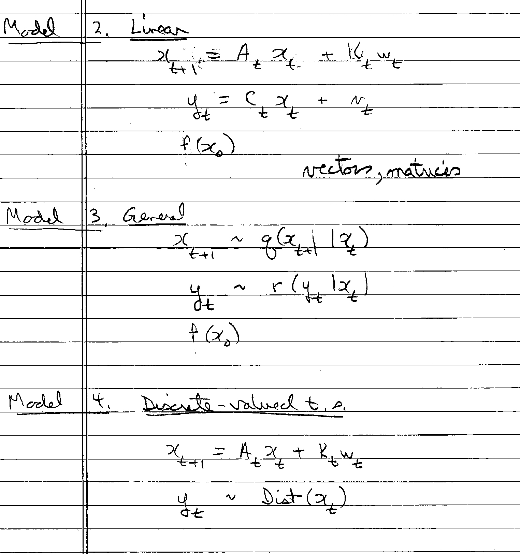

Slide 4
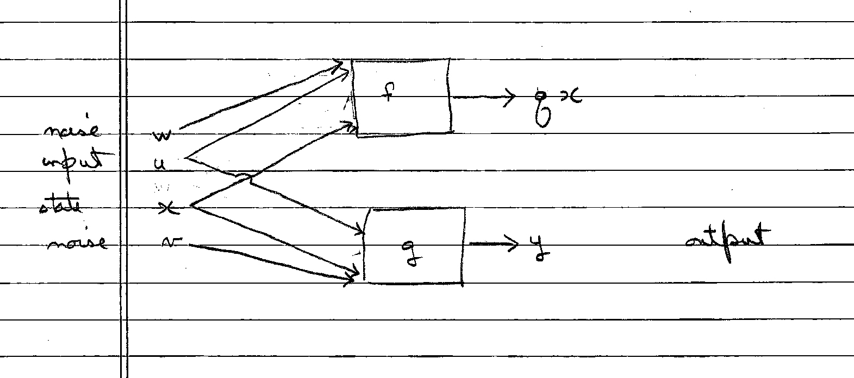

Slide 5
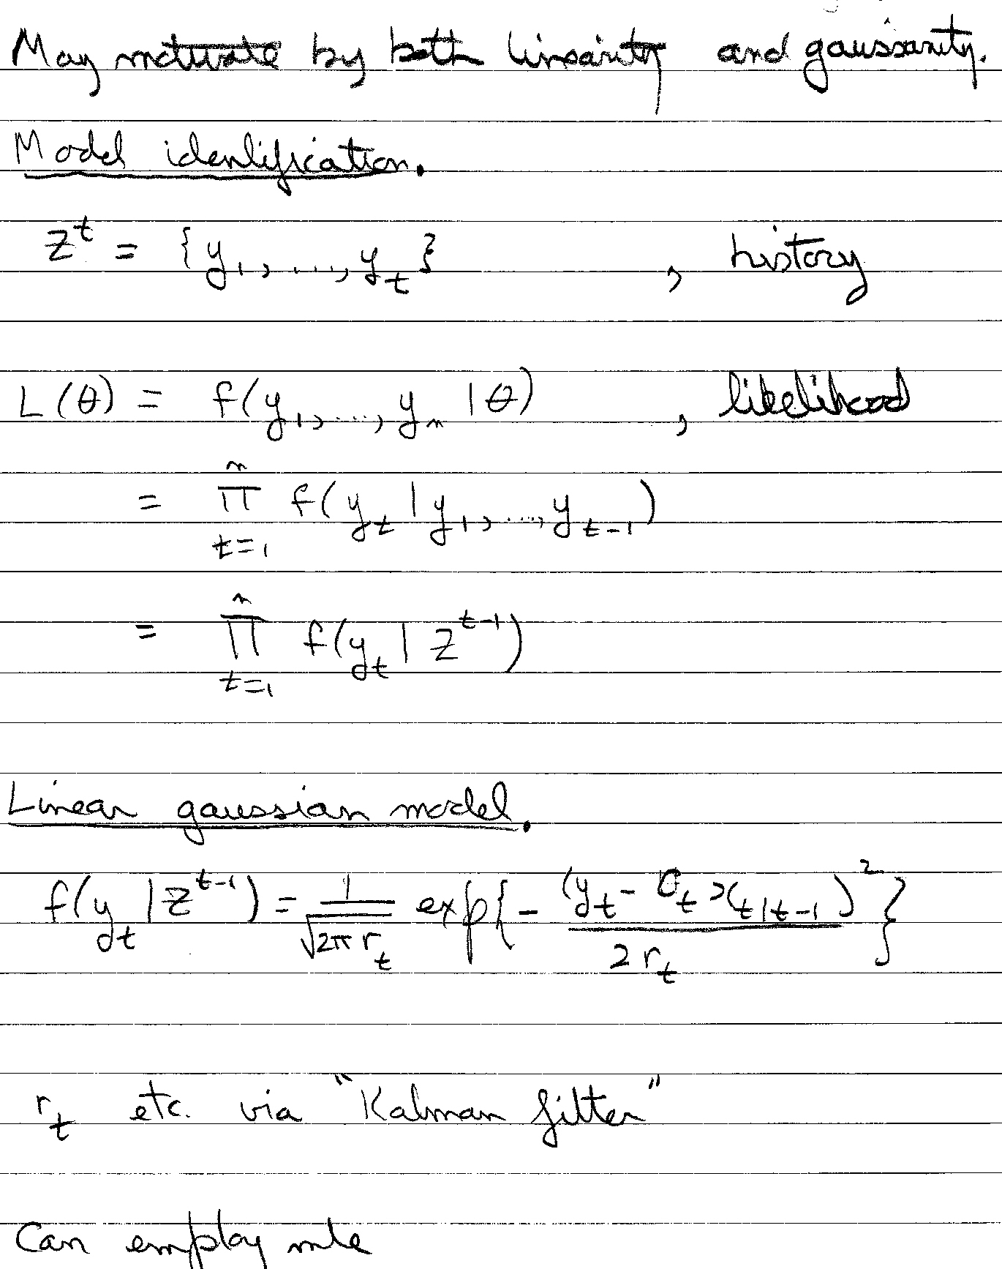

Slide 6
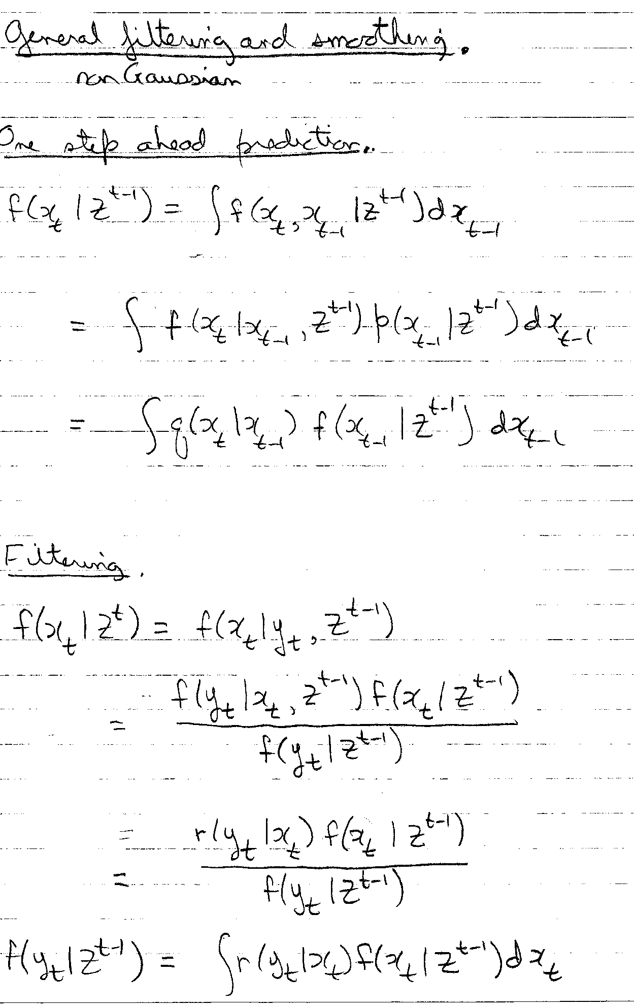

Slide 7
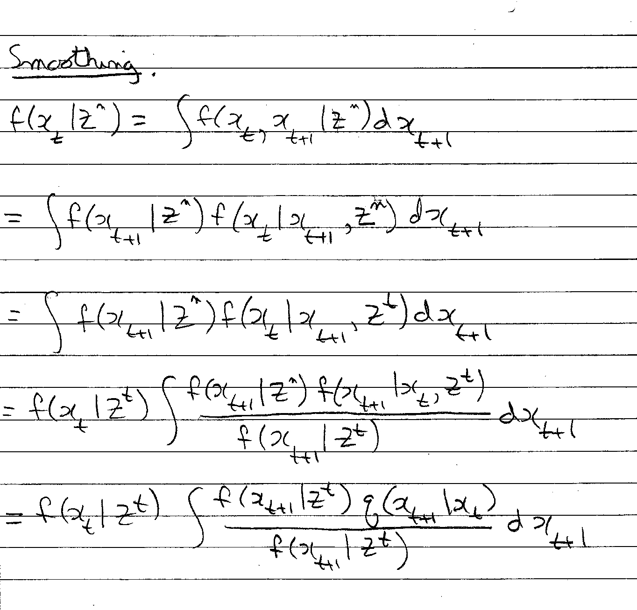

Slide 8
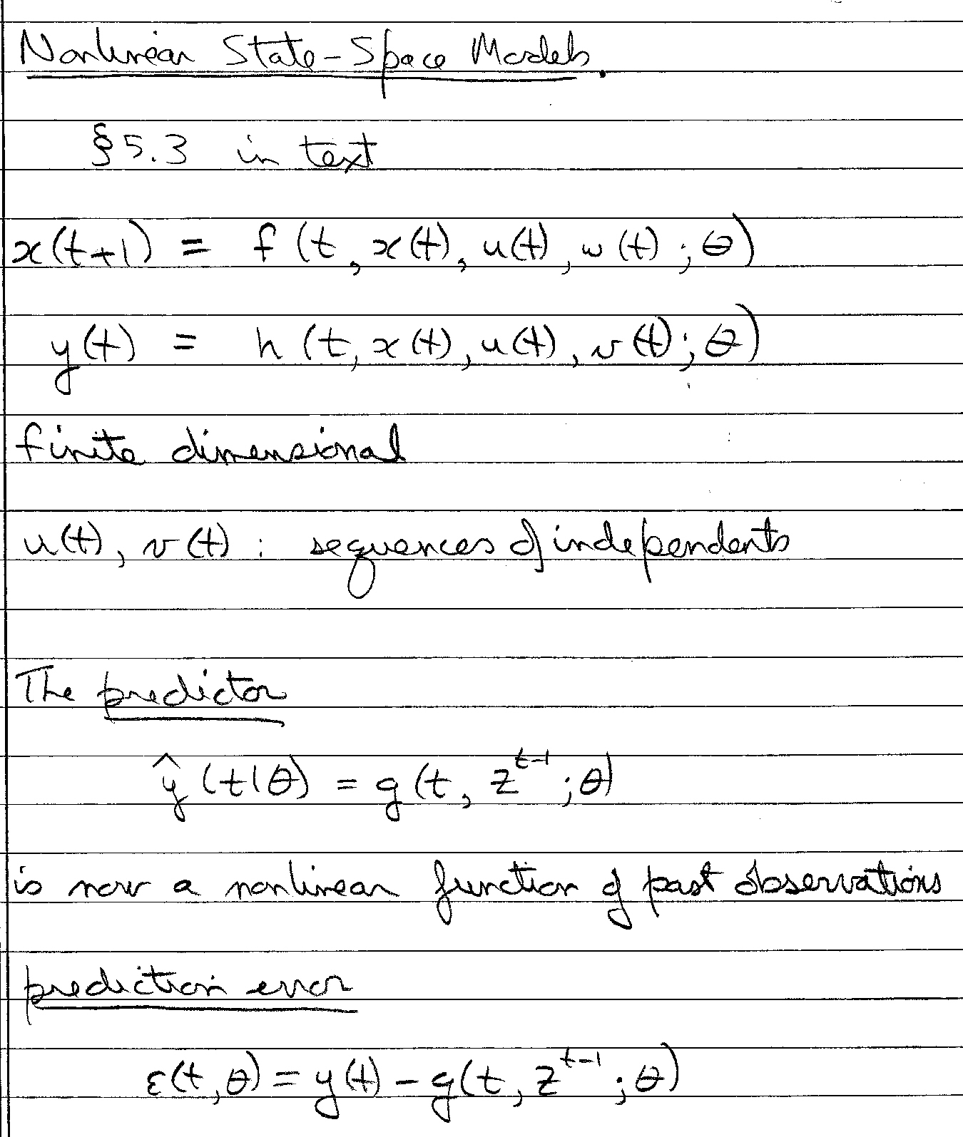

Slide 9
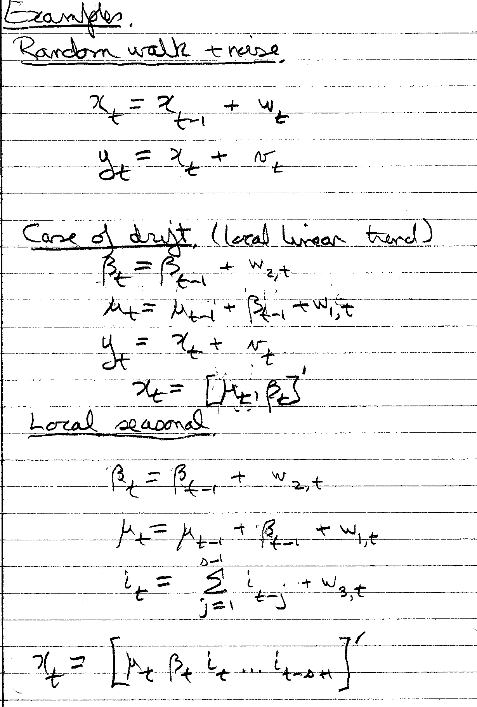

Slide 10
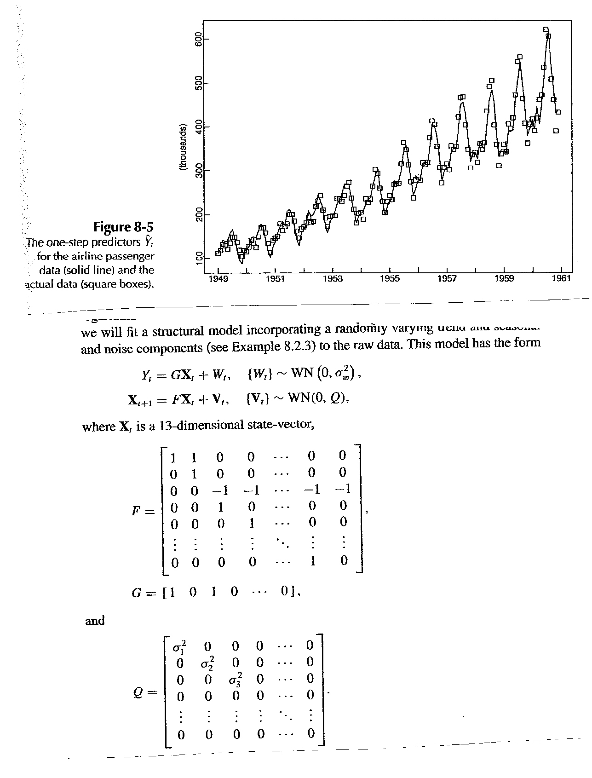

Slide 11
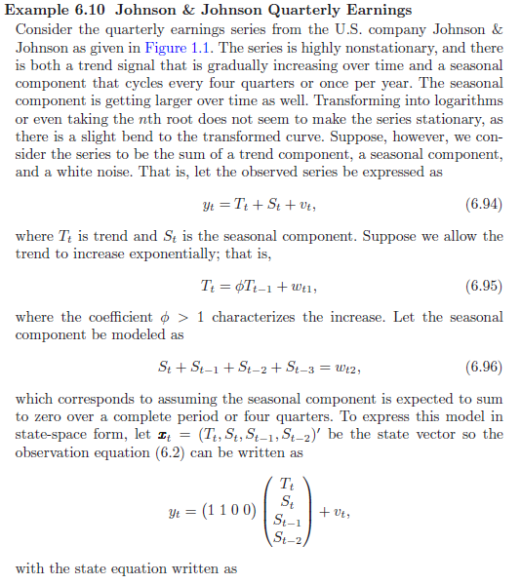

Slide 12
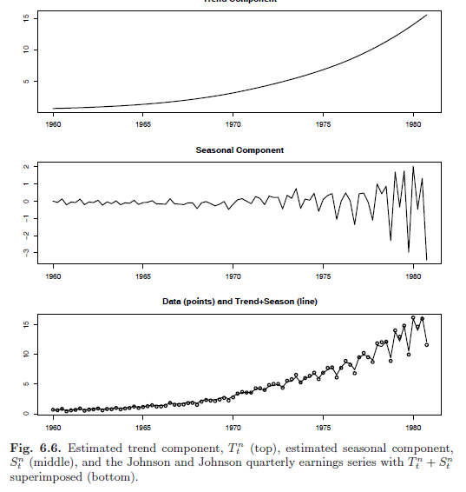

Slide 13
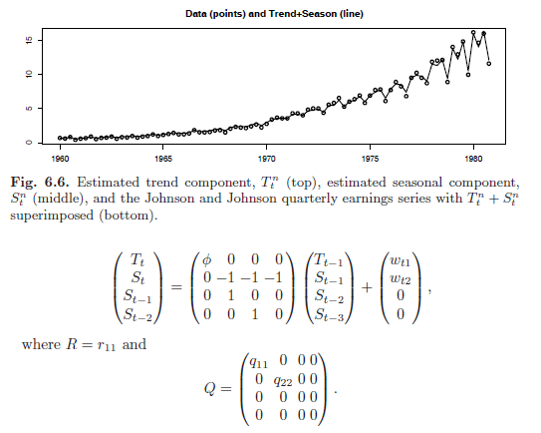

Slide 14
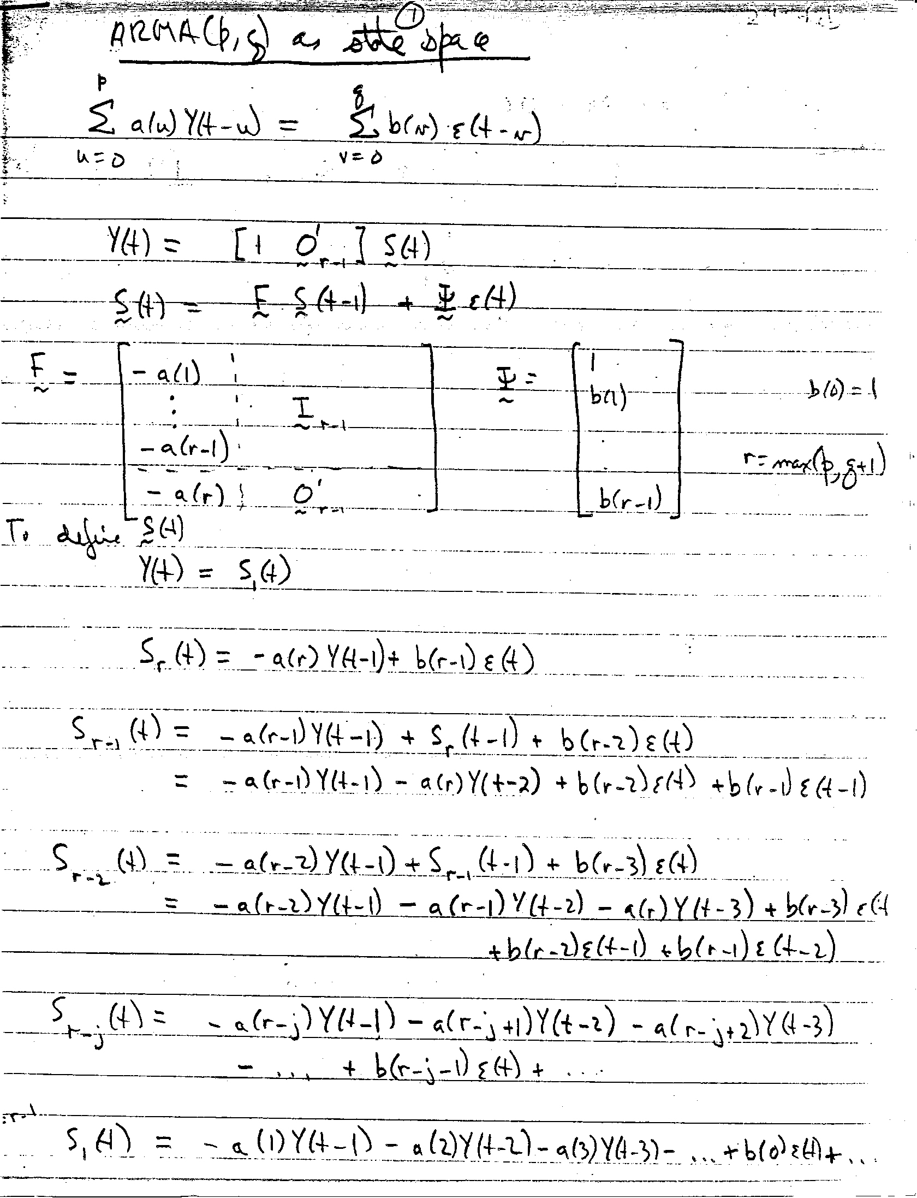

Slide 16
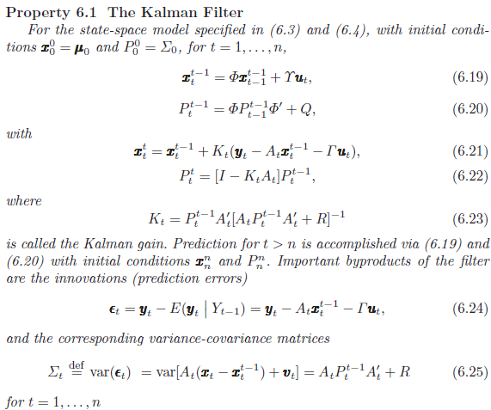

Slide 17
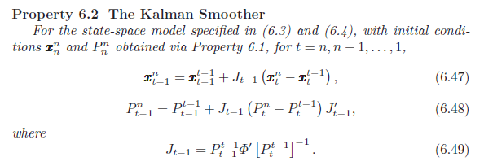

Slide 18
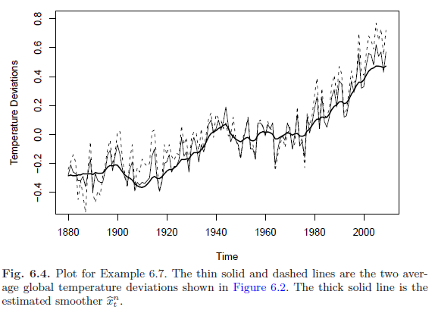

Slide 19
Details on Kalman Filter and Smoothing Code for Chapter 6
In astsa, there are three levels (0,1,2) of filtering and smoothing, Kfilter0/Ksmooth0, Kfilter1/Ksmooth1, Kfilter2/Ksmooth2.
For various models, each script provides the Kalman filter/smoother, the innovations and the corresponding variance-covariance matrices, and the value of the innovations likelihood at the location of the parameter values passed to the script. MLE is then accomplished by calling the script that runs the filter. The model is specified by passing the model parameters.
Level 0 is for the case of a fixed measurement matrix and no inputs; i.e., if A_{t} = A for all t, and there are no inputs, then use the code at level 0. If the measurement matrices are time varying or there are inputs, use the code at a higher level (1 or 2). Many of the examples in the text can be done at level 0. Level 1 allows for time varying measurement matrices and inputs, and level 2 adds the possibility of correlated noise processes. The models for each case are (x is state, y is observation, and t = 1, ..., n):
◊ Level 0: x_{t} = Φ x_{t-1} + w_{t}, y_{t} = A x_{t} + v_{t}, w_{t} ~ iid N_{p}(0, Q) ⊥ v_{t} ~ iid N_{q}(0, R) ⊥ x₀ ~ N_{p}(μ₀, Σ₀) ◊ Level 1: x_{t} = Φ x_{t-1} + Υ u_{t} + w_{t}, y_{t} = A_{t} x_{t} + Γ u_{t} + v_{t}, u_{t} are r-dimensional inputs, etc. ◊ Level 2: x_{t+1} = Φ x_{t} + Υ u_{t+1} + Θ w_{t}, y_{t} = A_{t} x_{t} + Γ u_{t} + v_{t}, cov(w_{s}, v_{t}) = S δ_{s}^{t}, Θ is p × m, and w_{t} is m-dimensional, etc.
www.stat.pitt.edu/stoffer/tsa3

Slide 20
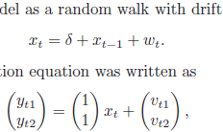
1 # Setup
2 y = cbind(gtemp,gtemp2); num = nrow(y); input = rep(1,num)
3 A = array(rep(1,2), dim=c(2,1,num))
4 mu0 = -.26; Sigma0 = .01; Phi = 1
5 # Function to Calculate Likelihood
6 Linn=function(para){
7 cQ = para[1] # sigma_w
8 cR1 = para[2] # 11 element of chol(R)
9 cR2 = para[3] # 22 element of chol(R)
10 cR12 = para[4] # 12 element of chol(R)
11 cR = matrix(c(cR1,0,cR12,cR2),2) # put the matrix together
12 drift = para[5]
13 kf = Kfilter1(num,y,A,mu0,Sigma0,Phi,drift,0,cQ,cR,input)
14 return(kf$like) }
15 # Estimation
16 init.par = c(.1,.1,.1,0,.05) # initial values of parameters
17 (est = optim(init.par, Linn, NULL, method="BFGS", hessian=TRUE,
control=list(trace=1,REPORT=1)))
18 SE = sqrt(diag(solve(est$hessian)))

Slide 21
19 # display estimates
20 u = cbind(estimate=est$par, SE)
21 rownames(u)=c("sigw","cR11", "cR22", "cR12", "drift"); u
estimate SE
sigw 0.032730315 0.007473594
cR11 0.084752492 0.007815219
cR22 0.070864957 0.005732578
cR12 0.122458872 0.014867006
drift 0.005852047 0.002919058
22 # Smooth (first set parameters to their final estimates)
23 cQ=est$par[1]
24 cR1=est$par[2]
25 cR2=est$par[3]
26 cR12=est$par[4]
27 cR = matrix(c(cR1,0,cR12,cR2), 2)
28 (R = t(cR)%*%cR) # to view the estimated R matrix
29 drift = est$par[5]
30 ks = Ksmooth1(num,y,A,mu0,Sigma0,Phi,drift,0,cQ,cR,input)
31 # Plot
32 xsmooth = ts(as.vector(ks$xs), start=1880)
33 plot(xsmooth, lwd=2, ylim=c(-.5,.8), ylab="Temperature Deviations")
34 lines(gtemp, col="blue", lty=1) # color helps here
35 lines(gtemp2, col="red", lty=2)

