Slide 1
5.4 GARCH models.

Slide 2
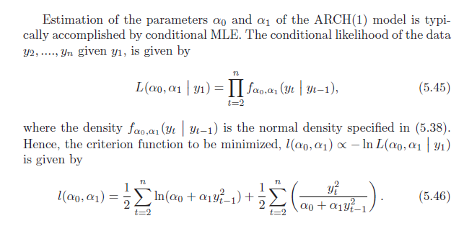

Slide 3
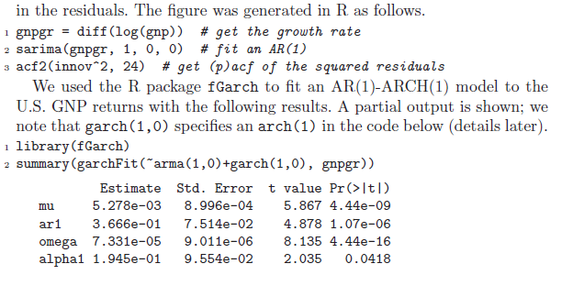

Slide 4
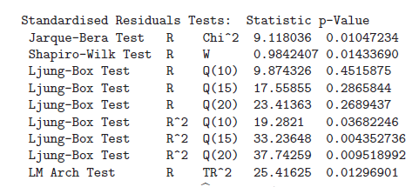

Slide 5
ARCH(m)
GARCH(m.r)

Slide 6
A martingale difference series,
E(y_{t} |Y_{t-1} } = 0
“Learning a potential function …”

Slide 7
Cov not 0 generally

Slide 8
postscript(file="arch.ps",paper="letter",hor=FALSE)
par(mfrow=c(2,1))
library(tseries)
set.seed(28112006)
a0<-1;a1<-.75
ylast<-1;Y<-ylast
Sig<-NULL
for(i in 1:250){
sig2<-a0+a1*ylast**2
y<-sqrt(sig2)*rnorm(1)
ylast<-y
Y<-c(Y,y)
Sig<-c(Sig,sqrt(sig2))
}
plot(Y,type="l",main="Data",xlab="time",ylab="",las=1)
plot(Sig,type="l",main="Sig",xlab="time",ylab="",las=1)
acf(Y,main="acf of data",xlab="lag",ylab="",las=1)
acf(Y**2,main="acf of data-squared",xlab="lag",ylab="",las=1)
graphics.off()

Slide 9
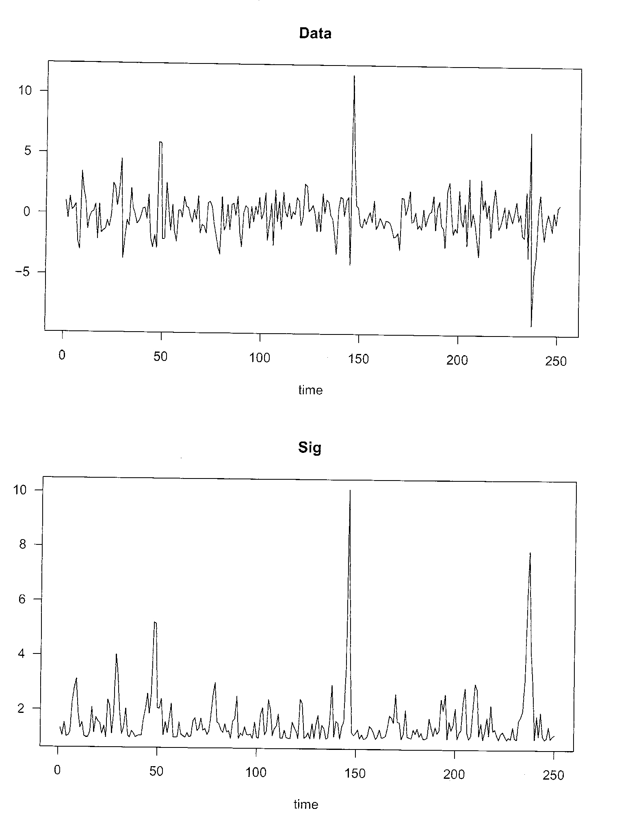

Slide 10
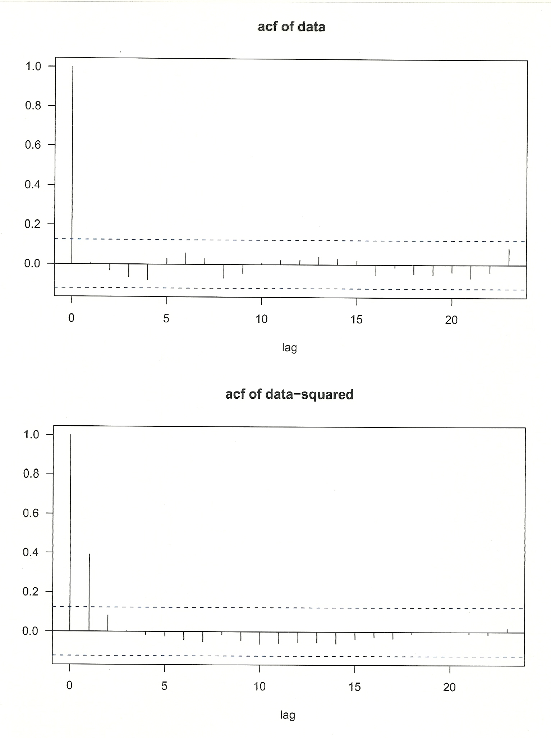

Slide 11
