Slide 1
6.4 GARCH models.

Slide 2
A martingale difference series
“Learning a potential function …”

Slide 3
Cov not 0 generally

Slide 4
postscript(file="arch.ps",paper="letter",hor=FALSE)
par(mfrow=c(2,1))
library(tseries)
set.seed(28112006)
a0<-1;a1<-.75
ylast<-1;Y<-ylast
Sig<-NULL
for(i in 1:250){
sig2<-a0+a1*ylast**2
y<-sqrt(sig2)*rnorm(1)
ylast<-y
Y<-c(Y,y)
Sig<-c(Sig,sqrt(sig2))
}
plot(Y,type="l",main="Data",xlab="time",ylab="",las=1)
plot(Sig,type="l",main="Sig",xlab="time",ylab="",las=1)
acf(Y,main="acf of data",xlab="lag",ylab="",las=1)
acf(Y**2,main="acf of data-squared",xlab="lag",ylab="",las=1)
graphics.off()

Slide 5
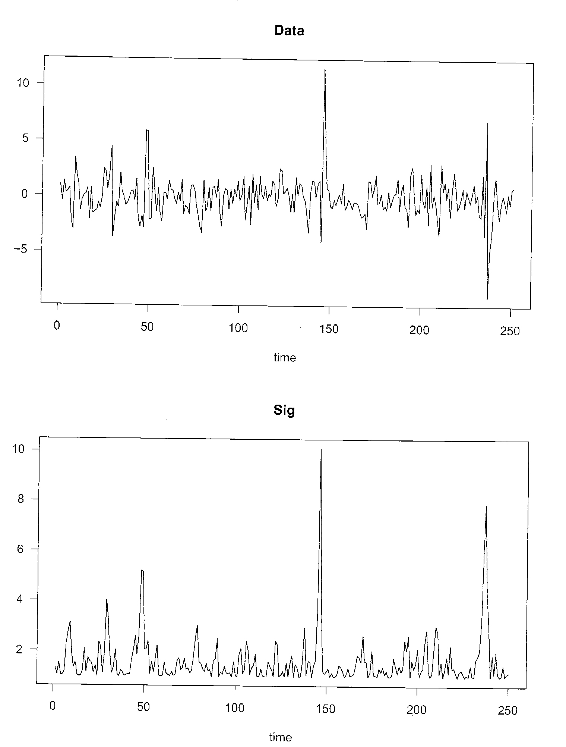

Slide 6
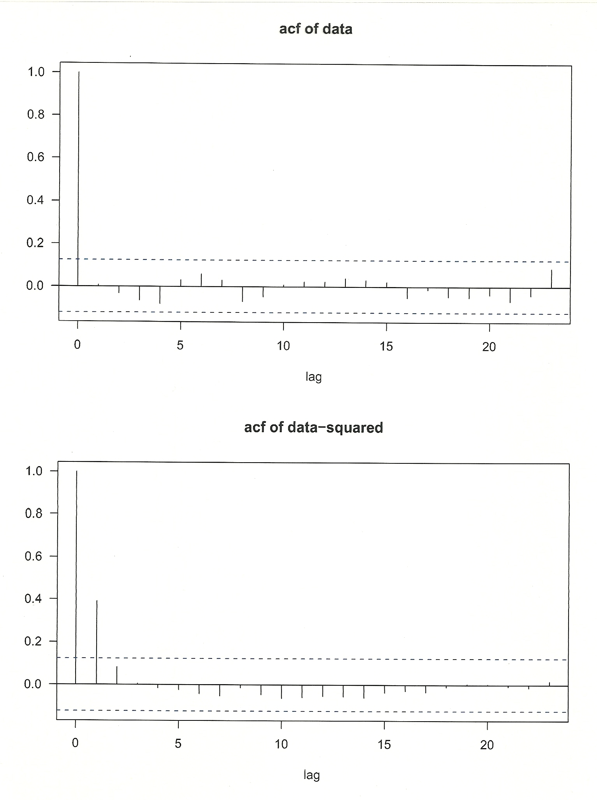

Slide 7
