Slide 1
cov(X,Y) != 0 does not imply X independent of Y
Example.
X ~ N(0,1) Y = X²
Cov(X,Y) = E(XY) – E(X) E(Y0
There is a time series variant

Slide 3
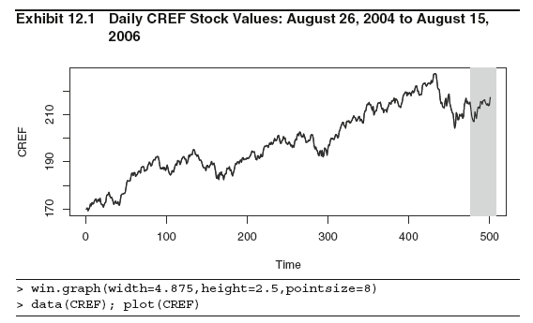

Slide 4
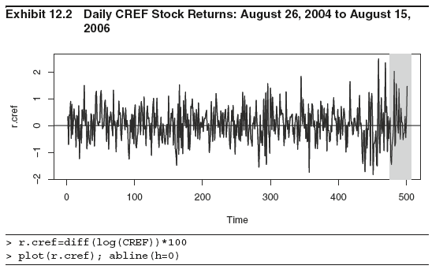
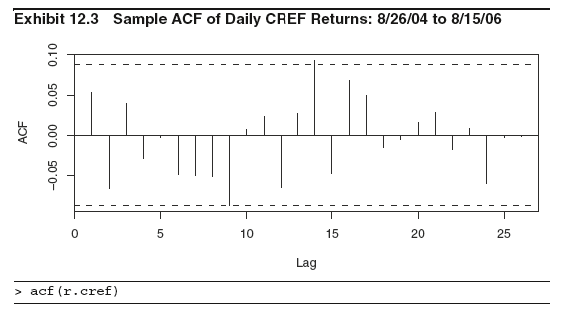

Slide 5
