Slide 1
Victor’s talk
http://smat.epfl.ch/victor/
Panaretos, V.M. & Tavakoli, S. (2012). Cramér-Karhunen-Loève Representation and Harmonic Principal Component Analysis of Functional Time Series. Technical Report #03-12, November 2012, Chair of Mathematical Statistics, EPFL. (Invited contribution to a special issue of Stochastic Processes and their Applications -- Under review).

Slide 3
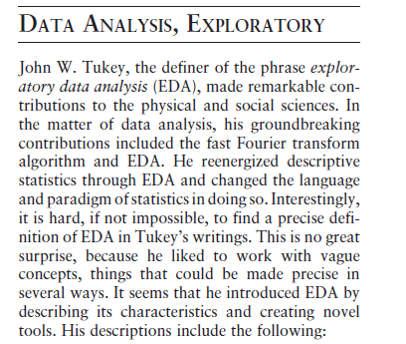

Slide 4
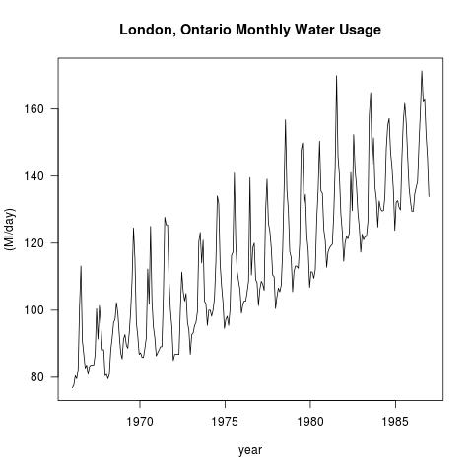
α + β t + γ cos 2 π t / 12 + δ sin 2 π t /12

Slide 5
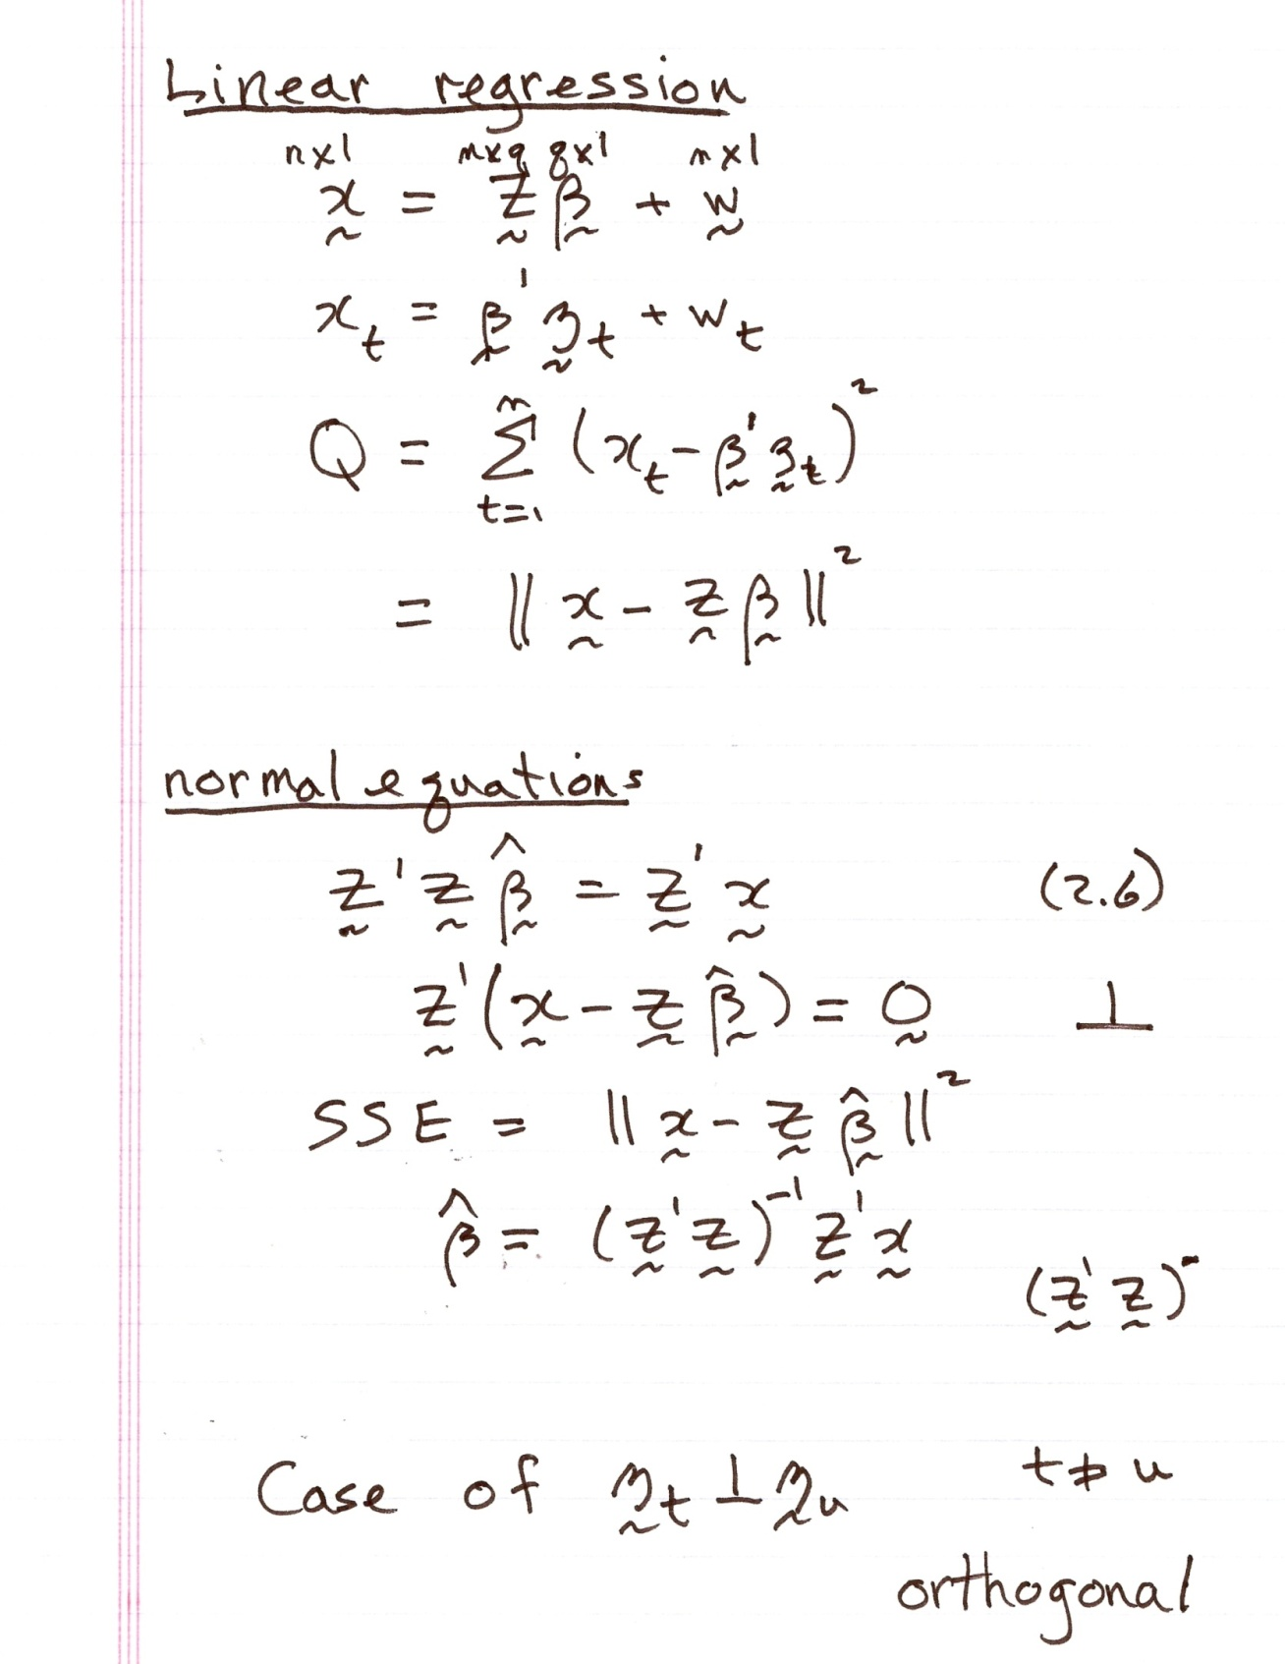

Slide 6
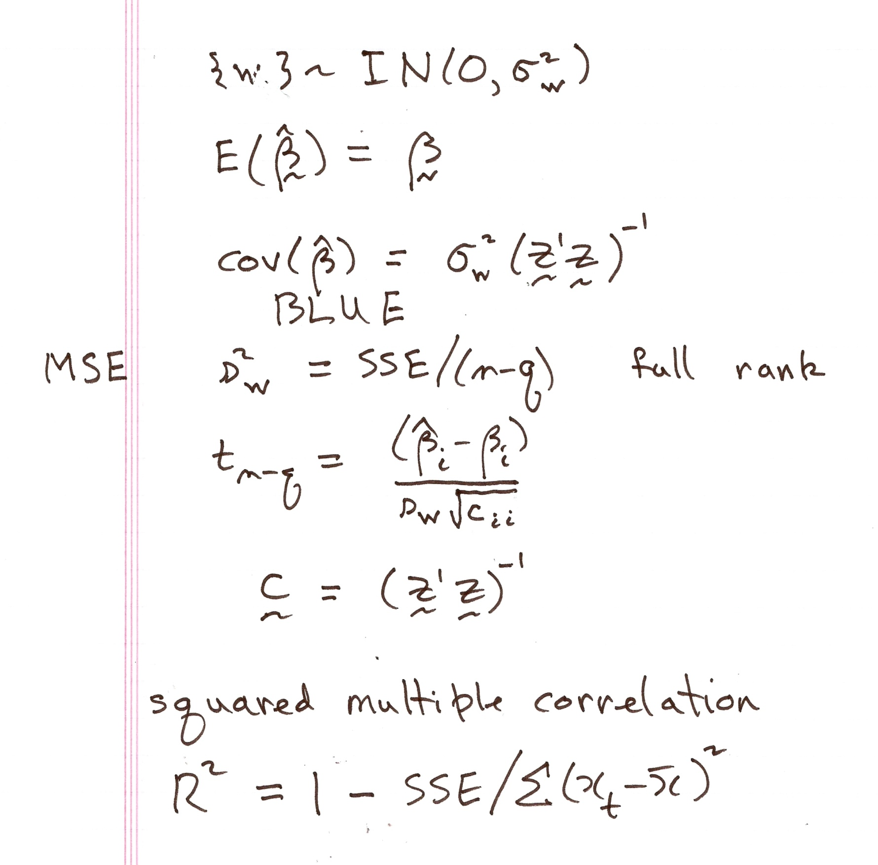

Slide 7
ANOVA table

Slide 9
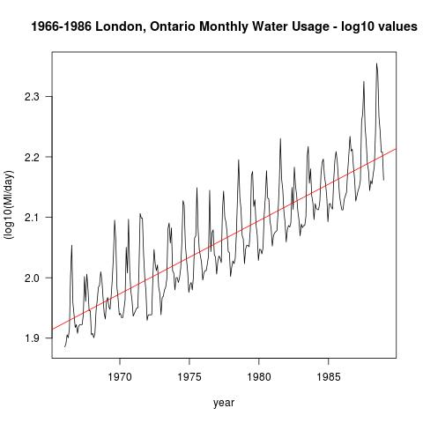
anova(junk1) (Intercept) xaxis
Analysis of Variance Table 21.84923 0.01209
Response: log10(junk)
Df Sum Sq Mean Sq F value Pr(>F)
xaxis 1 1.77919 1.77919 811.16 < 2.2e-16 ***
Residuals 274 0.60099 0.00219

Slide 10
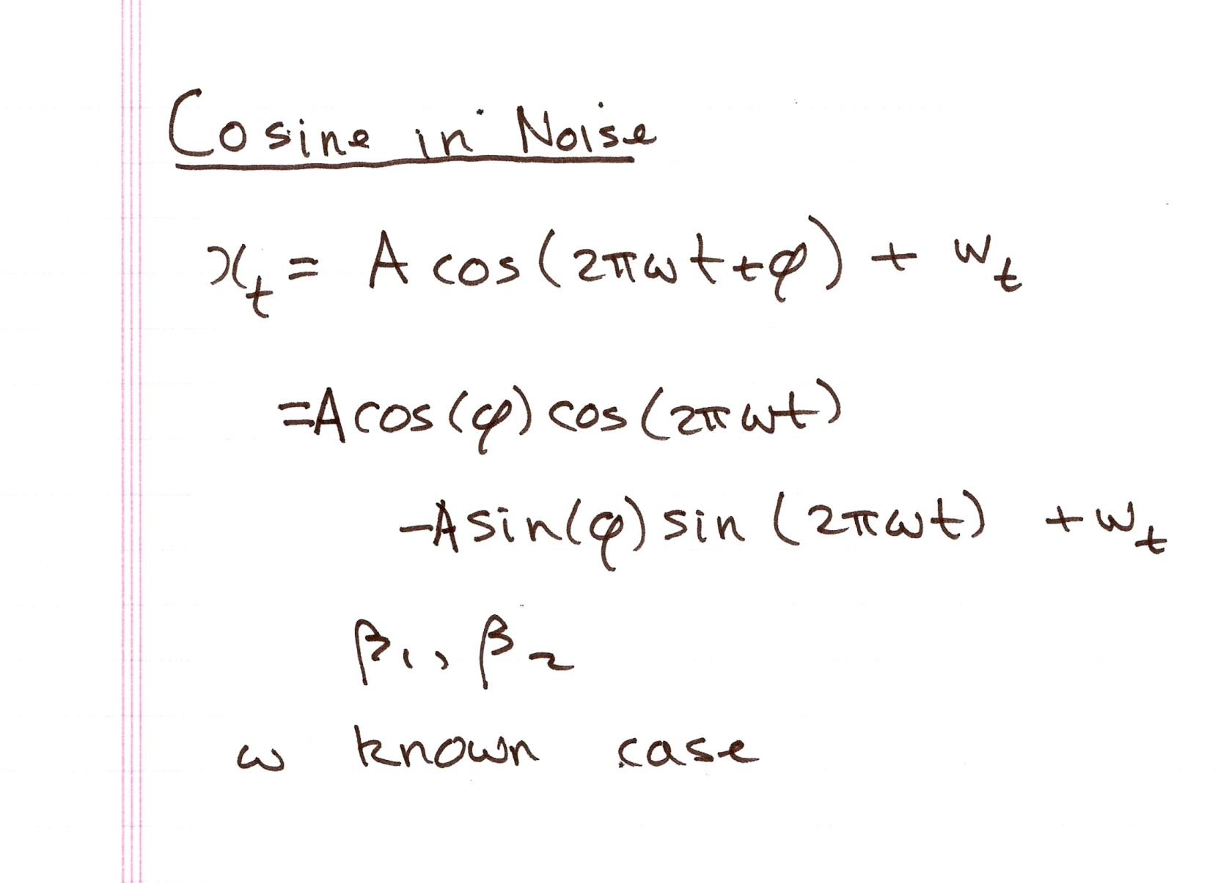

Slide 11
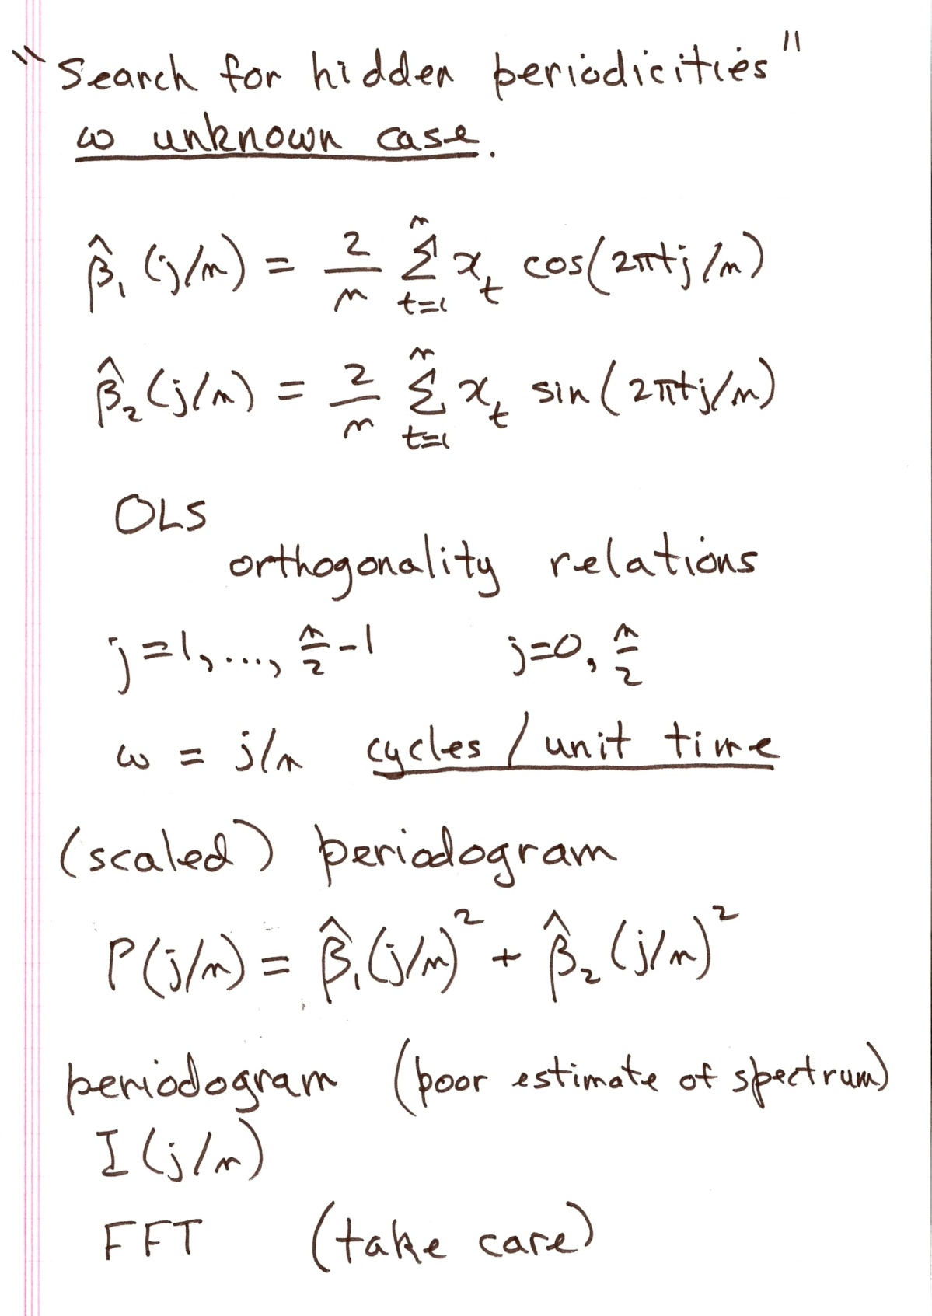

Slide 12
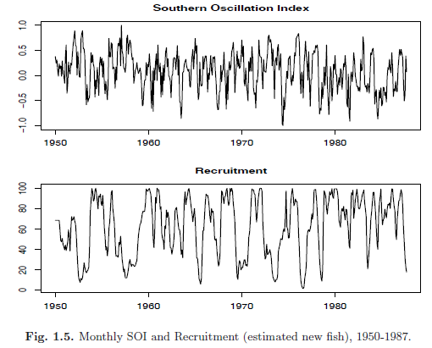

Slide 13
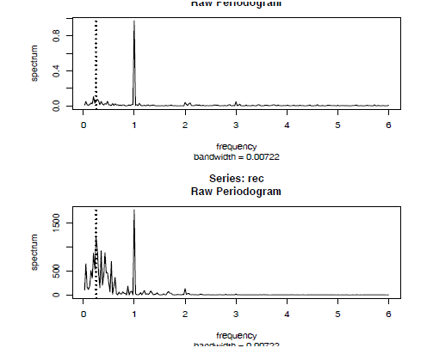

Slide 14
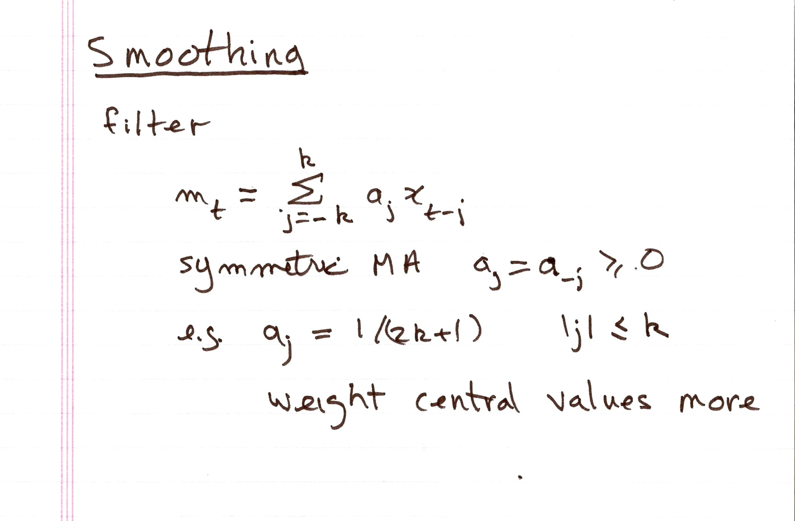

Slide 15
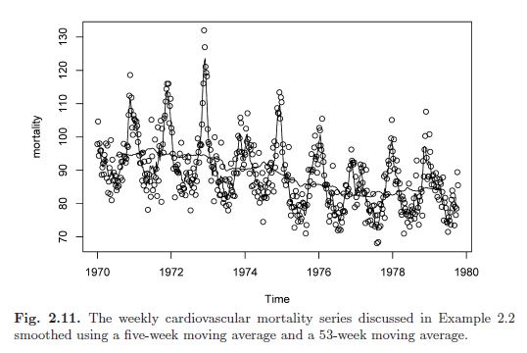

Slide 16
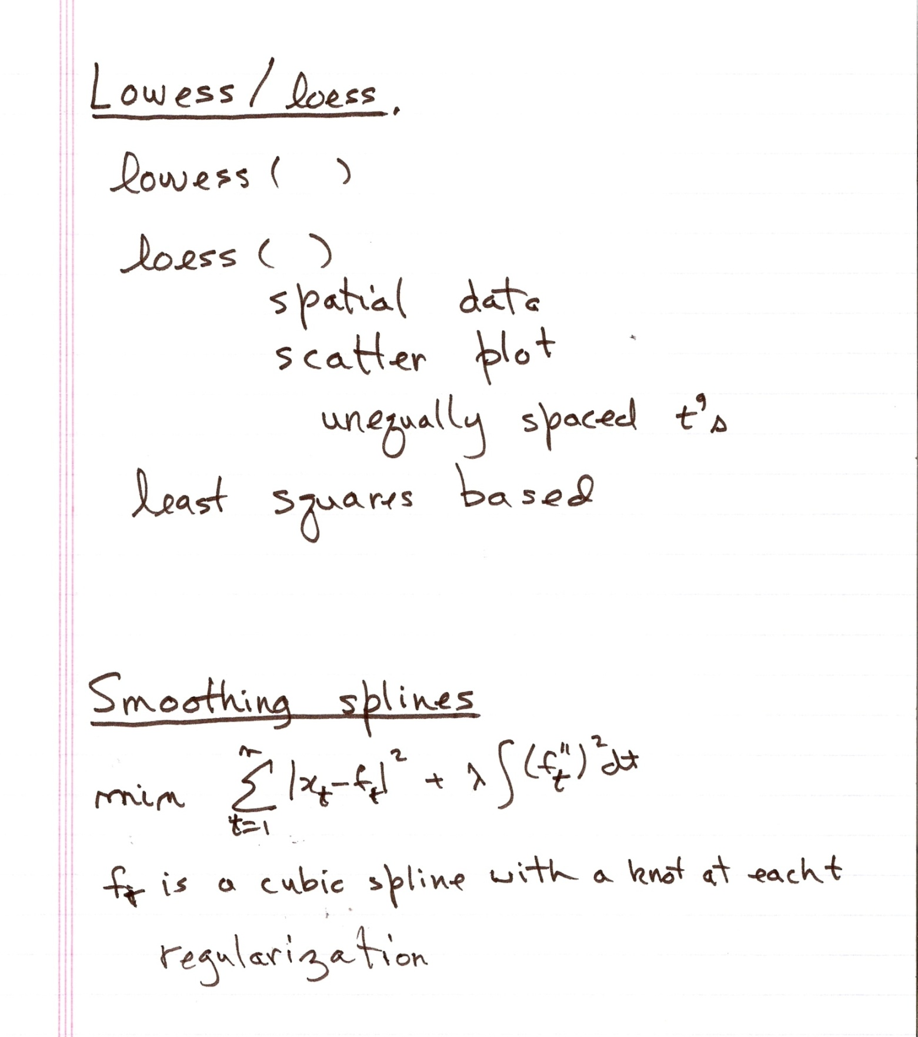

Slide 17
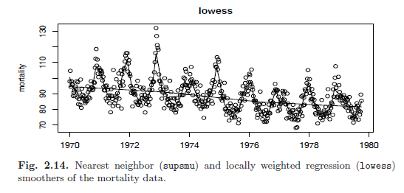

Slide 18
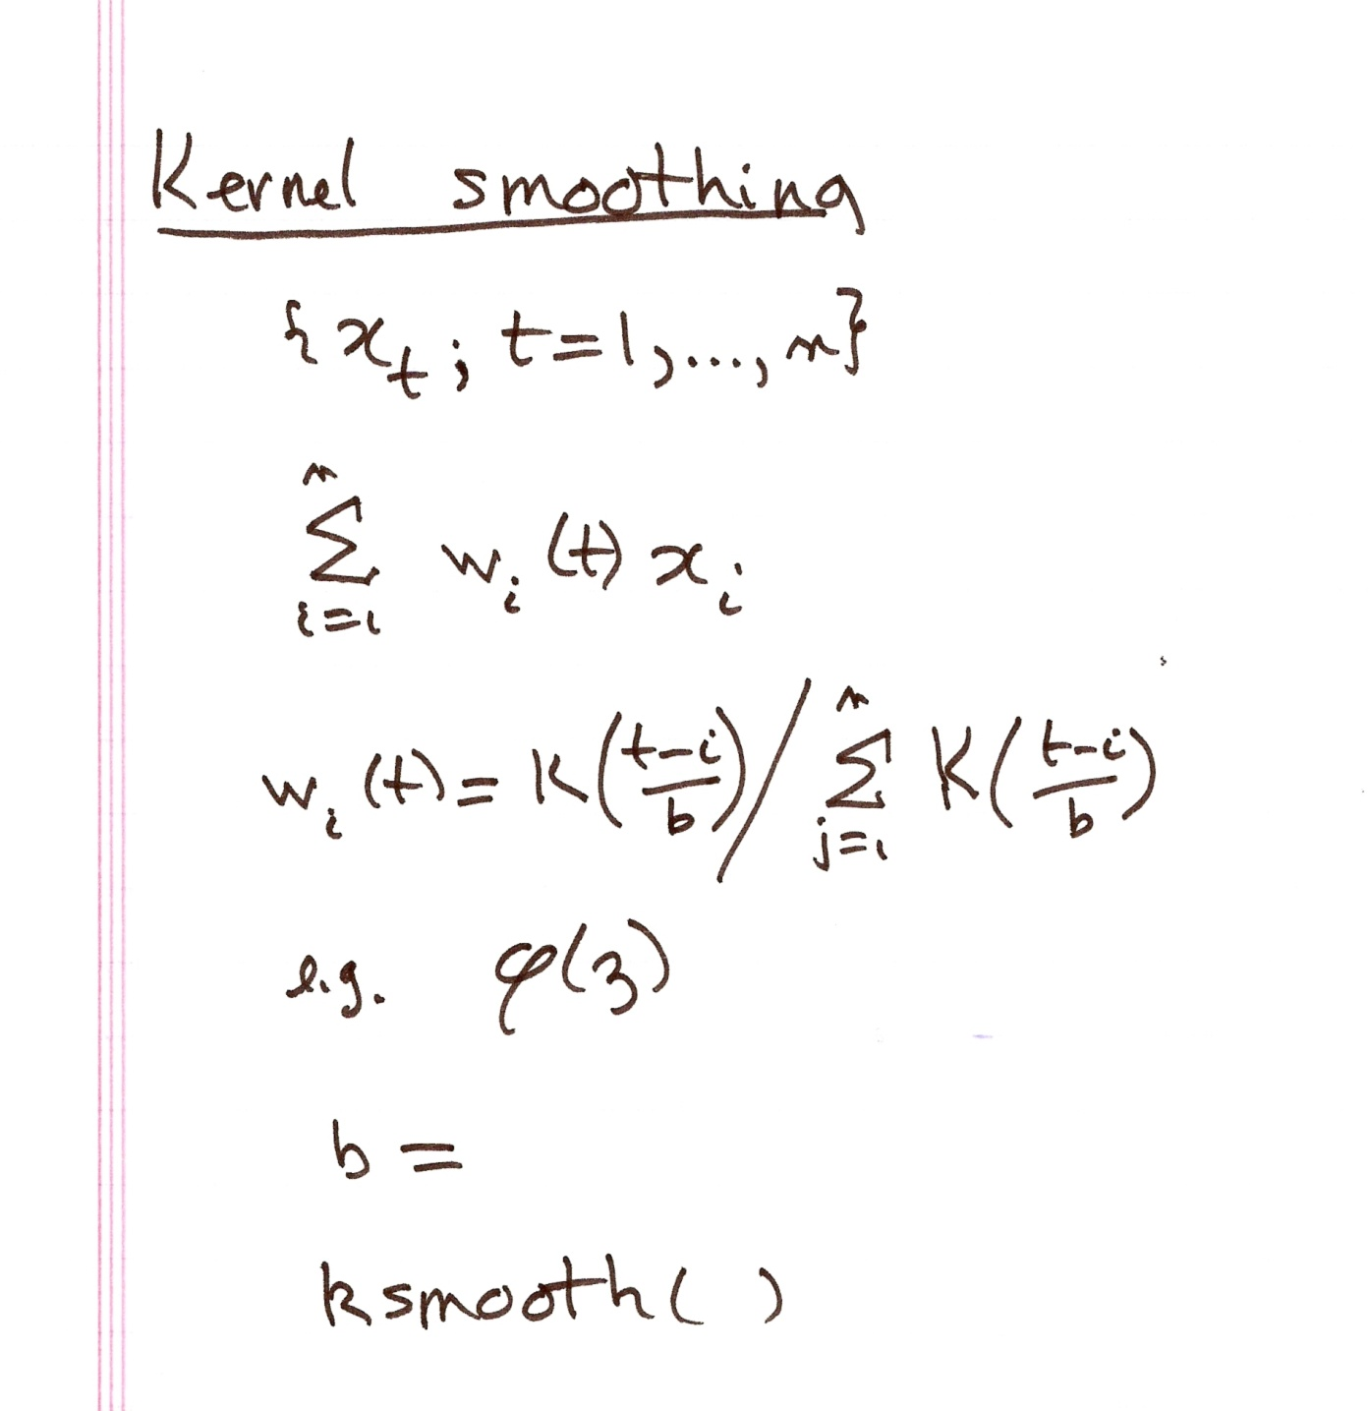

Slide 19
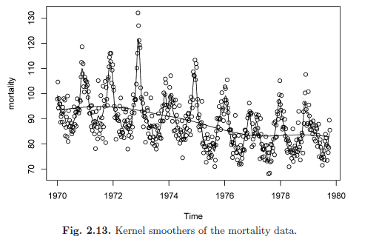

Slide 20
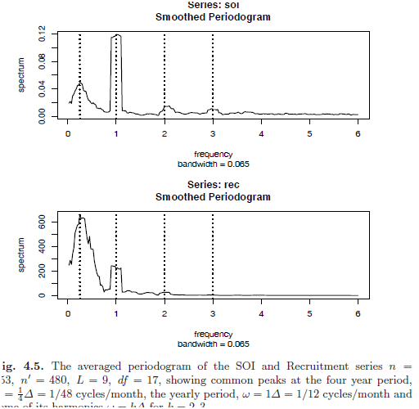

Slide 21
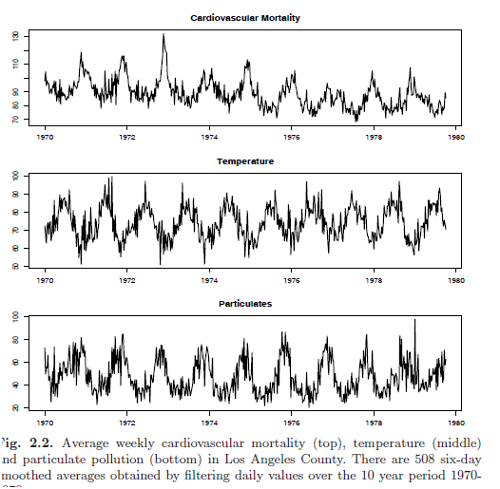

Slide 22
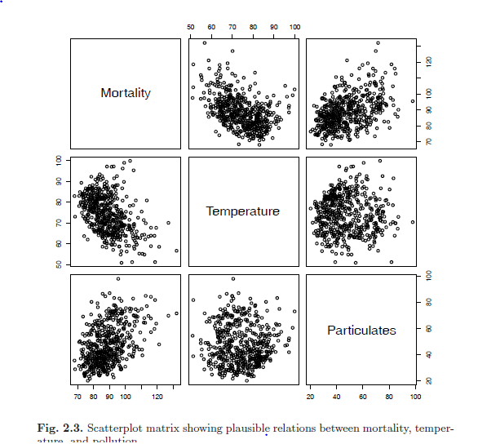

Slide 23
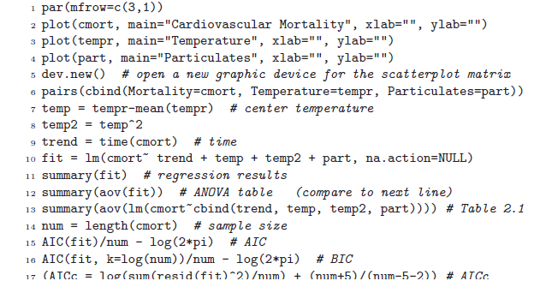

Slide 24
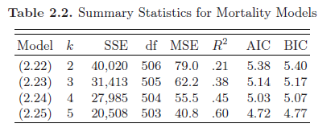
Classical regression
Response: cardiovascular mortality
Explanatories: temperature, particulates

Slide 25
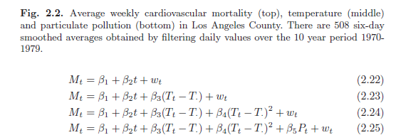

Slide 26
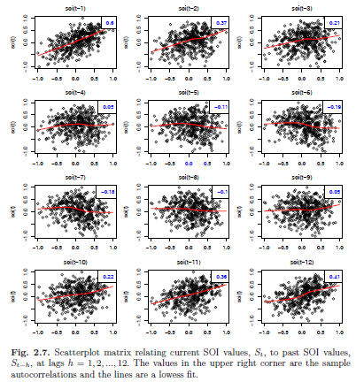
Lag.plot S_t = β_1 + β_2 S{t-l} + w_t

Slide 27
Detrending plus algebra
Difference operator
∇x_t = x_t – x_{t-1}
Backshift operator
Bx_t = x_{t-1}
∇x_t = (1 – B)x_t
B^k x_t = x_{t-k}
∇^3 = (1-B)^3 = 1 – 3B +3B^2 – B^3

Slide 28
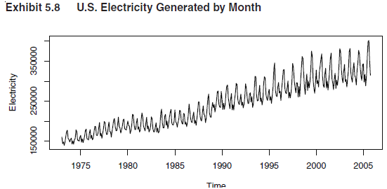
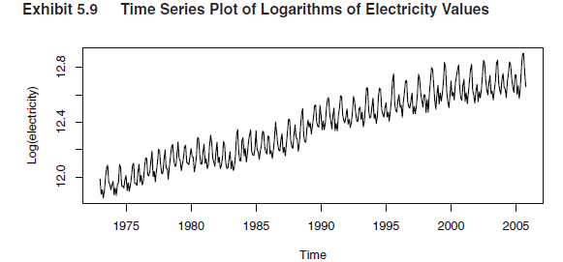

Slide 29
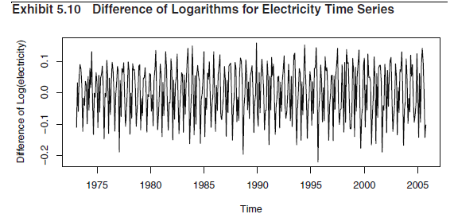
“return” = (x_t – x_{t-1])/x_{t-1}
∇ log x_t = log(x_t/x_{t-1}) ≅ return

Slide 30
Appendix B

Slide 32
